Slide 1
Chain Wear Precision Matrix Operational Data Plots
Kevin O’Malley
The Lubrizol Corporation
September 16, 2016

Slide 2
Overview
Four plots are shown for each operational parameter (one for each phase: PH1, PH2, PH1-2 and PH2-1)
To help identify whether erroneous data exist, additional plots are shown where “odd” data appear
This does not imply that these are the only occurrences of “odd” data
During a task force call on 9-15-16 the group decided that each lab would review these plots to identify which, if any, of these “odd” data are erroneous and should be removed from data files.

Slide 3
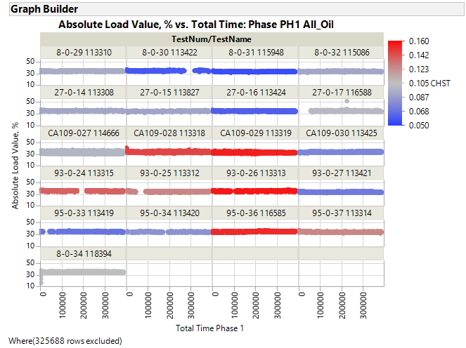
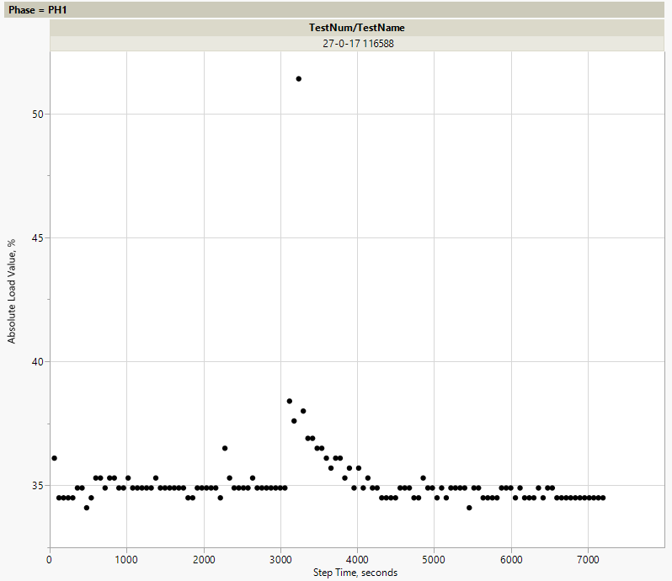
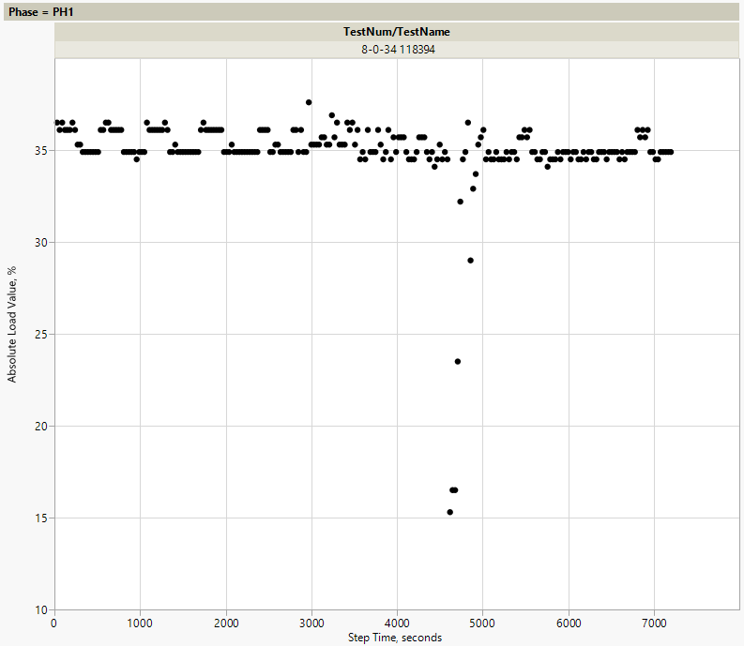
Cycle 32
Remove?
If yes, please resize box to indicate which data
Cycle 1
Remove?
If yes, please resize box to indicate which data

Slide 4
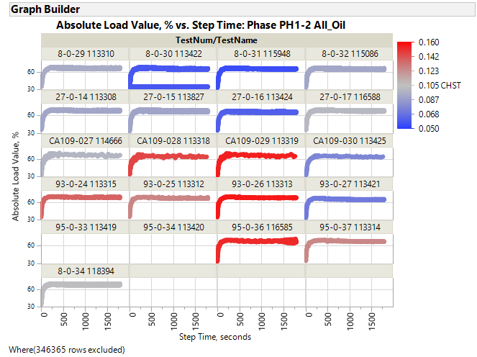
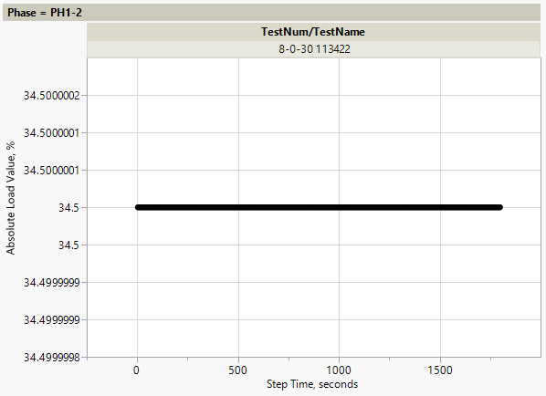
Cycle 39
Remove?

Slide 5
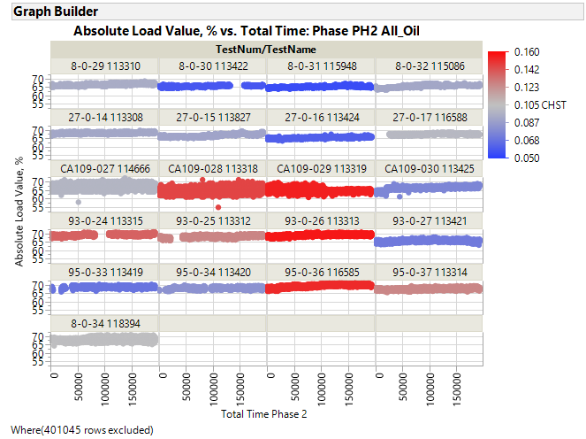

Slide 6
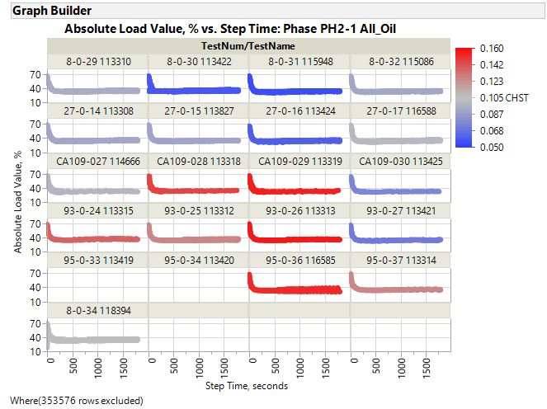
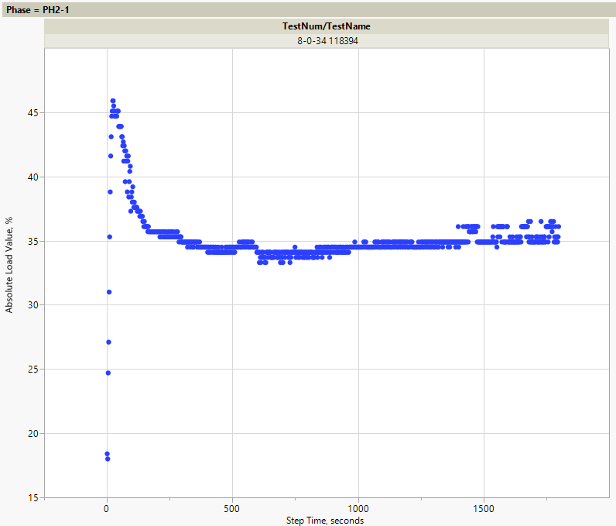
Cycle 1
Remove?
If yes, please resize box to indicate which data

Slide 7
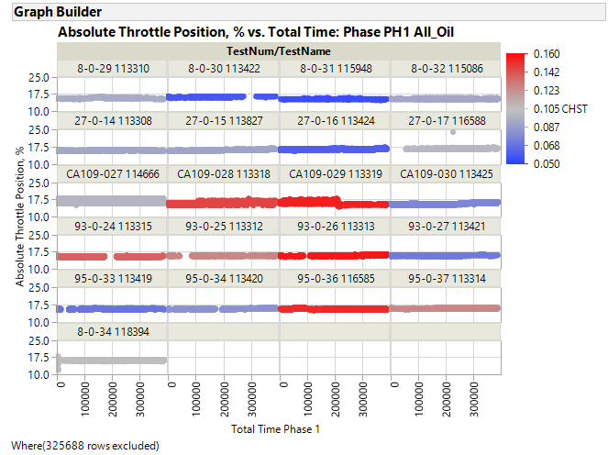
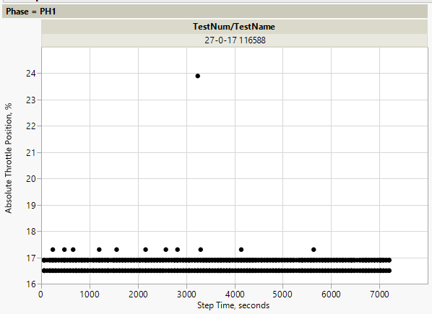
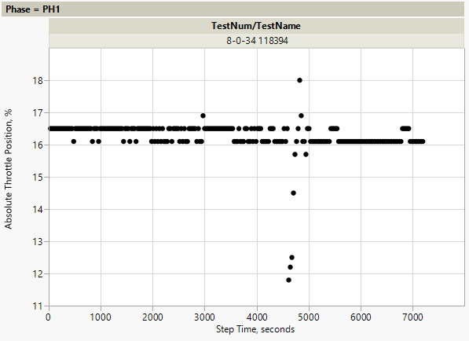
Cycle 32
Remove?
Cycle 1
Remove?
If yes, please resize box to indicate which data

Slide 8
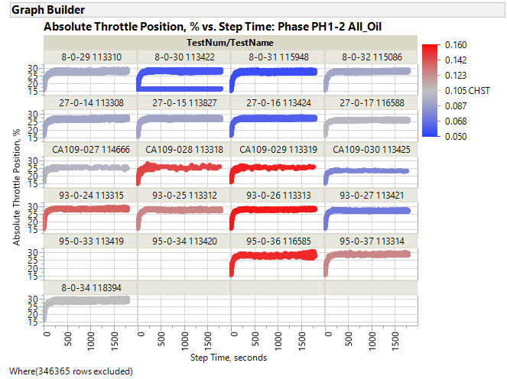
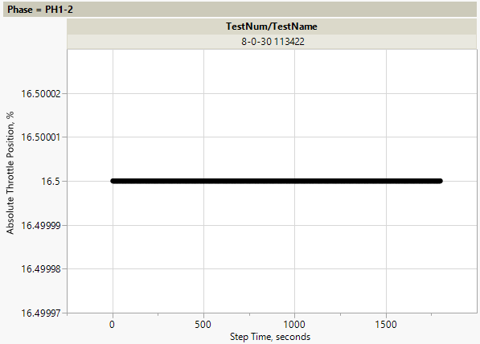
Cycle 39
Remove?

Slide 9
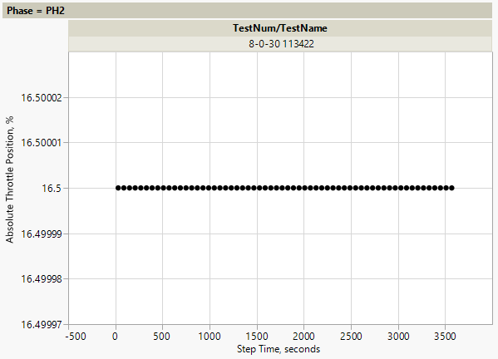
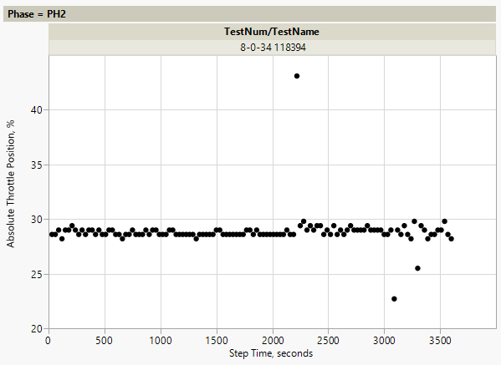
Cycle 38
Remove?
Cycle 2
Remove?

Slide 10
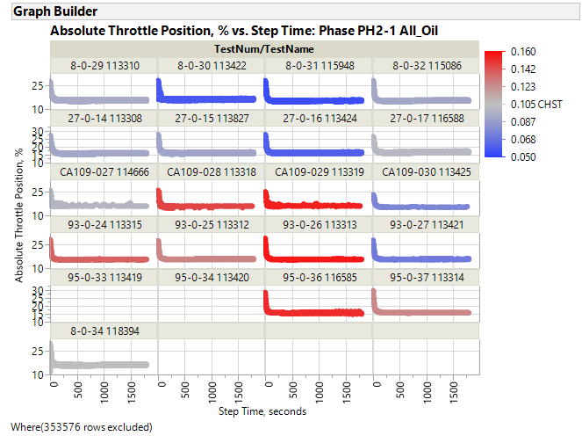
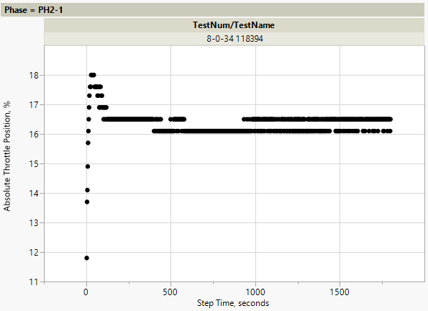
Cycle 1
Remove?
If yes, please resize box to indicate which data

Slide 11
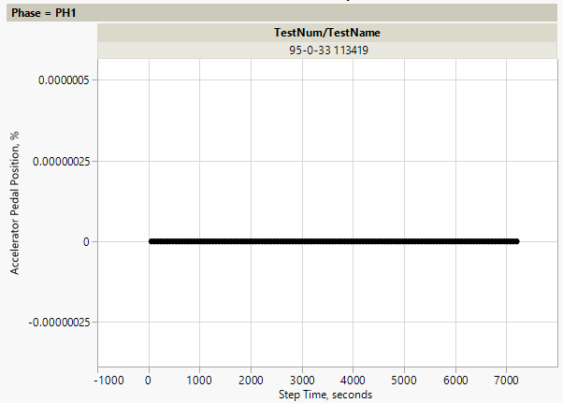
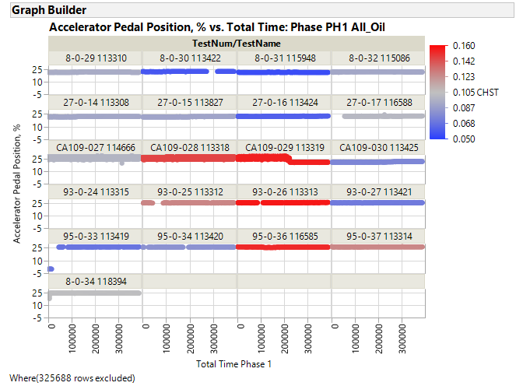
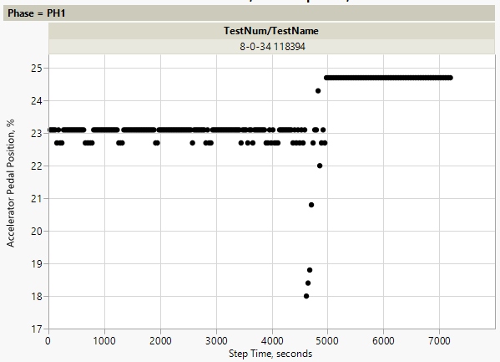
Cycle 1
We agreed to remove these if they are zero. They are all zero and will be deleted from analysis data file.
Cycle 1
Remove?
If yes, please resize box to indicate which data

Slide 12
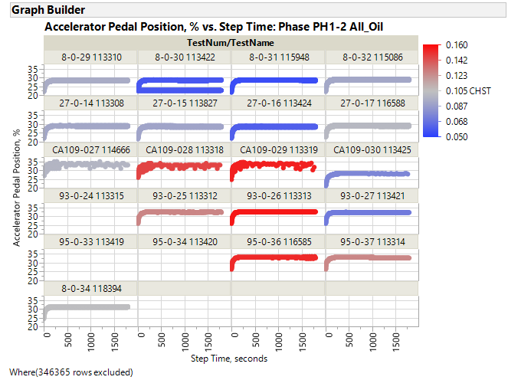
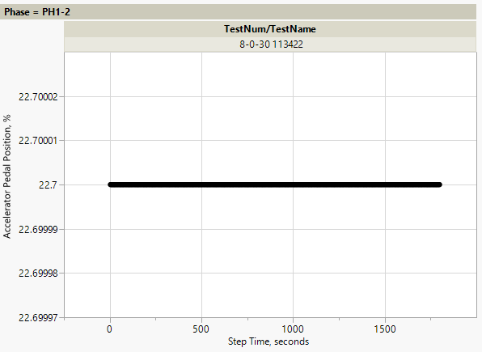
Cycle 39
Remove?

Slide 13
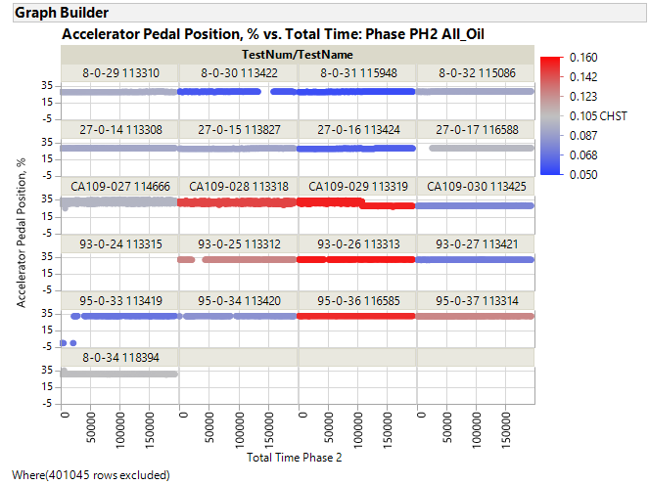
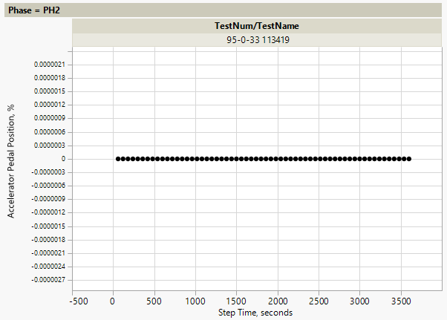
Cycle 1
We agreed to remove these if they are zero. They are all zero and will be deleted from analysis data file.

Slide 14
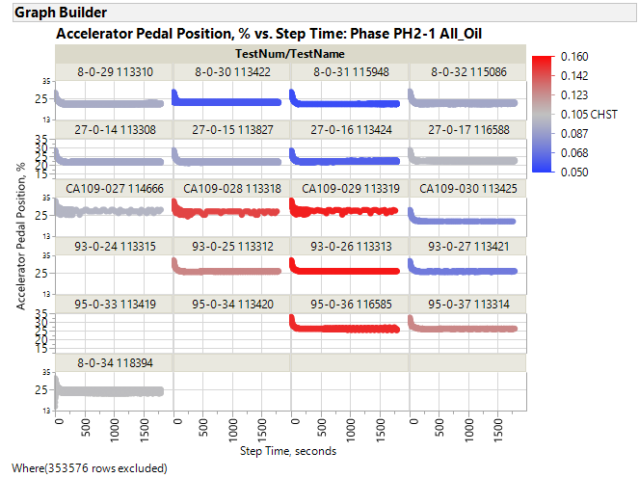
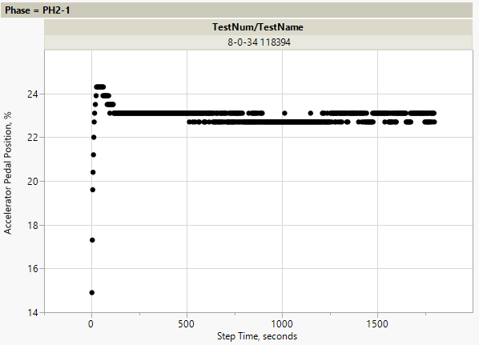
Cycle 1
Remove?
If yes, please resize box to indicate which data

Slide 15
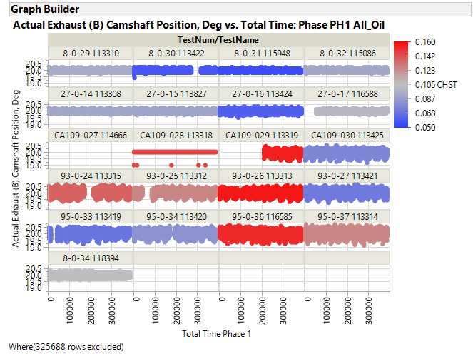

Slide 16
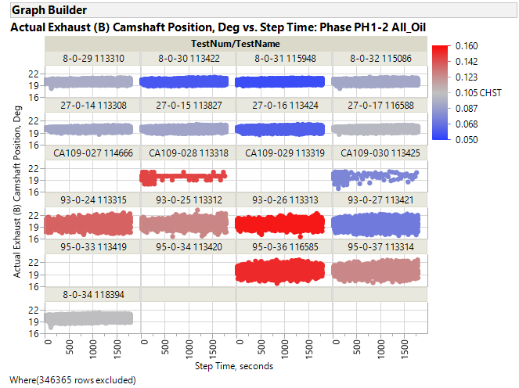

Slide 17
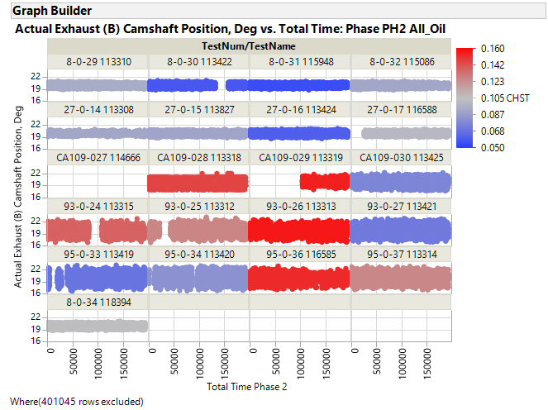

Slide 18
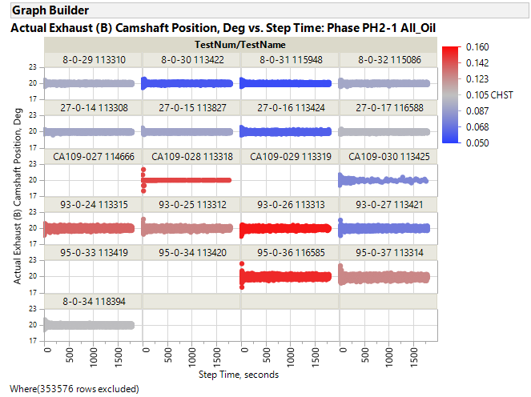

Slide 19
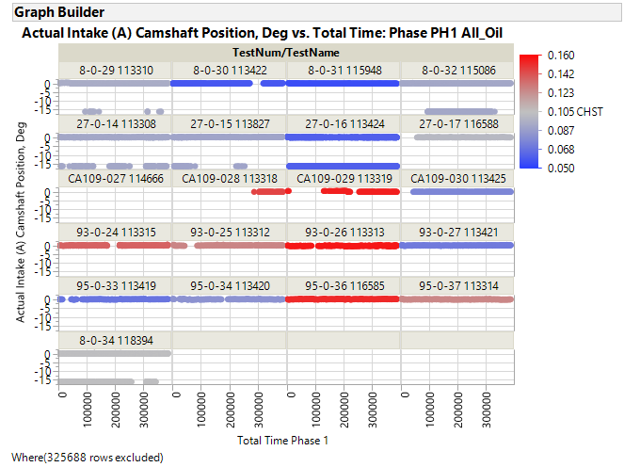
TF agreed to remove. These data will be removed from analysis data file

Slide 20
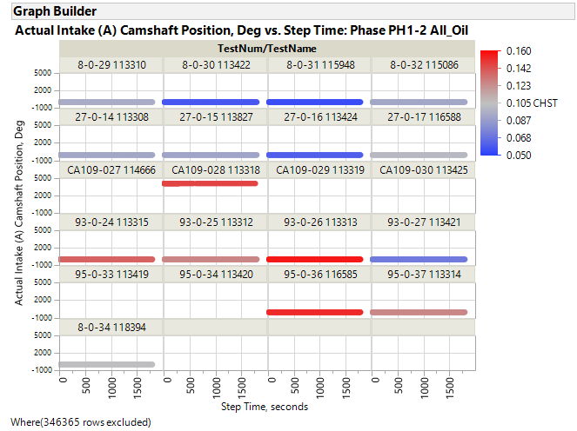
TF agreed to remove. These data will be removed from analysis data file

Slide 21
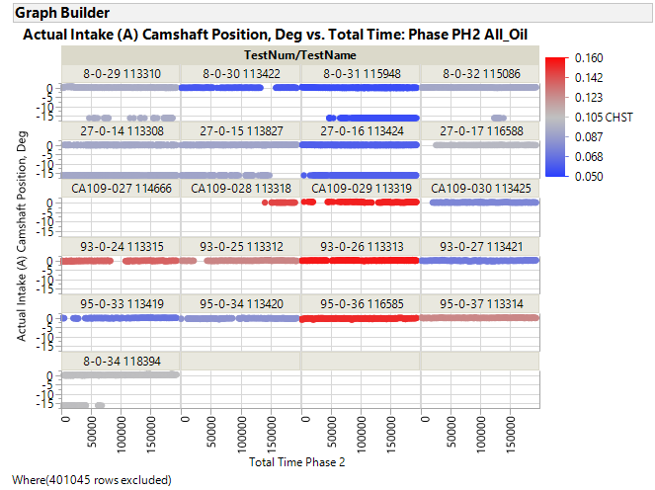
TF agreed to remove. These data will be removed from analysis data file

Slide 22
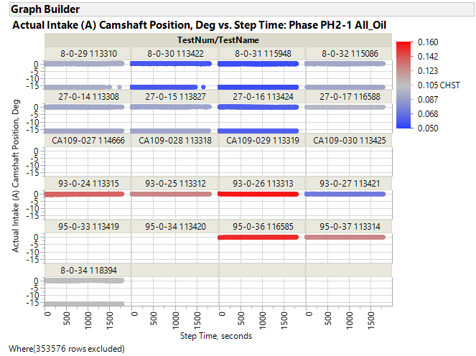
TF agreed to remove. These data will be removed from analysis data file

Slide 23
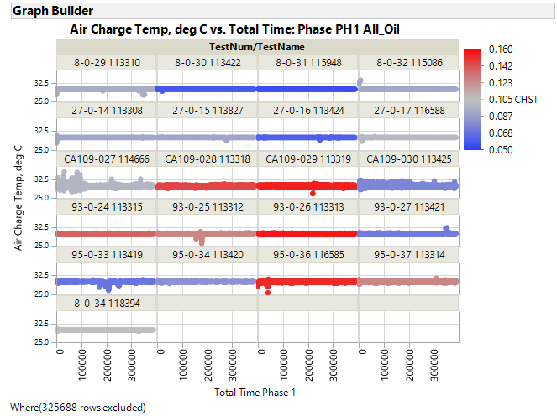

Slide 24
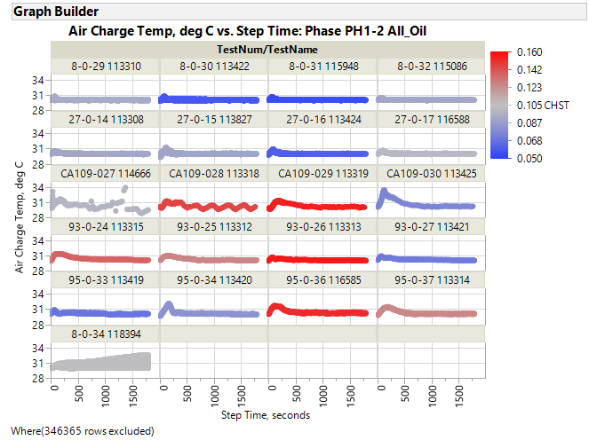

Slide 25
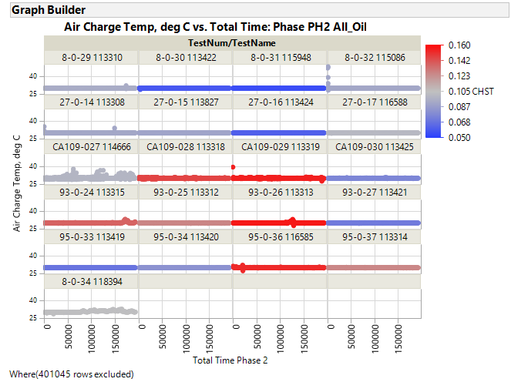

Slide 26
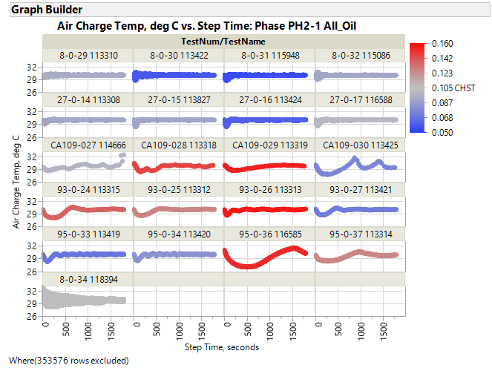

Slide 27
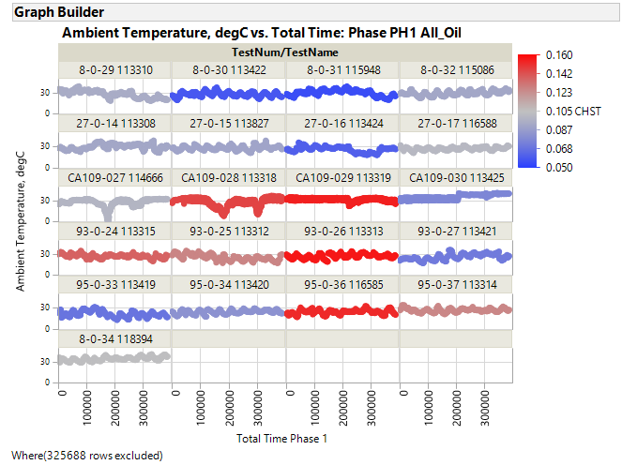
TF agreed to remove. These data will be removed from analysis data file

Slide 28
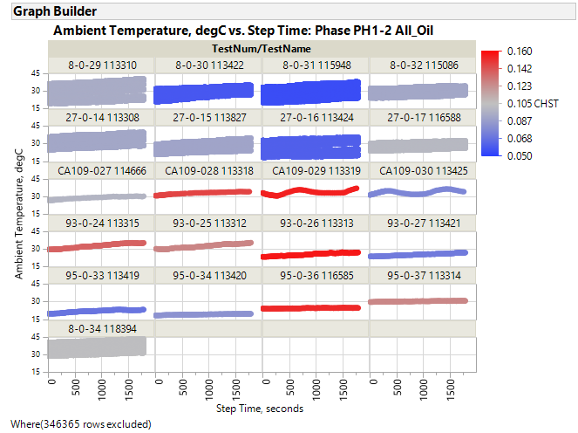
TF agreed to remove. These data will be removed from analysis data file

Slide 29
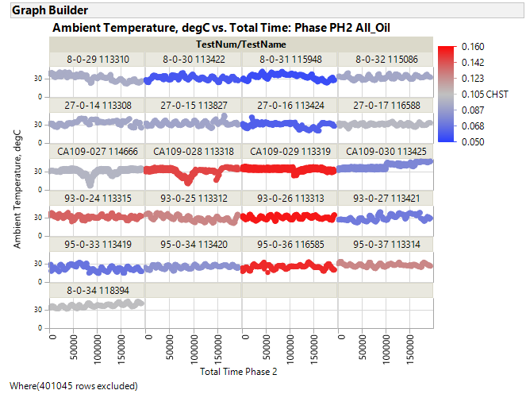
TF agreed to remove. These data will be removed from analysis data file

Slide 30
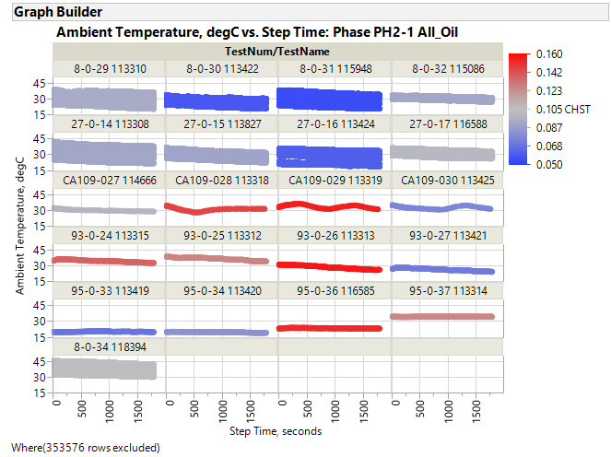
TF agreed to remove. These data will be removed from analysis data file

Slide 31
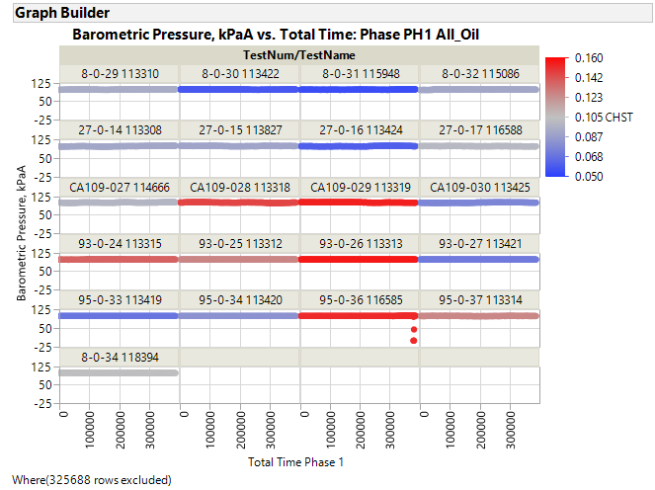
TF agreed to remove. These data will be removed from analysis data file

Slide 32
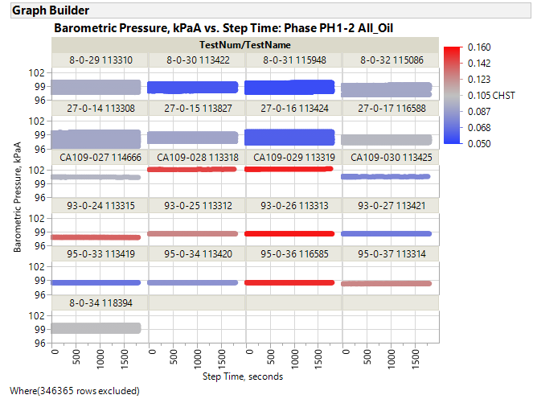

Slide 33
TF agreed to remove. These data will be removed from analysis data file

Slide 34
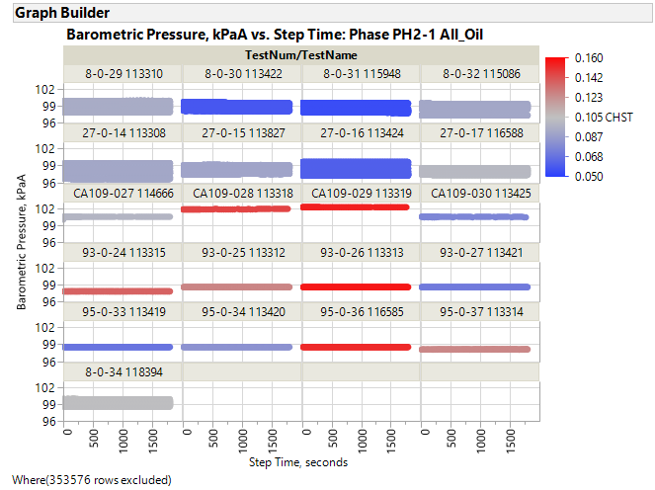

Slide 35
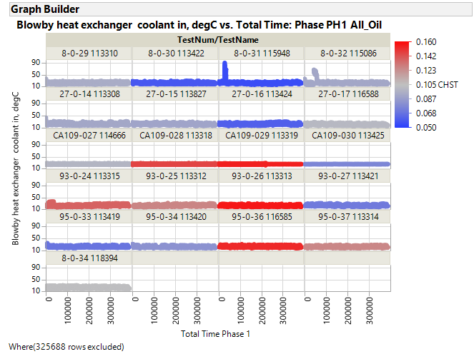
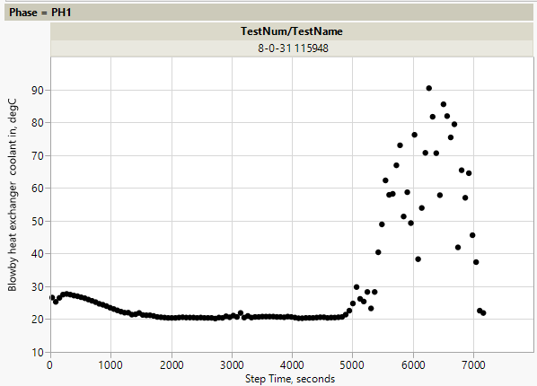
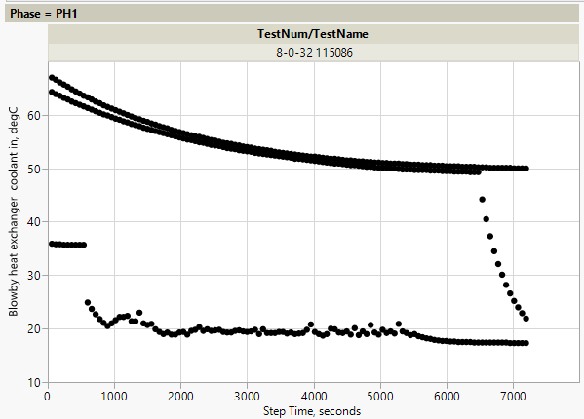
Cycle 4
Remove?
If yes, please resize box to indicate which data
Remove?
If yes, please resize box to indicate which datac
Cycle 7
Cycle 8
Cycle 1

Slide 36
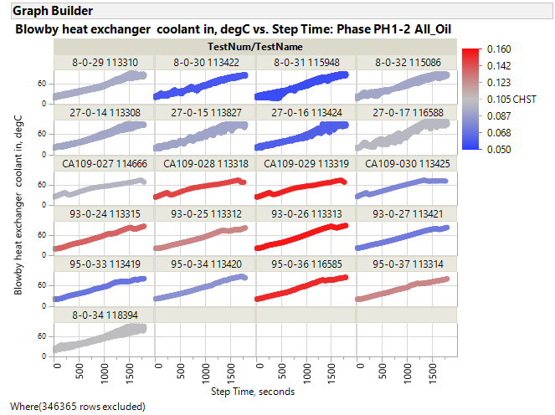

Slide 37
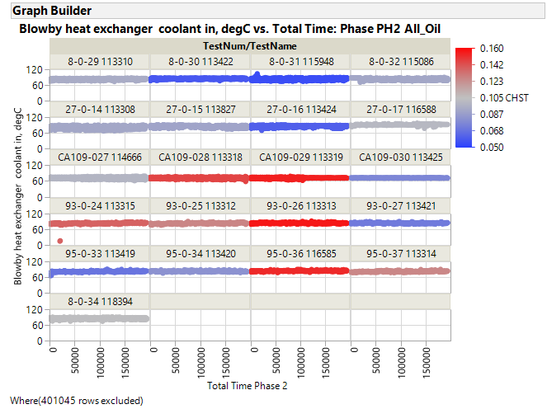
Cycle 6
TF agreed to remove. These data will be removed from analysis data file

Slide 39
Remove?
Cycle 1
Remove?

Slide 40
Remove?

Slide 41
Remove?

Slide 42
Remove?

Slide 43
TF agreed to remove. This data will be removed from analysis data file

Slide 45
TF agreed to remove. This data will be removed from analysis data file

Slide 49
Cycle 45
Remove?
Remove?

Slide 51
Cycle 8
Remove?
Cycle 54
Cycle 53
Remove?

Slide 53
Cycle 47
Remove?

Slide 59
Cycle 7
Cycle 1
Remove?
Remove?

Slide 80
Cycle 39
Remove?

Slide 81
Cycle 39
Remove?

Slide 82
Cycle 39
Remove?

Slide 83
Cycle 32
Cycle 1
Remove?
Remove?

Slide 85
Cycle 2
Remove?

Slide 86
Cycle 1
Remove?

Slide 87
Cycle 1
Remove?

Slide 89
Cycle 2
Remove?

Slide 90
Cycle 1
Remove?

Slide 91
Cycle 6
Cycle 31
Remove?
Remove?

Slide 92
Cycle 3
Data not provided for PH1 or PH2 or other Lab D tests.
Remove all cycle 3 data?

Slide 93
Data not equal to 1 found in many cycles

Slide 94
Data not provided for PH1 or PH2 or other Lab D tests.
Remove all cycle 3 data?

Slide 96
Remove?

Slide 98
Remove?

Slide 109
Cycle 34
Remove?

Slide 115
1 point in cycle 32 with pressure = 7550
Remove?
REMOVE?

Slide 116
c
REMOVE?

Slide 117
3 values are 89630 (found in cycles 40, 41, 42)
Remove?
REMOVE?

Slide 118
Cycle 39
4 values are 89610 (found in cycle 2)
Remove?
REMOVE?
Cycles 3 & 9

Slide 125
One occurrence in cycle 47 where humidity = 0.
Erroneous?

Slide 127
Remove???

Slide 131
2 occurrences in cycle 1 where pressure = -2.323
Remove?

Slide 135
Cycle 49 has lower temperature

Slide 137
First half of Cycle 49 has lower temperature

Slide 148
Cycle 39: Pressure = 53

Slide 150
Cycle 1

Slide 158
Cycle 1

Slide 159
Cycle 1

Slide 165
Cycle 1

Slide 166
Cycle 1 ramp

Slide 167
Cycle 1

Slide 170
Cycle 1

Slide 174
Cycle 1

Slide 175
Cycle 1

Slide 177
Cycle 2

Slide 178
Cycle 1

Slide 179
Cycle 54
1 occurrence in cycle 8 where pressure = 3.10075
Cycle 53

Slide 181
1 occurrence in cycle 47 where pressure = 14.77086

Slide 183
1 occurrence in cycle 32 where value = 37.2

Slide 184
Cycle 39

