Slide 1
Sequence X Severity Task Force
Meeting Minutes
04/13/22

Slide 2
Attendance 04/13/22
Michael Deegan
Rich Grundza
Ben Maddock
Christine Eickstead
George Szappanos
Jason Soto
Alfonso Lopez
Travis Kostan
Amol Savant

Slide 3
Agenda 04/13/22
Corrective Action for Severity Trend – Math Solutions
Fuels Task Force Update
Hardware Quote from FCS
Surveillance Panel – meeting schedule

Slide 4
Severity Shift -
Travis reviewed the mathematical options that were considered in June of 2021. See attached presentation.
Travis to schedule a statistician meeting to review the options and plan a presentation to the surveillance panel.

Slide 5
Hardware
FCS forwarded a current quotation for 2.0L hardware. The quote worksheet was sent to all the test labs and is available upon request.
Mike announced that the Sequence X test will be included in GF7.
Timing for the end of GF6 is estimated at 2028
Possible new engine platform for GF7 or use of remanufactured engines.
Mike to look into re-man availability
Task force to have weekly meetings to plan hardware purchases and engine/piston batch transitions
2018 Engines have AD and CA pistons. Pistons rings may be different to BC. Jason compiling information.

Slide 6
Surveillance Panel Meeting
The task force agreed to have the statisticians meet and work on the math models before we schedule a full task force meeting.

Slide 7
Sequence X Severity Mathematical Corrective Options
Statistics Group
June 2021

Slide 8
Statistics Group
Doyle Boese, Infineum
Jo Martinez, Chevron Oronite
Martin Chadwick, Intertek
Phil Scinto, Lubrizol
Richard Grundza, TMC
Todd Dvorak, Afton
Travis Kostan, SwRI

Slide 9
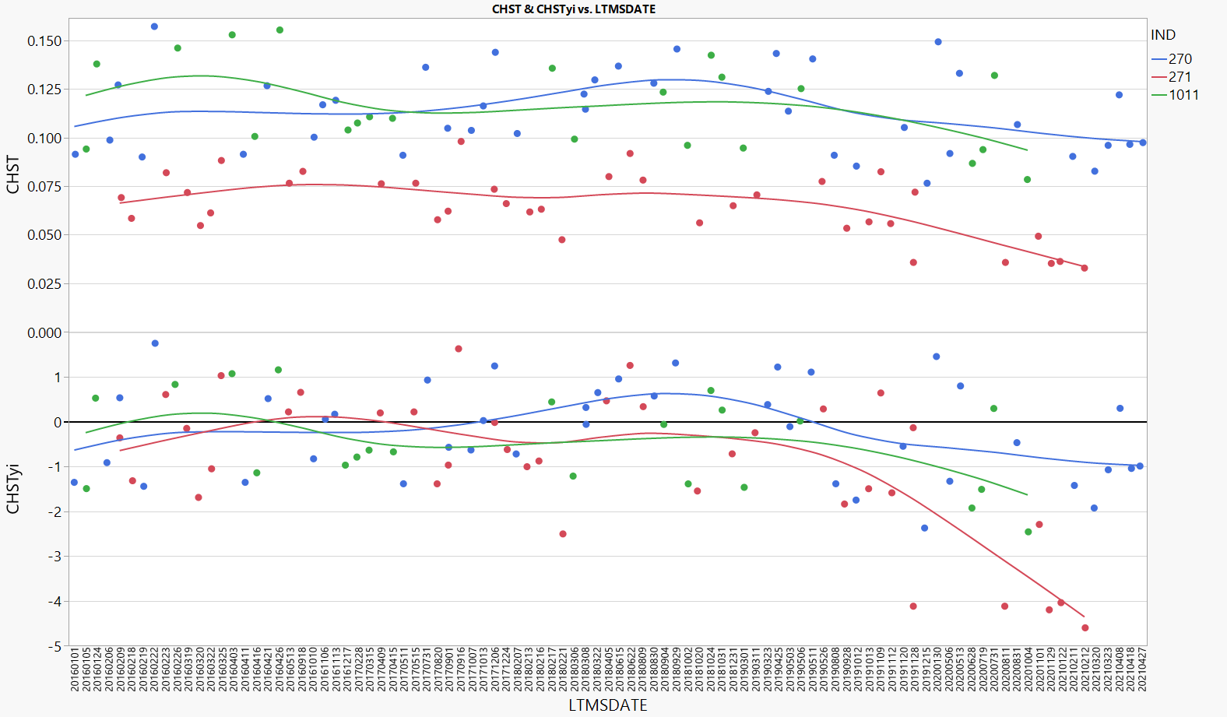
Background
All 3 reference oils appear to have shifted by similar CHST amount. Therefore Ln(CHST) more greatly impacted Oil 271. Oil 271 has been temporarily suspended.
Notes:
Updated

Slide 10
Executive Summary
The statistics group has ordered potential test severity remedies below in order from most to least preferred.
Return the test to traditional severity levels through an engineering solution.
Continue the suspension of reference oil 271.
The remaining 2 oils can still track test severity in both the mild and severe direction, and are not causing problems with lab calibration.
Some options exist for running 271 on a less frequent basis and not for calibration. This can be explored/discussed further if the panel desires.
If a mathematical solution is desired, the majority preference of the statistics group is to update the reference oil standard deviations as shown in the table below. To prevent an overly large influence of oil 271 on the severity adjustment standard deviation, the stats group recommends using the oil 270 standard deviation as the standard deviation for severity adjustments. This is appropriate if one believes candidate results near the performance of oil 271 have not seen as large a shift in transformed units.
Oil | Current S.D. | New S.D.
270 | 0.17435 | 0.24011
271 | 0.17537 | 0.56272
1011 | 0.18882 | 0.27434
Severity Adj. S.D. | 0.17856 | 0.24011*
* - Standard deviation on Oil 270

Slide 11
Mathematical Corrective Options Considered
The following are a list of options for mathematical corrective options evaluated (in no particular order). Fixing a problem mathematically for the reference oils does not mean that the underlying problem will be fixed for candidate oils.
Re-evaluate the transformation based on the current data set. If different from Ln, calculate new means and standard deviations. Also consider removing the transformation from Oil 271 only. Would require new mean and standard deviation for this oil.
Result – A square root transformation was slightly preferred over the natural log but provided only small relief. This fix would likely be needed in addition to a standard deviation adjustment, and fewer changes are preferred to many.
Correction factors. This would be applied equally to all oils, candidates and references. Evaluate constant and proportional correction factors to transformed and untransformed results.
Result – Constant correction factors in untransformed units were reasonable, but slightly over- and under-corrected some reference oils. Proportional correction factors bring all oils back to target, but results in large positive corrections for mild oils, requiring strong belief that candidates near oil 271 performance are behaving similarly. For any correction factor options, the lack of root cause also makes starting/stopping point of correction factor implementation unclear.
Calculate new standard deviations. This will make the standard deviation of 271 larger and thus bring the standardized result closer to target.
Result – This option was chosen, as it provides relief to the test while requiring the least amount of changes to the way the test has been run historically.
Notes:
Updated

Slide 12
When Did the Shift Occur?

Slide 13
When did the shift occur?
Because we have been unable to tie the shift in severity to any particular change in the test, we do not have clear guidance as to how we draw the line in the sand. The following slides will discuss each of the 3 options below.
#1
#2
#3

Slide 14
When did the shift occur?
Line #1 is suggested as the best split according to a partition analysis (08/08/19). After this date we began to see some of the lowest results even seen on oil 270.
#1

Slide 15
When did the shift occur?
Split #2 is based on the date of the first data of an extreme mild 271. The other 271 from the same day would go in the pre-shift group.
#2

Slide 16
When did the shift occur?
Split #3 appears to be the split which best captures the point in time when all 3 oils were producing almost exclusively mild results.
#3

Slide 17
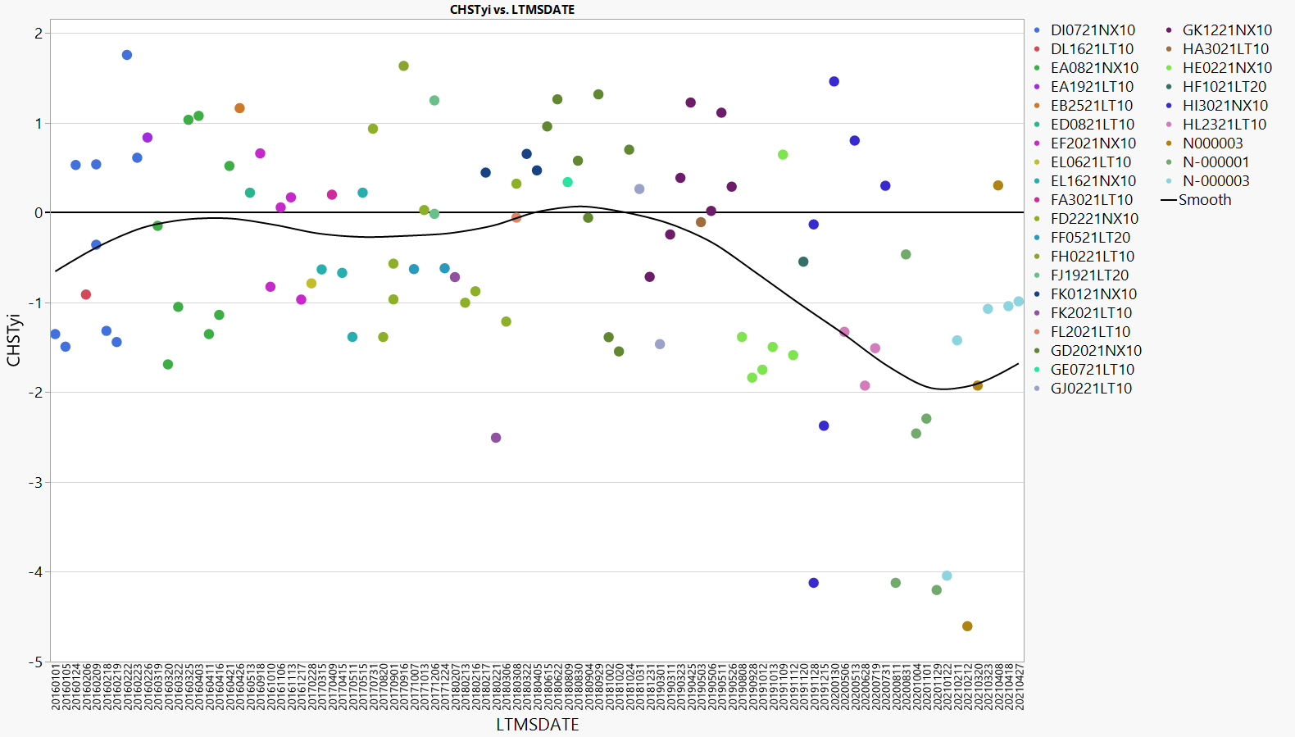
When did the shift occur? -Fuel Batches
The data was colored by fuel batch ID to investigate how the timeline aligns with fuel batch changes. Split #1 lines up fairly well with change to “H” batch, while split #3 lines up with change to “N” batch.
#1
#2
#3

Slide 18
When did the shift occur? -Lab Differences
The plot below shows Lab G showed the first evidence of the shift among labs after split #1.
#1
#2
#3

Slide 19
Standard Deviation Update

Slide 20
New Standard Deviations
Below are some comparisons of options for new standard deviations. The standard deviation update using “Post #1” was preferred.
Oil | Current S.D. | S.D. Post #1 | S.D. Post #3 | S.D. All Data
270 | 0.17435 | 0.24011 | 0.21619 | 0.19023
271 | 0.17537 | 0.56272 | 0.77157 | 0.33291
1011 | 0.18882 | 0.27434* | 0.24701* | 0.21735
Pooled | 0.17856 | 0.39913 | 0.46779 | 0.25746
Recommended |  | 0.24011**
* - Actual was 0.37932. However, with only 4 data points in Post #1 and Post #3, it seemed more appropriate to estimate using the ratio observed with the “All Data” standard deviation for 270/1011 (0.21735/0.19023).
** - Standard deviation of oil 270

Slide 21
Updating Yi Using Post #1 S.D.
Yi’s after 08/08/2019 here shown with updated standard deviations for Post #1 period.
Tests after here corrected

Slide 22
Impact of Updated Severity Adjustment S.D.
The table to the right indicates how candidate results will be adjusted on a stand with a Zi value of -1 with the updated pooled SA of 0.24011.
CHST | Ln(CHST) | Ln(CHST)+0.24011 | CHST FNL
0.010 | -4.6052 | -4.3651 | 0.013
0.020 | -3.9120 | -3.6719 | 0.025
0.030 | -3.5066 | -3.2664 | 0.038
0.040 | -3.2189 | -2.9788 | 0.051
0.050 | -2.9957 | -2.7556 | 0.064
0.060 | -2.8134 | -2.5733 | 0.076
0.070 | -2.6593 | -2.4192 | 0.089
0.080 | -2.5257 | -2.2856 | 0.102
0.090 | -2.4079 | -2.1678 | 0.114
0.100 | -2.3026 | -2.0625 | 0.127
0.110 | -2.2073 | -1.9672 | 0.140
0.120 | -2.1203 | -1.8802 | 0.153
0.130 | -2.0402 | -1.8001 | 0.165
0.140 | -1.9661 | -1.7260 | 0.178
0.150 | -1.8971 | -1.6570 | 0.191

Slide 23
Appendix
Notes:
Updated

Slide 24
Re-evaluation of the Transformation
Notes:
Updated

Slide 25
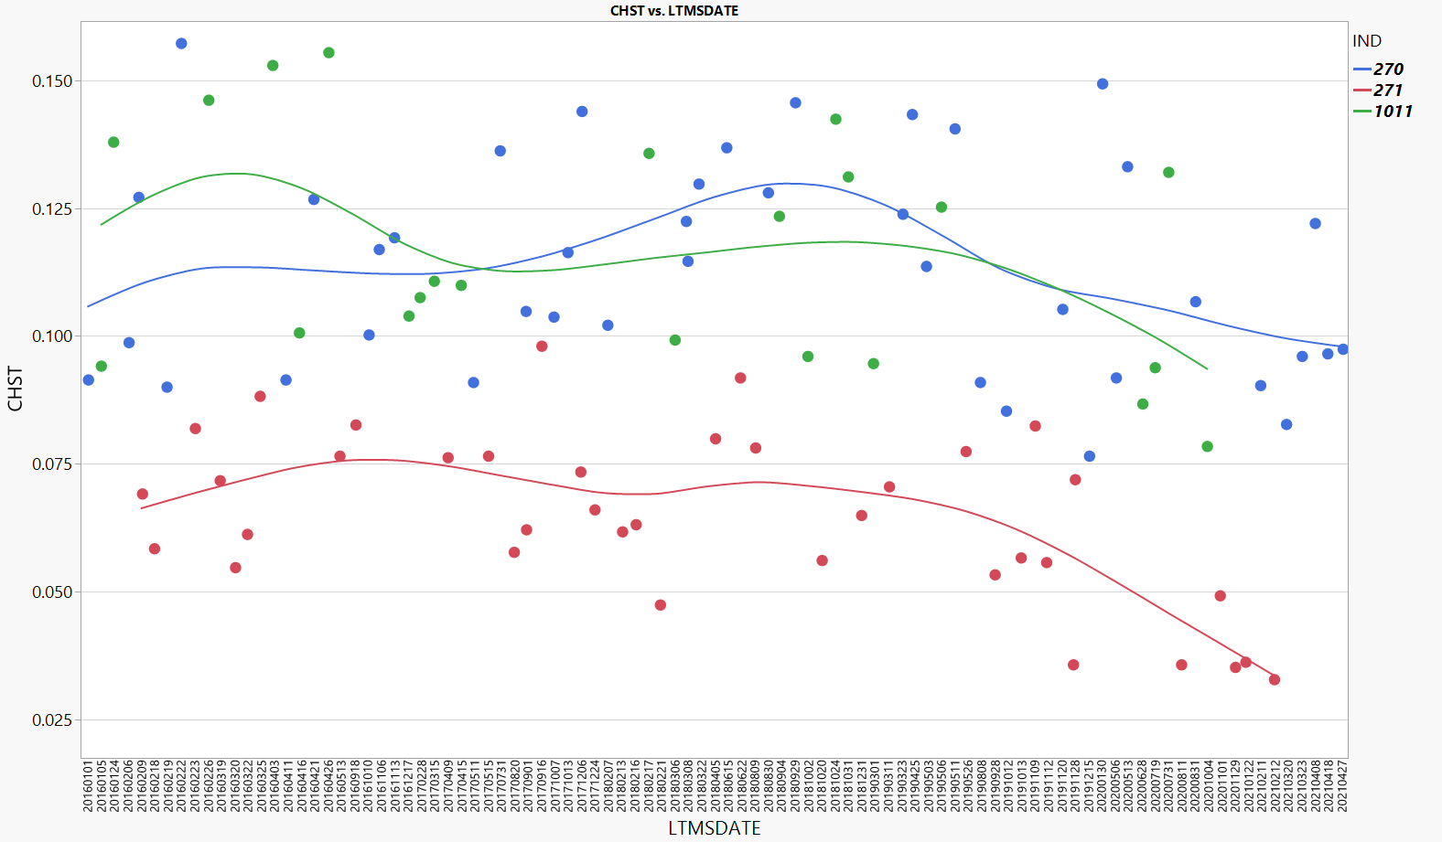
Re-evaluating the transformation -Using All Data with “Pre” or “Post” added to Model
Partition analysis suggests best split at 08/08/19. All data in in right box labeled as “Post.” All other data labeled “Pre”. Then modeled CHST ~ Oil, Lab, Stand[Lab], Pre/Post. Square root transformation more appropriate here.
Pre #1
Post #1

Slide 26
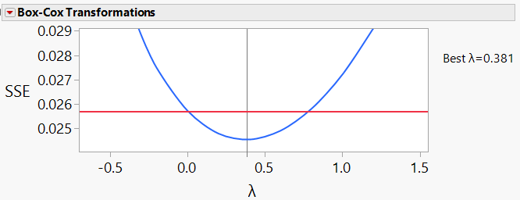
Re-evaluating the transformation -Using All Data with “Pre” or “Post” added to Model
All data in in right box labeled as “Post” (except for first near target 271). All other data labeled “Pre”. Then modeled CHST ~ Oil, Lab, Stand[Lab], Pre/Post. Square root transformation more appropriate here.
Pre #2
Post #2

Slide 27
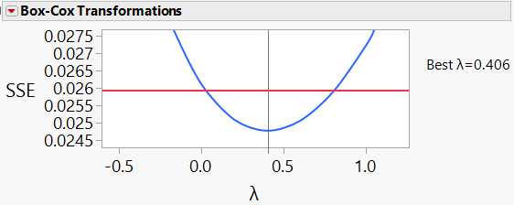
Re-evaluating the transformation -Using All Data with “Pre” or “Post” added to Model
All data in in right box labeled as “Post” All other data labeled “Pre”. Then modeled CHST ~ Oil, Lab, Stand[Lab], Pre/Post. Square root transformation more appropriate here.
Pre #3
Post #3

Slide 28
Sqrt. Transformed Targets -Averages
In order to keep the pivot point the same for positive and negative severity adjustments, the original targets were back-transformed into original units, and then the square root transformation is applied to obtain the target Sqrt(CHST) for each oil.
Reference Oil | Target Ln(CHST) | Target CHST | Target Sqrt(CHST)
270 | -2.15699 | 0.1157 | 0.34011
271 | -2.60987 | 0.0735 | 0.27119
1011 | -2.08191 | 0.1247 | 0.35312

Slide 29
Sqrt. Transformed Targets -Standard Deviations
Standard Deviation #1 – For each Oil, Calculated Std. Dev. of (Result-Target). Used $n=71$ data set prior to any evidence of the mild shift (labeled “Pre #1” in previous slide).
Standard Deviation #2 – For each Oil, Calculated Std. Dev. of (Result-Target). Used all data.
Reference Oil | Target Sqrt(CHST) | Std. Dev. 1 | Std. Dev. 2
270 | 0.34011 | 0.02784 | 0.03116
271 | 0.27119 | 0.02298 | 0.03421
1011 | 0.35312 | 0.03023 | 0.03343
Pooled |  | 0.02681 | 0.03281
Average |  | 0.02702 | 0.03293

Slide 30
Plot of CHST Yi Using Sqrt. With SD#1
Below is a plot of the CHST Yi when calculated using the standard deviation of the data “PRE #1” data only with the square root transformation.

Slide 31
Plot of CHST Yi Using Sqrt. With SD#2
Below is a plot of the CHST Yi when calculated using the standard deviation calculated using all of the data and the square root transformation.

Slide 32
No Transformation for Oil 271
For Oil 271, the mean of untransformed result is the back-transformed current mean for Ln(CSHT).
Standard deviation of (result-mean) is calculated using the 271 untransformed data from data set “Pre 1” only.
No changes to oil 270 or oil 1011.
Oil | CHST Mean | Standard deviation
271 | 0.0735 | 0.0125
Same as current LTMS for these oils
Oil | Ln(CHST) Mean | Standard deviation
270 | -2.15699 | 0.17435
1011 | -2.08191 | 0.18882

Slide 33
271 New Yi’s
The graph below shows how the 271 Yi values would change without the transformation.

Slide 34
Correction Factors
Pre- and Post-Transformation Options

Slide 35
Some Constant Correction Options
Below are some options for corrections to be applied to all tests depending on when you choose to identify the start of the shift and the type of correction factor you wish to apply (before of after transformation).
C.F. Number | Model | Pre LS Mean | Post LS Mean | Post Correction Factor (To “Pre”) | Post Correction Factor (To Target)*
1. | CHST ~ Oil, Lab, Stand[Lab], Pre/Post #1 | 0.1047 | 0.0785 | +0.0262 | +0.0253
2. | CHST ~ Oil, Lab, Stand[Lab], Pre/Post #2 | 0.1021 | 0.0785 | +0.0236 | +0.0249
3. | CHST ~ Oil, Lab, Stand[Lab], Pre/Post #3 | 0.1024 | 0.0740 | +0.0284 | +0.0296
4. | Ln(CHST) ~ Oil, Lab, Stand[Lab], Pre/Post #1 | -2.28375 | -2.62183 | +0.33808 | +0.33073
5. | Ln(CHST)~ Oil, Lab, Stand[Lab], Pre/Post #2 | -2.31325 | -2.63989 | +0.32664 | +0.34451
6. | Ln(CHST) ~ Oil, Lab, Stand[Lab], Pre/Post #3 | -2.31344 | -2.68375 | +0.37031 | +0.39137
*Calculated by using the prediction equation to predict average performance across all lab-stands in the “post” period (did not use nested stand term here, but lab-stand).

Slide 36
Ln(CHST+CF) with Measurement Correction Factor #1 -Corrected To Target
Reference tests shown below on of after 08/08/2019 have the measurement correction factor of +0.0253 applied.
Tests after here corrected

Slide 37
LN(CHST+CF) with Measurement C.F. #1
Reference tests shown below on of after 08/08/2019 have the measurement correction factor of +0.0253 applied.
Tests after here corrected

Slide 38
Ln(CHST+CF) with Measurement Correction Factor #3 -Corrected To Target
Reference tests shown below on of after 06/28/2020 have the measurement correction factor of +0.0296 applied.
Tests after here corrected

Slide 39
LN(CHST+CF) with Measurement C.F. #3
Reference tests shown below on of after 06/28/2020 have the measurement correction factor of +0.0296 applied.
Tests after here corrected

Slide 40
Ln(CHST)+CF with Correction Factor #4
Reference tests shown below on of after 08/08/2019 have the post-transformation (typical application) correction factor of +0.33073 applied.
Tests after here corrected

Slide 41
Ln(CHST)+CF with Correction Factor #4
Reference tests shown below on of after 08/08/2019 have the post-transformation (typical application) correction factor of +0.33073 applied.
Tests after here corrected

Slide 42
What about a non-constant C.F.? -Using Post #1 & #3 Modeled Means
The below shows how the correction factor would increase with improved oil performance. This assumes candidates are showing the same trend as the reference oils by level.
Correction Factor = -0.8534-0.4675X,
Where “X” is the Ln(CHST) result.
Correction Factor = -0.4508-0.3002X,
Where “X” is the Ln(CHST) result.

Slide 43
Correction factors by CHST Level
The table below shows how the CHST values would adjust when using a level dependent correction factor.
CHST | Ln(CHST) | C.F. w/ Post #1 | Adj. CHST w/ Post #1 | C.F. w/ Post #3 | Adj CHST w/ Post #3
0.010 | -4.6052 | 0.9317 | 0.025 | 1.2995 | 0.037
0.020 | -3.9120 | 0.7236 | 0.041 | 0.9755 | 0.053
0.030 | -3.5066 | 0.6019 | 0.055 | 0.7859 | 0.066
0.040 | -3.2189 | 0.5155 | 0.067 | 0.6514 | 0.077
0.050 | -2.9957 | 0.4485 | 0.078 | 0.5471 | 0.086
0.060 | -2.8134 | 0.3938 | 0.089 | 0.4619 | 0.095
0.070 | -2.6593 | 0.3475 | 0.099 | 0.3898 | 0.103
0.080 | -2.5257 | 0.3074 | 0.109 | 0.3274 | 0.111
0.090 | -2.4079 | 0.2721 | 0.118 | 0.2723 | 0.118
0.100 | -2.3026 | 0.2404 | 0.127 | 0.2231 | 0.125
0.110 | -2.2073 | 0.2118 | 0.136 | 0.1785 | 0.131
0.120 | -2.1203 | 0.1857 | 0.144 | 0.1378 | 0.138
0.130 | -2.0402 | 0.1617 | 0.153 | 0.1004 | 0.144
0.140 | -1.9661 | 0.1394 | 0.161 | 0.0658 | 0.150
0.150 | -1.8971 | 0.1187 | 0.169 | 0.0335 | 0.155

Slide 44
New Ln(CHST) and Yi w/ Post #1
The table below shows how data after 08/08/2019 would change with the level-dependent correction factor.
Tests after here corrected

Slide 45
New Ln(CHST) and Yi w/ Post #3
The table below shows how data after 06/28/2020 would change with the level-dependent correction factor.
Tests after here corrected

Slide 46
More Standard Deviation Options

Slide 47
Updating Yi Using Post #3 S.D.
Yi’s after 06/28/2020 here shown with updated standard deviations for Post #3 period.
Tests after here corrected

Slide 48
Updating Yi All Data Standard Deviations
All tests below have been corrected using the updated standard deviations calculated with all data.
All tests corrected

