Slide 1
Sequence X Severity Task Force
Meeting Minutes
12/01//21

Slide 2
Attendance
Michael Deegan
Rich Grundza
Christian Porter
Christine Eickstead
Amol Savant
George Szappanos
Jason Soto
Alfonso Lopez
Travis Kostan
Juan Vega
Pat Lang

Slide 3
Agenda 11/16/21
Review Oil Analysis Plots – Travis
Valvoline Vs Others on oil 271
Blowby stack standardization
Plan going forward
Lab visit planning

Slide 4
Meeting Minutes
The group reviewed plots of operational data from the 3 Valvoline tests that were conducted with the orifice restrictor and 2 without the restrictor. These data were plotted with 10 other industry tests on 271.
The plots are attached below.
There were no outstanding parameters that indicated a difference in operation that would explain the shift in severity of the tests using the orifice.

Slide 5
Meeting Minutes
There were two main issues with the blowby stack that needed addressing.
1. The procedure needs to be corrected to indicate counter flow of the coolant / BB gas. The labs agreed to counter flow. Most labs were already in compliance. This correction will be added to the motion of procedure changes that is pending e-ballot.
2. Another difference between labs is the 45 degree elbows that have been used to prevent condensation from contacting the thermocouple. Not all labs are seeing the problem and hence have not switched to the 45 degree elbow plumbing. George proposed a different solution of orienting the thermocouple and eliminating the elbows.

Slide 6
Meeting Minutes
Discussion continued on what to do next. The panel has given the task force until April to fix the mild shift issue.
The group agreed to plan lab visits in early 2022.
Holidays were on the horizon so we agreed to meet the first week of January to continue our efforts.

Slide 7
Chain Wear Chem. Data Comparisons

Slide 8
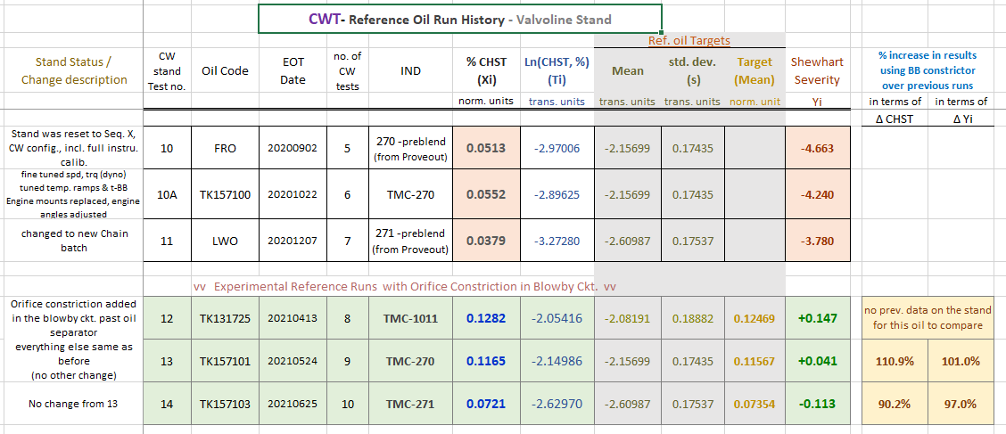
The Data Set
Valvoline Data – 5 Tests
Industry Data – 10 recent tests on Oil 271 included for comparison

Slide 9
Oil Consumption

Slide 10
Fuel Dilution
Val10 and Val11 both have identical fuel dilution at all hours. No fuel dilution for Val12.

Slide 11
100C Visc.

Slide 12
40C Visc.

Slide 13
TBN and TAN

Slide 14
Aluminum

Slide 15
Copper

Slide 16
Iron

Slide 17
Lead

Slide 18
Silicon

Slide 19
Sodium

Slide 20
Potassium

Slide 21
Karl Fischer Water

Slide 22
Oxidation (IR FTNG_E2412)

Slide 23
Oxidation (IR 5.8_6.1)

Slide 24
Nitration (IR FTNG_E2412)

Slide 25
Nitration (IR 5.8_6.1)

Slide 26
Soot TGA Residue

Slide 27
Soot TGA Volatile

Slide 28
Soot

