Slide 1

VIE Precision Matrix Analysis
Industry Statistician Team
Date: 05-17-2016

Slide 2
Statistics Group
Arthur Andrews, ExxonMobil
Doyle Boese, Infineum
Jo Martinez, Chevron Oronite
Kevin O’Malley, Lubrizol
Martin Chadwick, Intertek
Richard Grundza, TMC
Lisa Dingwell, Afton
Todd Dvorak, Afton
Travis Kostan, SwRI

Slide 3
VIE Analysis Check List – Answers to SP Questions
Do we really need to run three RO tests to establish the new engine for LTMS? LTMS Topic
Discussion of reducing the new reference requirement to two oils, then a third oil run after a defined number of candidates. LTMS Topic
Discussion of using FEI 2 and FEI Sum for references to match candidate pass/fail criteria. LTMS – Consensus reached in Stats team to continue with FEI1 and FEI2
Discussion of evaluating 80/20 ratio of BL before to after for FEI 1 and 10/90 for FEI 2. Consider evaluating FEI 1 vs 100% BLB2 (or 3) and evaluating FEI 2 vs 100% BLA. Included in this presentation
Should the acceptance bands value of 1.96 be rounded up? Due to the rounding on FEI 1 and 2 the actual pass limit is 1.91 and 1.92. LTMS Topic
SP chair and test sponsor to investigate what is needed to establish VID equivalent limits for VIE TBD
Discussion of changing BLB1 to BLB2 delta acceptable limits. Included in this presentation
Review impact of variable oil pressure of FEI (review prove out data to determine if it is stand or engine related) Included in this presentation
Update Appendix K (update scheduled at next SP meeting in Wickliffe)

Slide 4
Executive Summary
Precision Matrix (PM) Analysis Highlights:
  No compelling rationale to change current 80/20 baseline weighting for FEI1 and 10/90 baseline weighting for FEI2
  VIE Precision¹ with Ln(Engine Hours) Adjustment option:
    FEI1 and FEI2 RMSE is 0.26 and 0.32, respectively
    Reference oil LSMeans indicate that (3) FEI1 and (1) FEI2 pair-wise contrast(s) are significantly different
  VIE Precision¹ with Ice Hockey Stick (Engine Hours) Adjustment option:
    FEI1 and FEI2 RMSE is 0.255 and 0.295, respectively
    Reference oil LSMeans indicate that (3) FEI1 and (2) FEI2 pair-wise contrast(s) are significantly different
  Both the Sequence VID and VIE show oil discrimination of over 4 standard deviations for FEI1, which is a comparatively good amount of discrimination. The VIE FEI2 shows oil discrimination of 1 standard deviation, which is less discrimination than VID FEI2, and less than most GF-5 PCMO engine tests.
    ¹VIE contrast with VID (PM) RMSE of 0.12 and 0.14, respectively

Slide 5
Executive Summary
Precision Matrix (PM) Analysis Highlights (continued):
  No Significant difference between test labs
  No significant difference between engines within the same test lab;
  Lab G engines differ in FEI1 when additional significant interactions are included in the model (lab*oil & oil*engine hours)
  FEI results suggest labs do not discriminate oils the same way, though sample size is small and inferences can be impacted by variation
  FEI1 oil discrimination changes over the range of engine hours
  Weak evidence that oil pressure differences between consecutive test runs on the same engine may be related to changes in FEI2 test results
  Two unusual (studentized deleted) residuals resulted on Engine128 in Lab A

Slide 6
Agenda
Review PM Data for Analysis
Evaluating Baseline Weighting Scenarios
Evaluating Alternatives for Engine Hour Adjustment
Analyzing PM Data
  FEI1 – LnEngHr Model
  FEI1 – Ice Hockey Stick Model
  FEI2 – LnEngHr Model
  FEI2 – Ice Hockey Stick Model
  Comparing VIE Precision and Oil Discrimination with other Tests

Slide 7
Agenda
Review PM Data for Analysis
Evaluating Baseline Weighting Scenarios
Evaluating Alternatives for Engine Hour Adjustment
Analyzing PM Data
  FEI1 – LnEngHr Model
  FEI1 – Ice Hockey Stick Model
  FEI2 – LnEngHr Model
  FEI2 – Ice Hockey Stick Model
  Comparing VIE Precision and Oil Discrimination with other Tests

Slide 8
Review PM Data for Analysis
Precision Matrix data summary:
  6 Labs {A, B, C, D, F, G}
  3 Reference Oils {1010-1, 542-2, 544}
  9 Engines {103, 11, 123, 128, 136, 29, 31, 55, 60}
  Within lab statistical tests - 3 Labs with engine pairs
    Lab A: 103 vs. 128
    Lab C: 29 vs. 31
    Lab G: 55 vs. 60
  Data set total sample size: 53

Slide 9
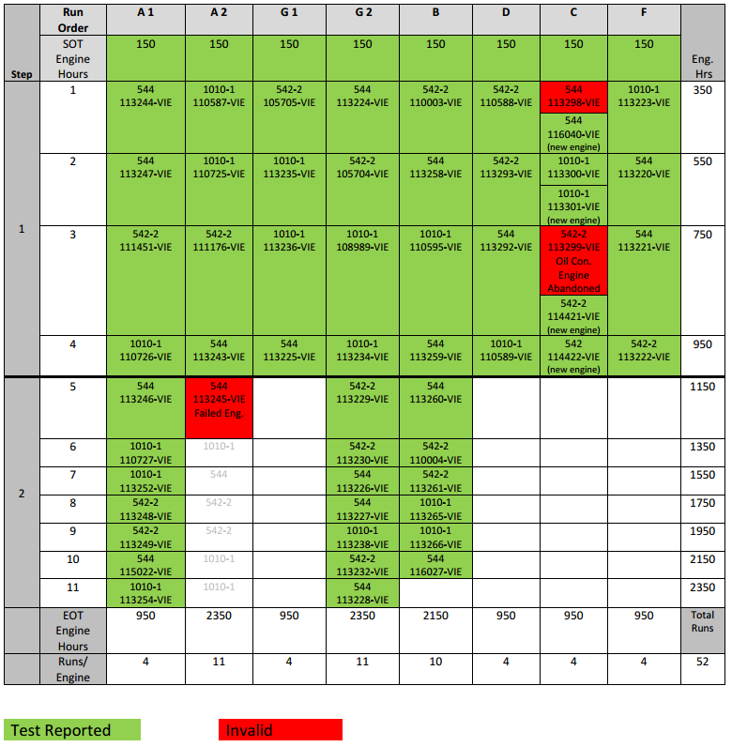
Review PM Data for Analysis
Precision Matrix (PM):
On 5-10-16 the surveillance panel concluded 53 tests were valid (these are shown in green).
Table is from Frank Faber’s 5-11-16 matrix update email

Slide 10
Review PM Data for Analysis
Precision Matrix data summary (continued):
  Average engine hour age¹:
    PM Average EngHrs = 1086
    PM Average Ln(EngHrs) Transform = 6.83 (e^{6.83} = 925 hours)
    ¹For reference: VID Ln(EngHrs) = 7.37 (e^{7.37} = 1598 hours)
Notes:
NOT UPDATED!!

Slide 11
Agenda
Review PM Data for Analysis
Evaluating Baseline Weighting Scenarios
Evaluating Alternatives for Engine Hour Adjustment
Analyzing PM Data
  FEI1 – LnEngHr Model
  FEI1 – Ice Hockey Stick Model
  FEI2 – LnEngHr Model
  FEI2 – Ice Hockey Stick Model
  Comparing VIE Precision and Oil Discrimination with other Tests

Slide 12
Evaluating Baseline Weight Scenarios
Excel Program developed to evaluate 10,000 different weight combinations of BLB1, BLB2, and BLA
Excel based prediction model for precision (RMSE) included Lab, Eng(Lab), Oil, and Ln(EngHr) factors
All BL weight combinations summed to a value of 1.0
For those runs that included a BLB3, BL weights were applied to BLB2 & BLB3 in lieu of BLB1 & BLB2
Results are shown on the following slides

Slide 13
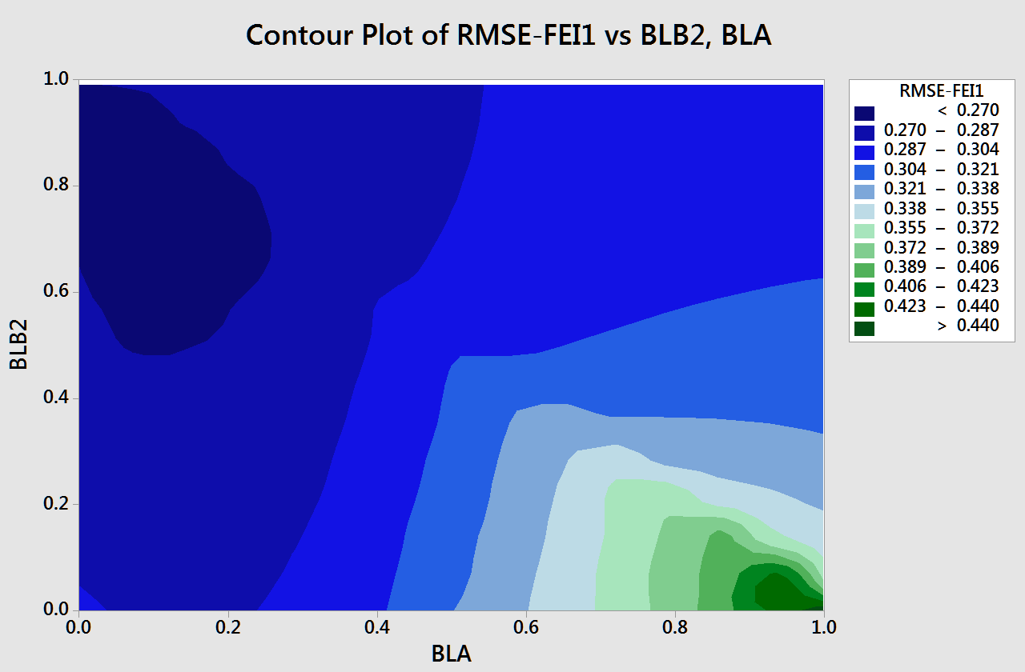
Evaluating Baseline Weight Scenarios
Plot of RMSE vs. baseline weight combinations for FEI1 shown below
  RMSE of weights can be interpreted from plot- if BL weights sum to 1.0
  VID FEI1 Baseline weights of 80% & 20% shown in red circle
  Other BL weighting combinations provide slight improvement to precision
  No compelling rationale to change current FEI1 Baseline weights
Notes:
NOT UPDATED!!

Slide 14
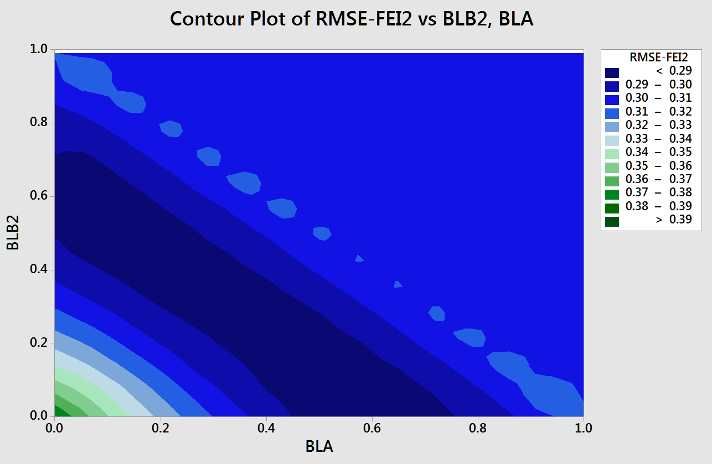
Evaluating Baseline Weight Scenarios
Plot of RMSE vs. baseline weight combinations for FEI2 shown below
  RMSE of weights can be interpreted from plot- if BL weights sum to 1.0
  VID FEI2 Baseline weights of 10% & 90% shown in red circle
  Other BL weighting combinations provide slight improvement to precision
  No compelling rationale to change current FEI2 Baseline weights
Notes:
NOT UPDATED!!

Slide 15
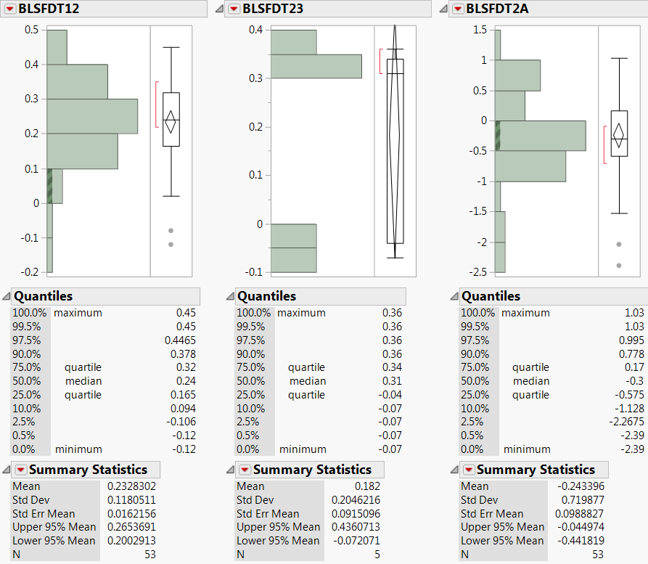
BL Shift
Not enough data to change limits at this time
BLB12 Shift Range: (-0.12, 0.45); BLB23 Shift Range: (-0.07, 0.36)
BLA Shift Range: (-2.39, 1.03)

Slide 16
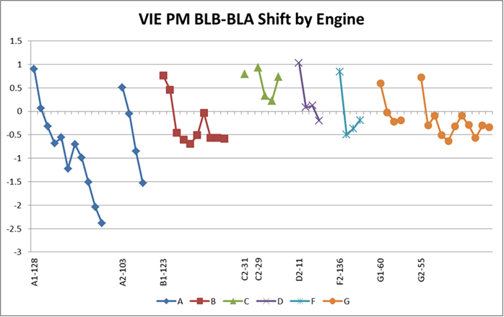
BLB-BLA Shift by Engine
Lab A profile appears to be different than the other labs
The first BLB-BLA shift in each engine is the largest
SP should review BLB-BLA shift

Slide 17
Agenda
Review PM Data for Analysis
Evaluating Baseline Weighting Scenarios
Evaluating Alternatives for Engine Hour Adjustment
Analyzing PM Data
  FEI1 – LnEngHr Model
  FEI1 – Ice Hockey Stick Model
  FEI2 – LnEngHr Model
  FEI2 – Ice Hockey Stick Model
  Comparing VIE Precision and Oil Discrimination with other Tests

Slide 18
Evaluating Alternatives for Engine Hour Adjustment
Analysis of the FEI1 and FEI2 model residuals were explored to identify the best method for Engine Hour Adjustment
The residuals were based on a model fit with LTMSLAB, IND, and ENGNO(LTMSLAB) factors
Various transforms of engine hours were evaluated (Ln, power, etc.) to try to approximate the relationship of engine age on FEI test results
Highlights of a natural log transform and Ice Hockey Stick (IHS) are shown on the following slides

Slide 19
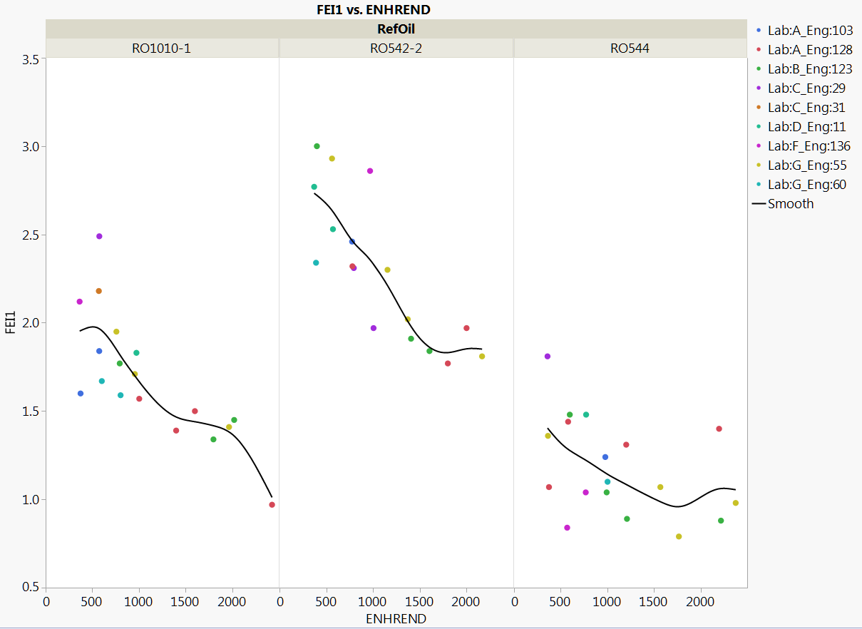
Evaluating Alternatives for Engine Hour Adjustment
FEI1 Ice Hockey Stick (IHS) Engine hour adjustment approach
  Data suggests a possible horizontal line at 1650 hours

Slide 20
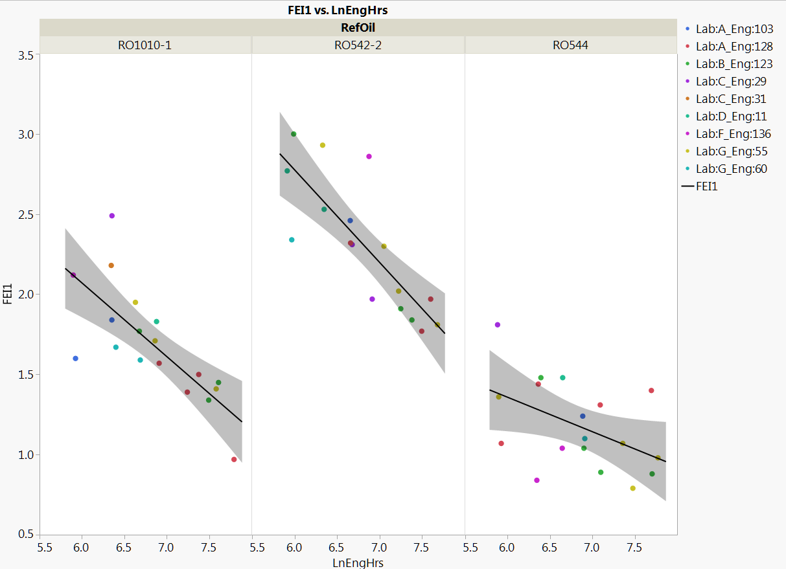
Evaluating Alternatives for Engine Hour Adjustment
Natural Log Engine hour adjustment approach
  Linear relationship exhibited between FEI1 and Ln(EngHrEnd)

Slide 21
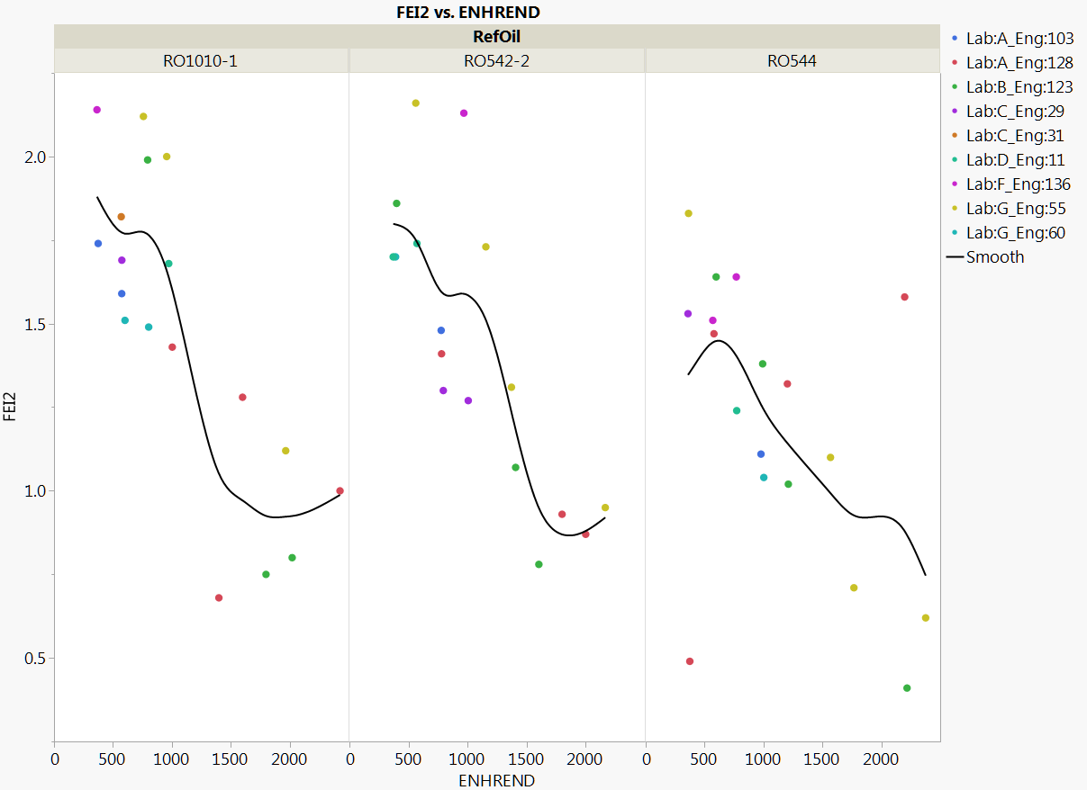
Evaluating Alternatives for Engine Hour Adjustment
FEI2 Ice Hockey Stick (IHS) Engine hour adjustment approach
  Data suggests a possible horizontal line at 1800 hours

Slide 22
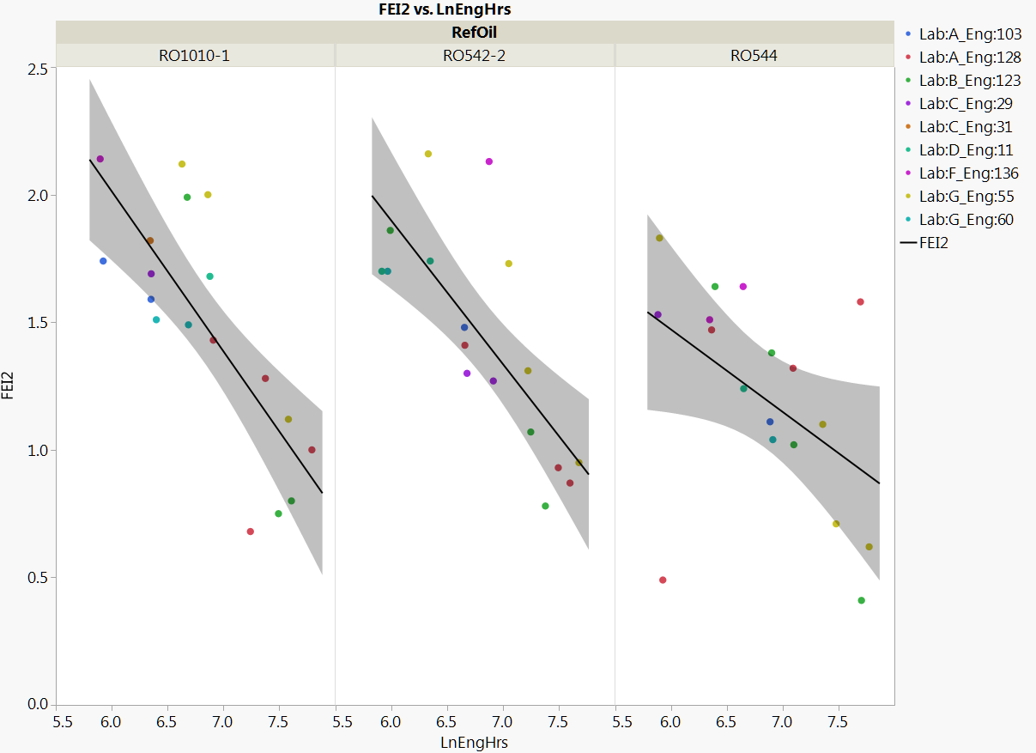
Evaluating Alternatives for Engine Hour Adjustment
Natural Log Engine hour adjustment approach
  Linear relationship exhibited between FEI1 and Ln(EngHrEnd)

Slide 23
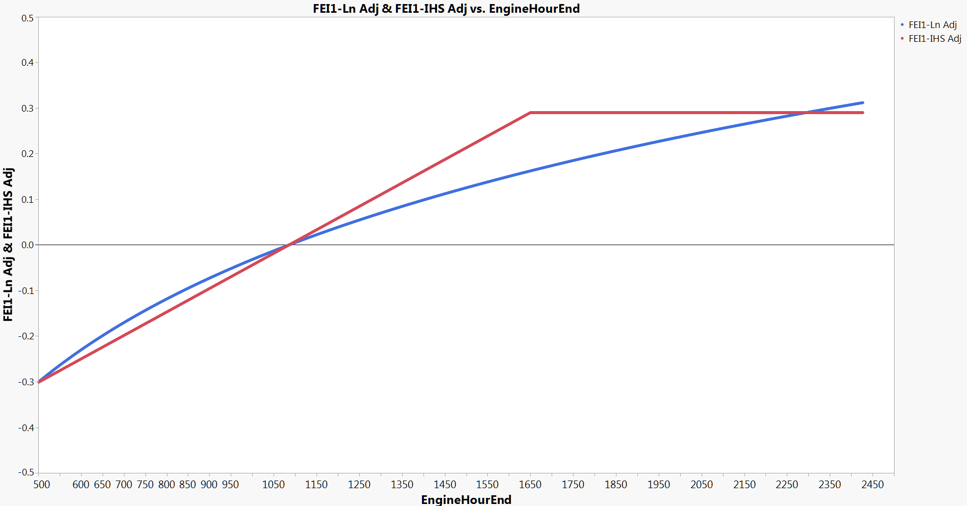
Evaluating Alternatives for Engine Hour Adjustment
FEI1 Adjustment approaches are summarized below
  Both adjustment approaches are aligned to EngHr Average of 1086
  FEI1 Ln Adj = 0.388*(Ln(EngHrs)-Ln(1086))
  FEI1 IHS Adj = 0.000514*(min(1650,EngHrs)-1086)

Slide 24
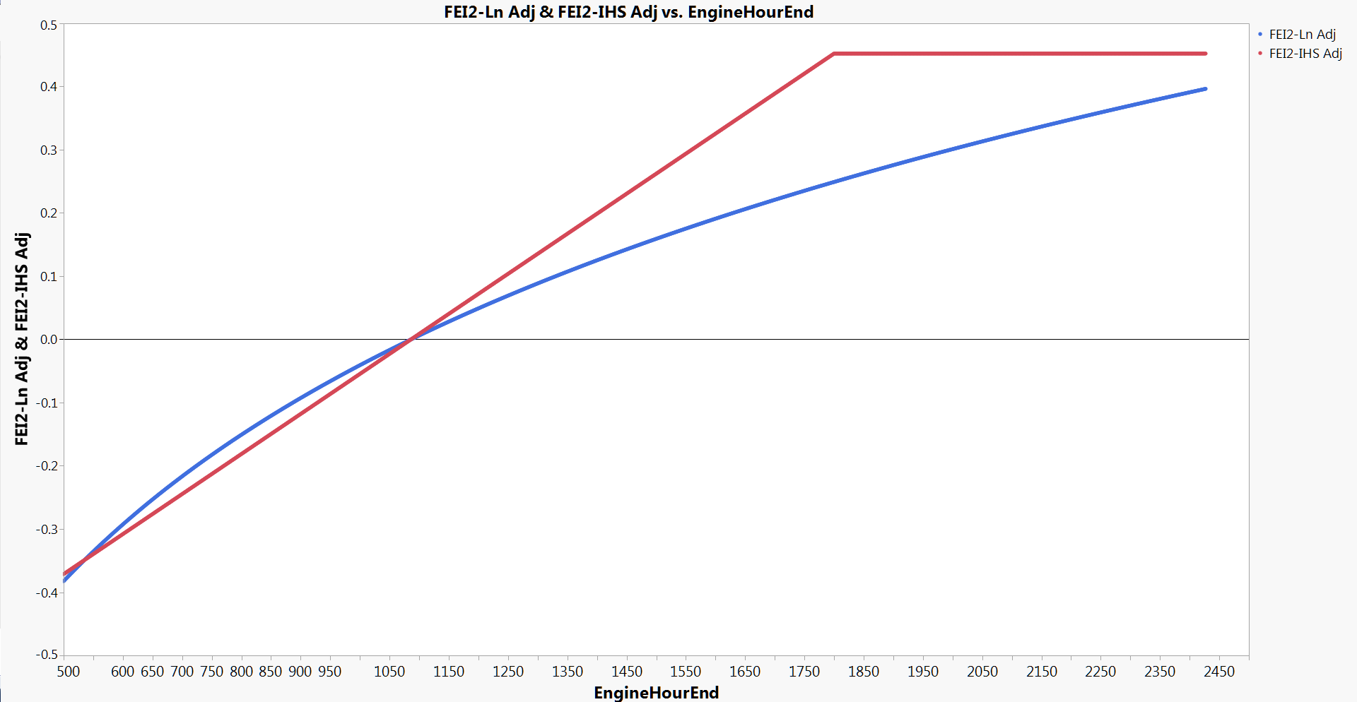
Evaluating Alternatives for Engine Hour Adjustment
FEI2 Adjustment approaches are summarized below
  Both adjustment approaches are aligned to EngHr Average of 1086
  FEI2 Ln Adj = 0.493*(LN(EngHrs)-Ln(1086))
  FEI2 IHS Adj = 0.000633*(min(1800,EngHrs)-1086)

Slide 25
Evaluating Alternatives for Engine Hour Adjustment
Review of correction factor approaches for EngHrEnd indicates that no one engine hour transform for FEI1 or FEI2 performs overwhelmingly better in terms of RMSE, Rsquare, or model fit residual diagnostics.
Additional reference tests will clarify the true engine hour effect at higher engine hours.
At this time, it is recommend that Subject Matter Experts (SMEs) in the Surveillance Panel choose from one of the two proposed engine hours adjustment methods (IHS vs. Ln) for FEI1 and FEI2.

Slide 26
Agenda
Review PM Data for Analysis
Evaluating Baseline Weighting Scenarios
Evaluating Alternatives for Engine Hour Adjustment
Analyzing PM Data
  FEI1 – LnEngHr Model
  FEI1 – Ice Hockey Stick Model
  FEI2 – LnEngHr Model
  FEI2 – Ice Hockey Stick Model
  Comparing VIE Precision and Oil Discrimination with other Tests

Slide 27
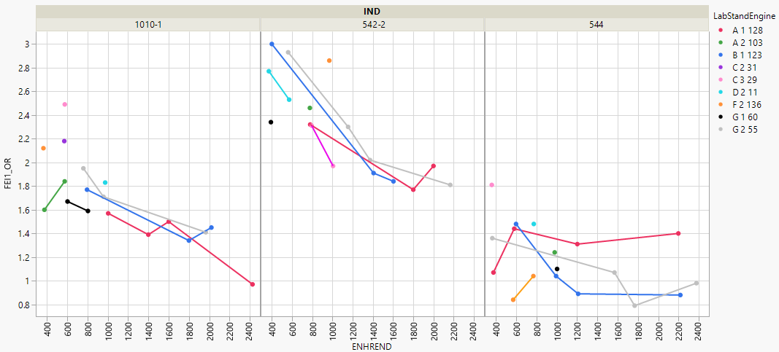
Analyzing PM Data
Plot of FEI1_OR
Notes:
Updated

Slide 28
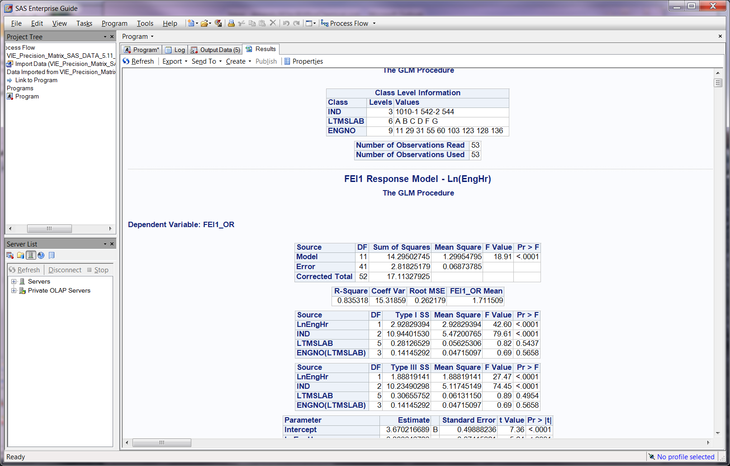
Analyzing PM Data (FEI1 – LnEngHr Model)
Overall ANOVA Summary of FEI1 data:
  Ln(EngHr) & Reference Oil factors are statistically Significant
  VIE PM Test Precision: 0.26 (contrast w/ VID PM test precision of 0.12)
Notes:
Updated

Slide 29
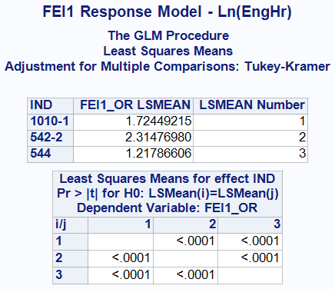
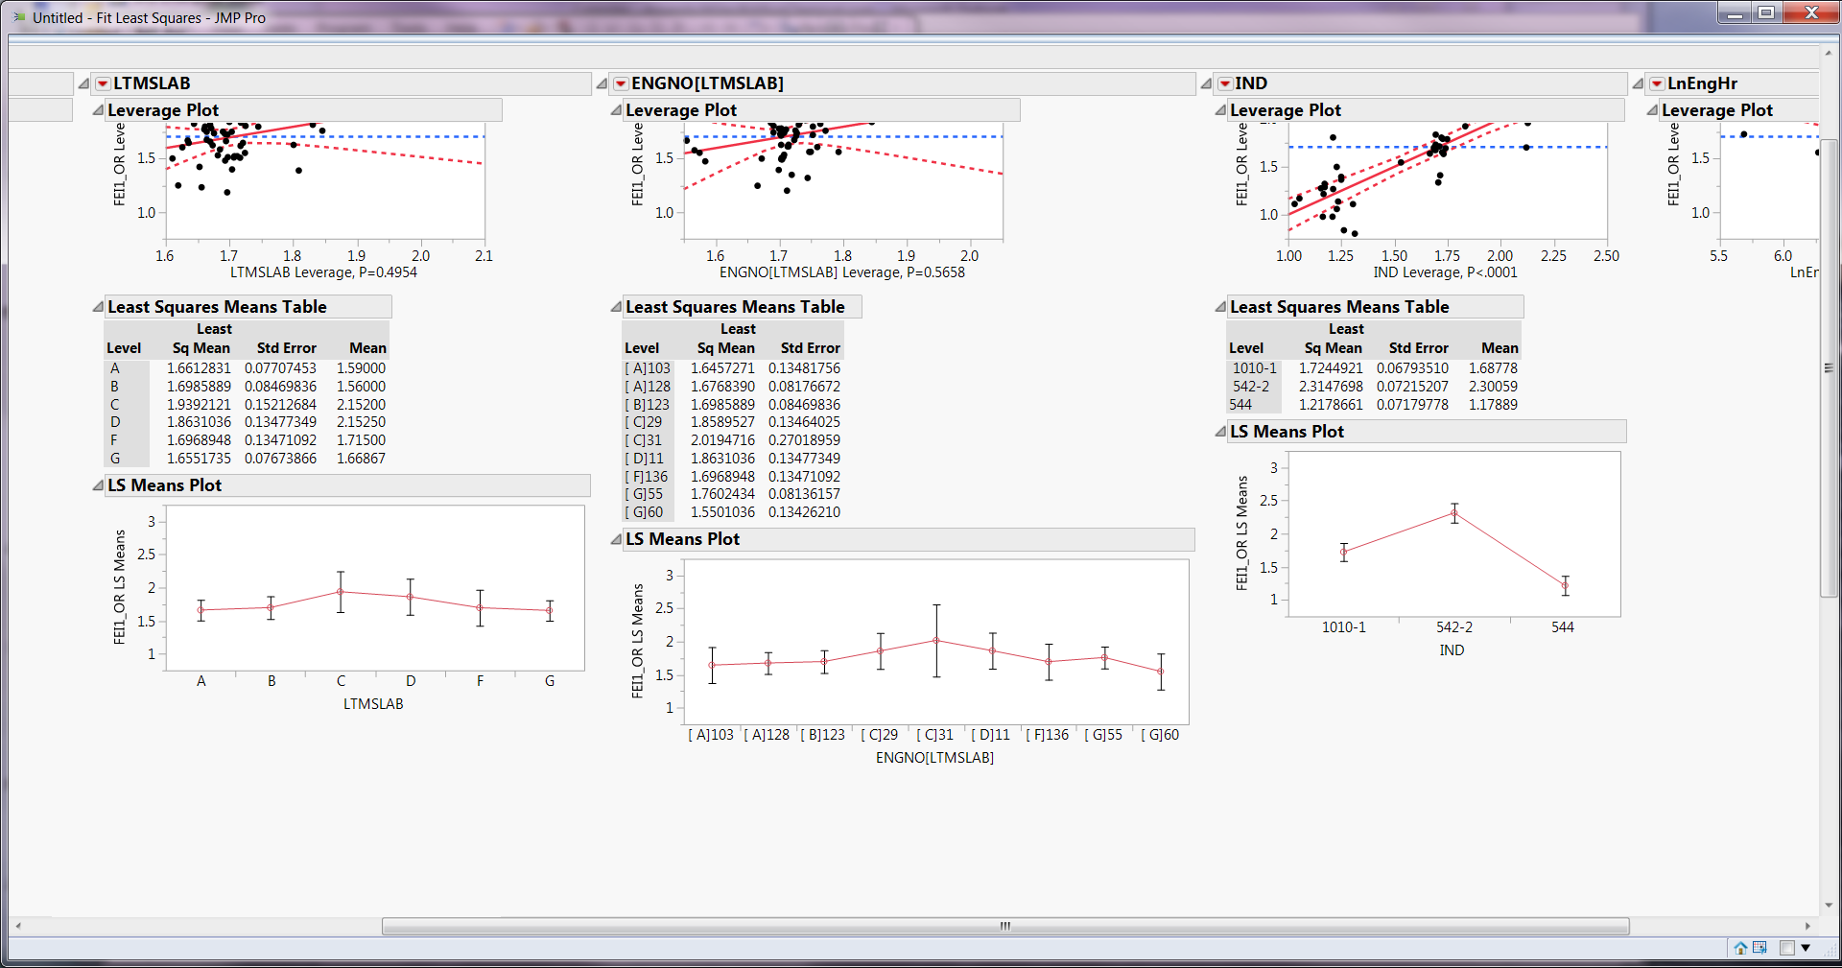
Analyzing PM Data (FEI1 – LnEngHr Model)
Difference between reference oil LsMeans for FEI1:
  All oil contrasts are significantly different
  {544 < 1010-1 < 542-2}
  Higher VIE FEIs as compared to VID is partially due to correction at reduced number of engine hours
Notes:
Updated

Slide 30
Analyzing PM Data (FEI1 – LnEngHr Model)
FEI1Adj Oil Discrimination by Engine
  Contrast below plot with oil ranking of {544 < 1010-1 < 542-2}
  Oil discrimination is not consistent across labs; in particular, Lab C, though sample size is small and inferences can be impacted by variation

Slide 31
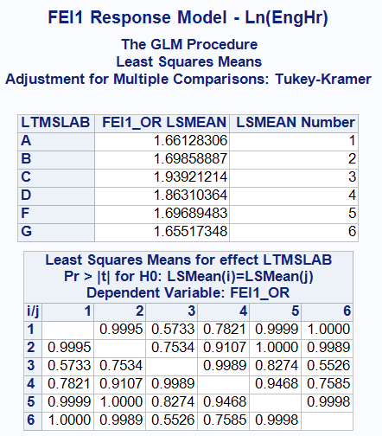
Analyzing PM Data (FEI1 – LnEngHr Model)
Difference between test Lab LSMeans for FEI1
  No significant difference between Labs
Notes:
Updated

Slide 32
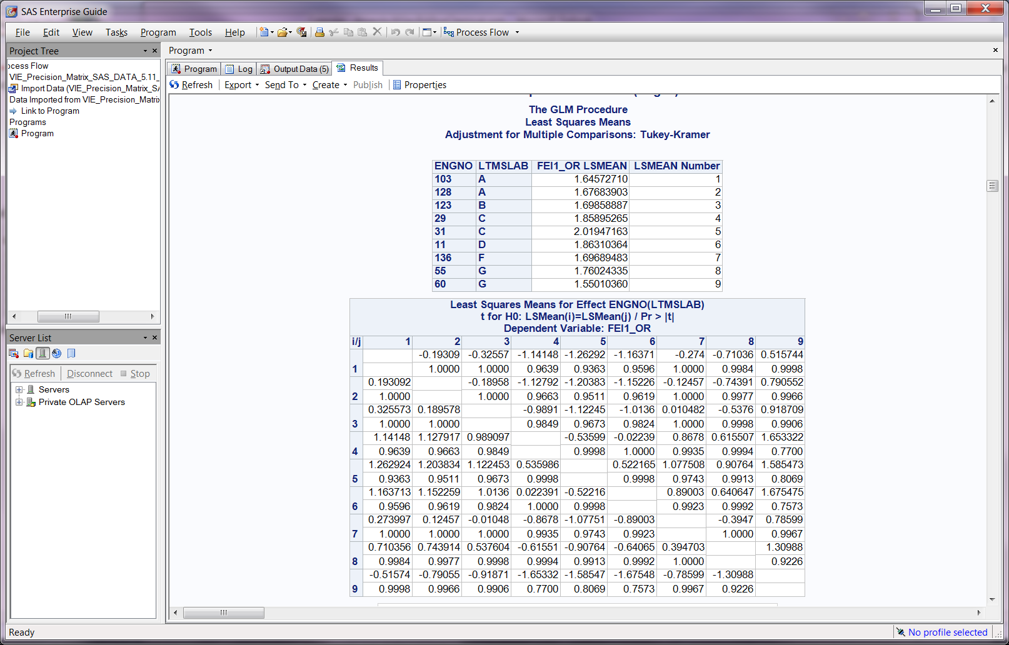
Analyzing PM Data (FEI1 – LnEngHr Model)
LSMean difference between engines within the same Lab
  Contrasts: {A-103 vs. A-128}, {C-29 vs. C-31}, {G-55 vs. G-60}
  Conclusion: No Significant¹ Difference between engines within a Lab
    Lab G engines significantly differ when additional significant model terms are added (lab*oil & oil*engine hours interactions)
¹Familywise error rate critical t of 2.49 selected for 3 contrasts
Notes:
Updated

Slide 33
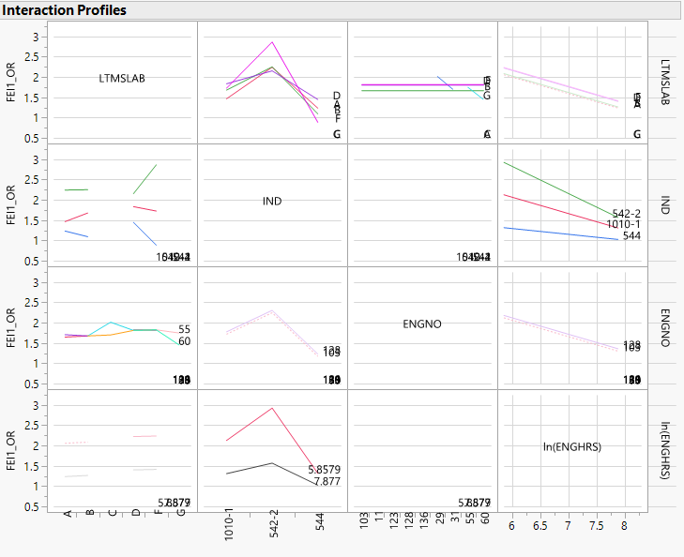
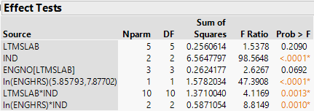
Analyzing PM Data (FEI1 – LnEngHr Model)
When additional significant model terms are added to the model (lab*oil & oil*engine hours interactions) we find that oil discrimination changes over the range of hours
Model Predicted FEI1_OR vs. Engine Hours by Oil
Model terms:
Notes:
Updated

Slide 34
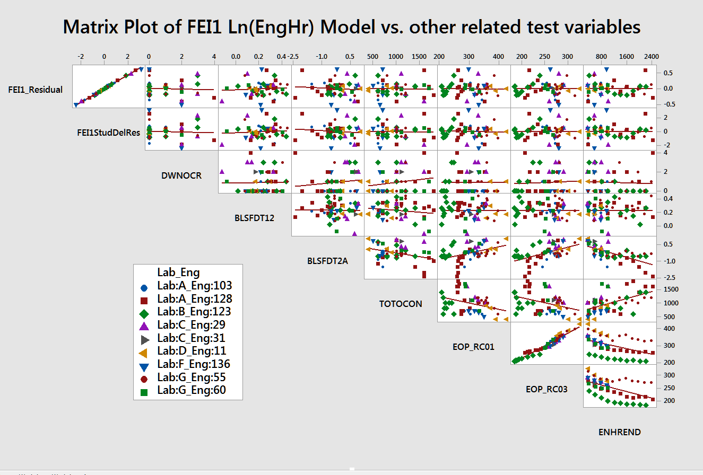
Analyzing PM Data (FEI1 – LnEngHr Model)
Matrix Plot of FEI1 residuals vs. other related test variables
  No observable trend that correlates with FEI1 residual data
Notes:
NOT UPDATED!!

Slide 35
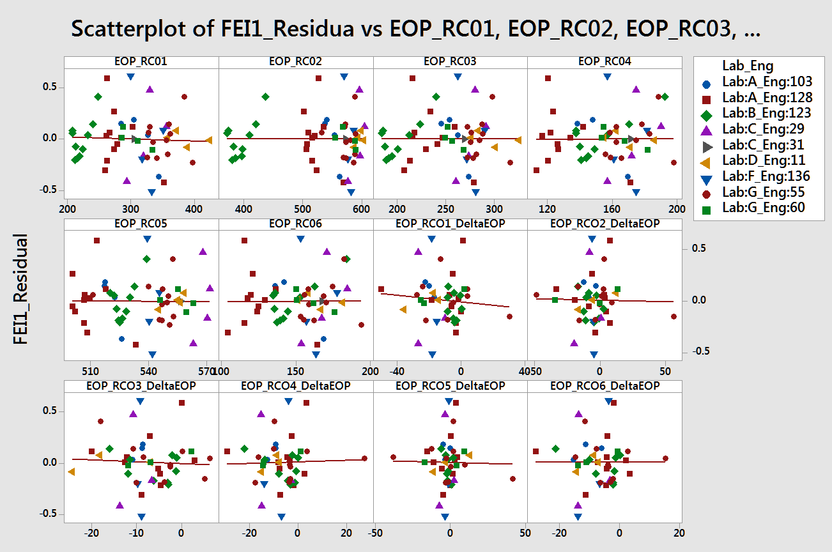
Analyzing PM Data (FEI1 – LnEngHr Model)
Plot of FEI1 residuals vs. oil pressure variable data
  Oil pressure delta_{(t)} = [Eng Oil Pressure]_{(t)}- [Eng Oil Pressure]_{(t-1)}
  No evidence found relating oil pressure to FEI1 residuals
Notes:
NOT UPDATED!!

Slide 36
FEI1 Precision (LnEngHr Model)
Model: Oil, Lab, Engine(Lab), LnEngHr
Model RMSE
Repeatability
Reproducibility
s = 0.26
s = 0.26
R = 0.72
s = 0.26
VID Precision Matrix s=0.14
VIE Prove-out s=0.21
VID current data s=0.12
r = 0.72

Slide 37
FEI1 Precision (LnEngHr Model)
Based upon the Seq. VIE and VID pooled standard deviations (s_{r}) and ASTM’s repeatability (r), there is no significant difference between an FEI1 result¹ of 1.3 – 2.0 for the VIE and
1.6 – 2.0 for the VID.
Note 1: An FEI1 of 2.0 was arbitrarily selected in the calculations as the upper pass/fail limit.

Slide 38
Agenda
Review PM Data for Analysis
Evaluating Baseline Weighting Scenarios
Evaluating Alternatives for Engine Hour Adjustment
Analyzing PM Data
  FEI1 – LnEngHr Model
  FEI1 – Ice Hockey Stick Model
  FEI2 – LnEngHr Model
  FEI2 – Ice Hockey Stick Model
  Comparing VIE Precision and Oil Discrimination with other Tests

Slide 39
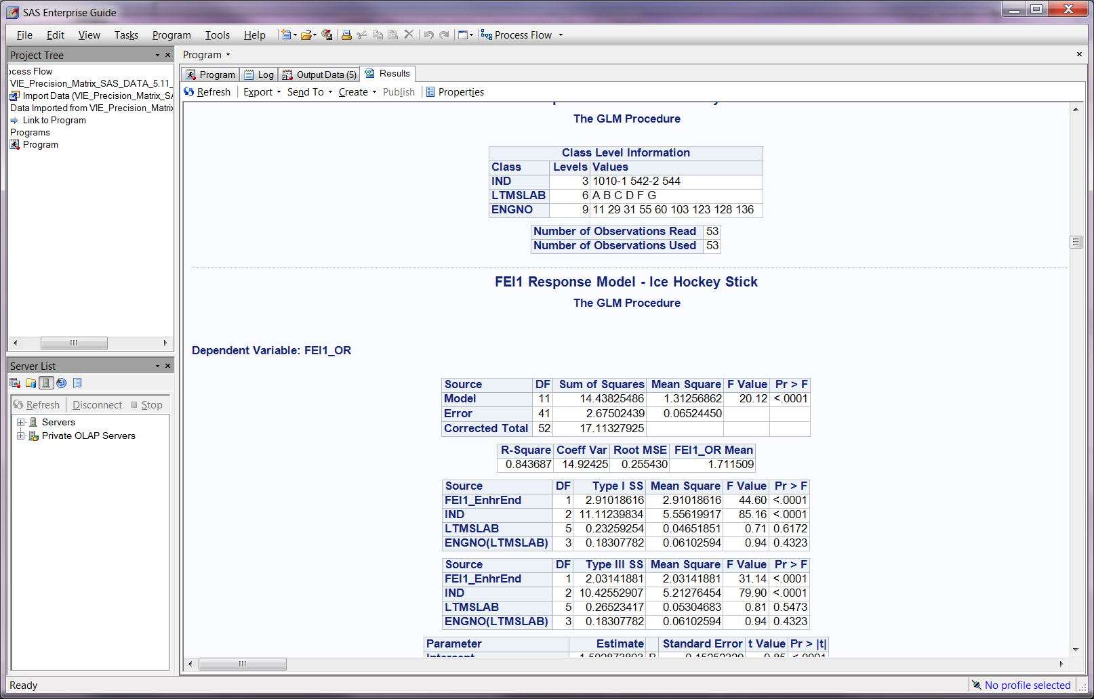
Analyzing PM Data (FEI1 – Ice Hockey Stick Model)
Overall ANOVA Summary of FEI1 data:
  FEI1_EnHrEnd & Reference Oil factors are statistically Significant
  VIE PM Test Precision: 0.26 (contrast w/ VID PM test precision of 0.12)
Notes:
Updated

Slide 40
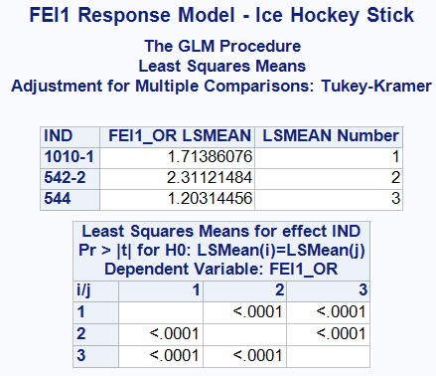
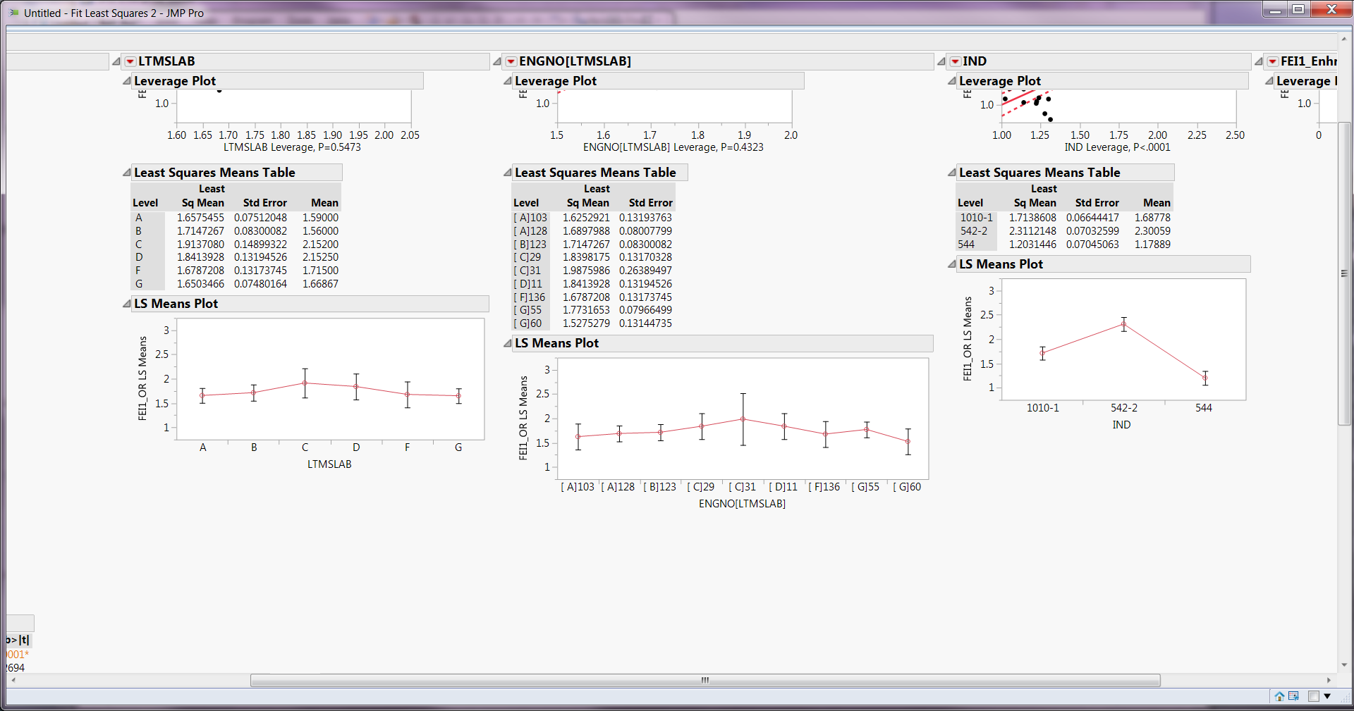

Analyzing PM Data (FEI1 – Ice Hockey Stick Model)
Difference between reference oil LsMeans for FEI1:
  All oil contrasts are significantly different
  {544 < 1010-1 < 542-2}
Notes:
Updated

Slide 41
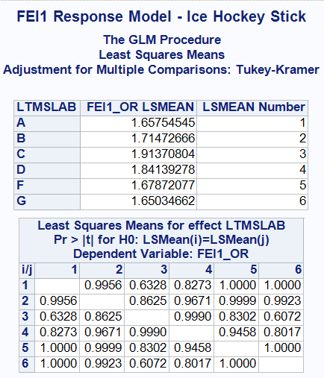
Analyzing PM Data (FEI1 – Ice Hockey Stick Model)
Difference between test Lab LSMeans for FEI1
  No significant difference between Labs
Notes:
Updated

Slide 42

Analyzing PM Data (FEI1 – Ice Hockey Stick Model)
LSMean difference between engines within the same Lab
  Contrasts: {A-103 vs. A-128}, {C-29 vs. C-31}, {G-55 vs. G-60}
  Conclusion: No Significant¹ Difference between engines within a Lab
    Lab G engines significantly differ when additional significant model terms are added (lab*oil & oil*engine hours interactions)
¹Familywise error rate critical t of 2.49 selected for 3 contrasts
Notes:
Updated

Slide 43
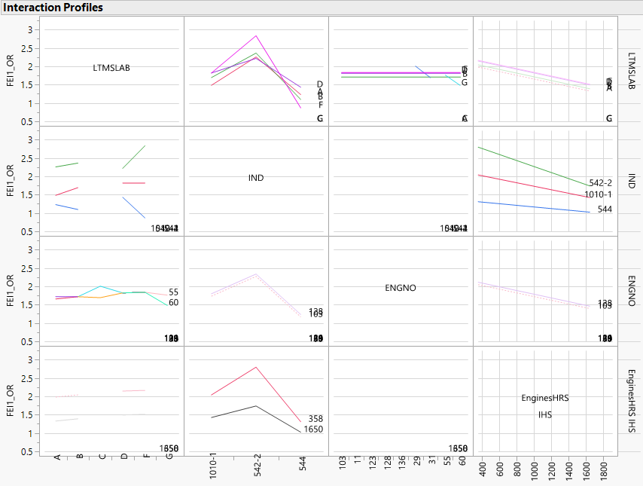
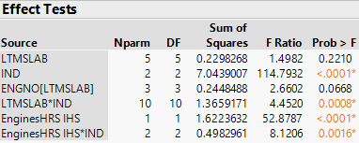
Analyzing PM Data (FEI1 – Ice Hockey Stick Model)
When additional significant model terms are added to the model (lab*oil & oil*engine hours interactions) we find that oil discrimination changes over the range of hours
Model Predicted FEI1_OR vs. Engine Hours by Oil
Model terms:
Notes:
Updated

Slide 44
FEI1 Precision (IHS Model)
Model: Oil, Lab, Engine(Lab), min(1650,EngHr)
Model RMSE
Repeatability
Reproducibility
s = 0.26
s = 0.26
R = 0.72
s = 0.26
VID Precision Matrix s=0.14
VIE Prove-out s=0.21
VID current data s=0.12
r = 0.72

Slide 45
FEI1 Precision (IHS Model)
Based upon the Seq. VIE and VID pooled standard deviations (s_{r}) and ASTM’s repeatability (r), there is no significant difference between an FEI1 result¹ of 1.3 – 2.0 for the VIE and
1.6 – 2.0 for the VID.
Note 1: An FEI1 of 2.0 was arbitrarily selected in the calculations as the upper pass/fail limit.

Slide 46
Agenda
Review PM Data for Analysis
Evaluating Baseline Weighting Scenarios
Evaluating Alternatives for Engine Hour Adjustment
Analyzing PM Data
  FEI1 – LnEngHr Model
  FEI1 – Ice Hockey Stick Model
  FEI2 – LnEngHr Model
  FEI2 – Ice Hockey Stick Model
  Comparing VIE Precision and Oil Discrimination with other Tests

Slide 47
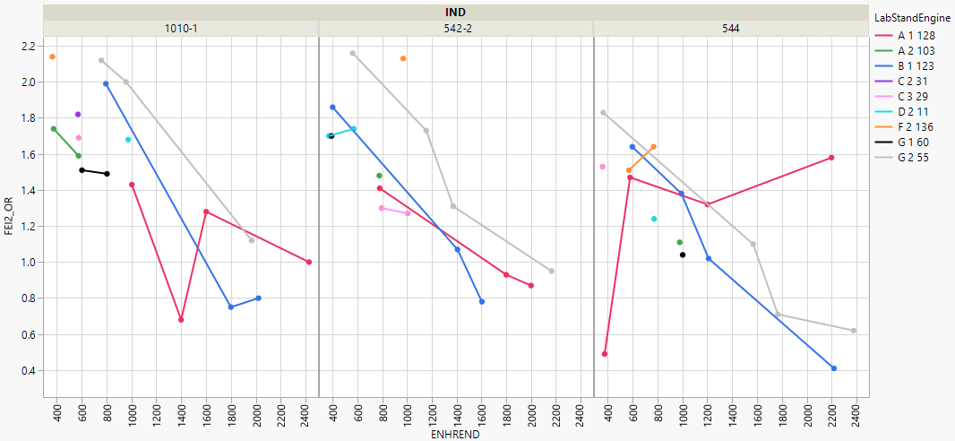
Analyzing PM Data
Plot of FEI2_OR
Notes:
Updated

Slide 48
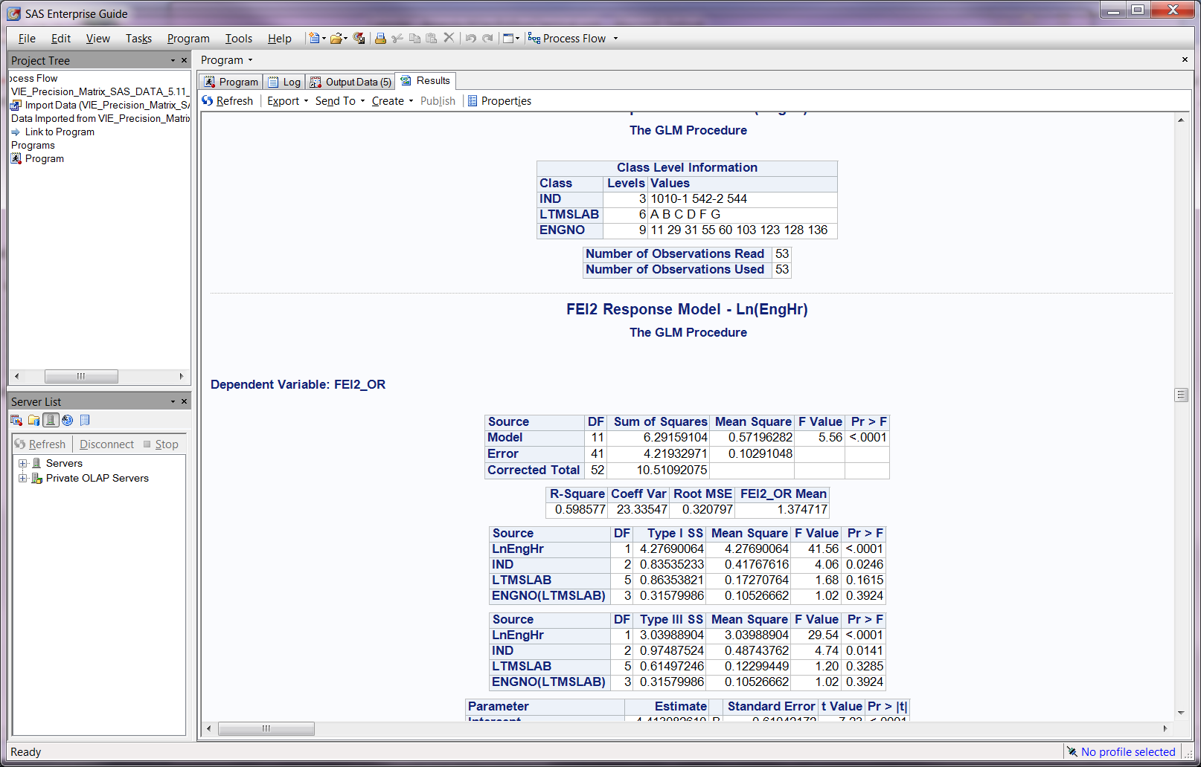
Analyzing PM Data (FEI2 – LnEngHr Model)
ANOVA Summary of FEI2 data
  Ln(EngHr) & Reference Oil factors are statistically Significant
  VIE PM Test Precision: 0.32 (contrast w/ VID PM test precision: 0.14)
Notes:
Updated!

Slide 49
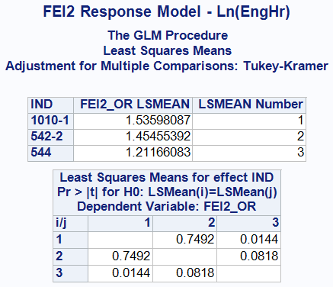
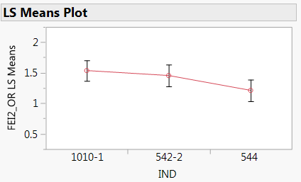
Analyzing PM Data (FEI2 – LnEngHr Model)
Difference between reference oil LSmeans for FEI2
  Significant Oil Contrast: 544 < 1010-1
Notes:
Updated

Slide 50
Analyzing PM Data (FEI2 – LnEngHr Model)
FEI2Adj Oil Discrimination by Engine
  Contrast below plot with oil ranking of {544 < 1010-1}
  Oil discrimination is not consistent across labs; in particular, Lab F, though sample size is small and inferences can be impacted by variation

Slide 51

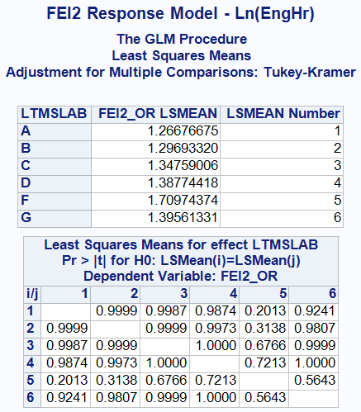
Analyzing PM Data (FEI2 – LnEngHr Model)
Difference between test Lab LSMeans for FEI2
  No significant difference between labs
Notes:
Updated

Slide 52
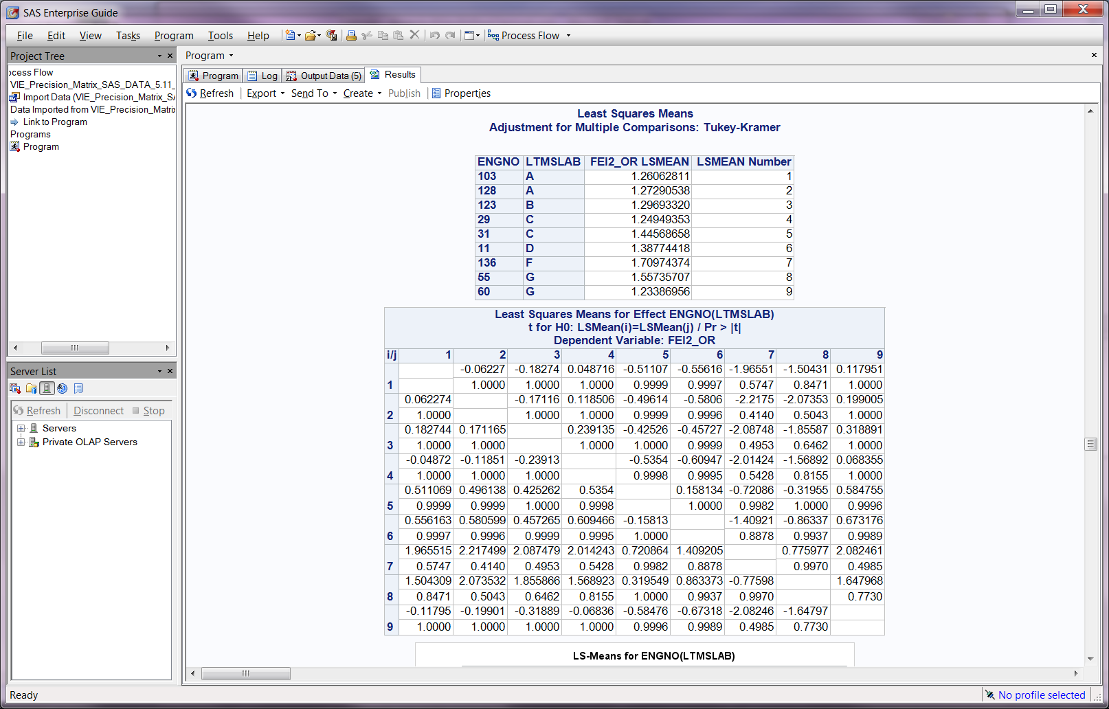
Analyzing PM Data (FEI2 – LnEngHr Model)
LSMeans difference between engines within the same Lab
  Contrasts: {A-103 vs. A-128}, {C-29 vs. C-31}, {G-55 vs. G-60}
  Conclusion: No ¹Significant Difference between engines with Lab
    Lab G engines significantly differ when additional significant model terms are added (lab*oil & oil*engine hours interactions)
¹Familywise error rate critical t of 2.49 selected for 3 contrasts
Notes:
Updated

Slide 53
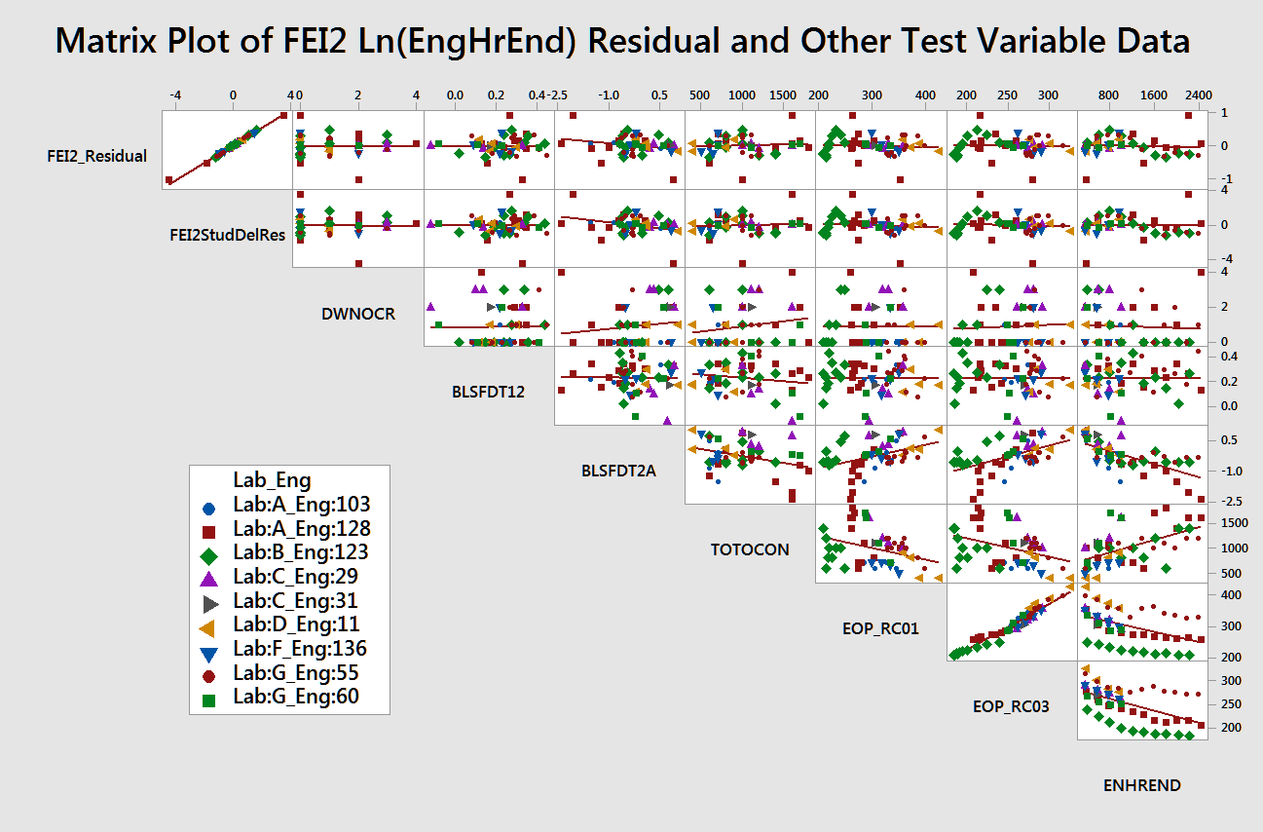
Analyzing PM Data (FEI2 – LnEngHr Model)
Matrix Plot of FEI2 residuals vs. other variables
  2 unusual studentized deleted residual results for Engine128 in Lab A
Extreme Stud Del Resid
TestKey 115022 (3.55)
TestKey 113244 (-4.47)
Notes:
NOT UPDATED!!

Slide 54
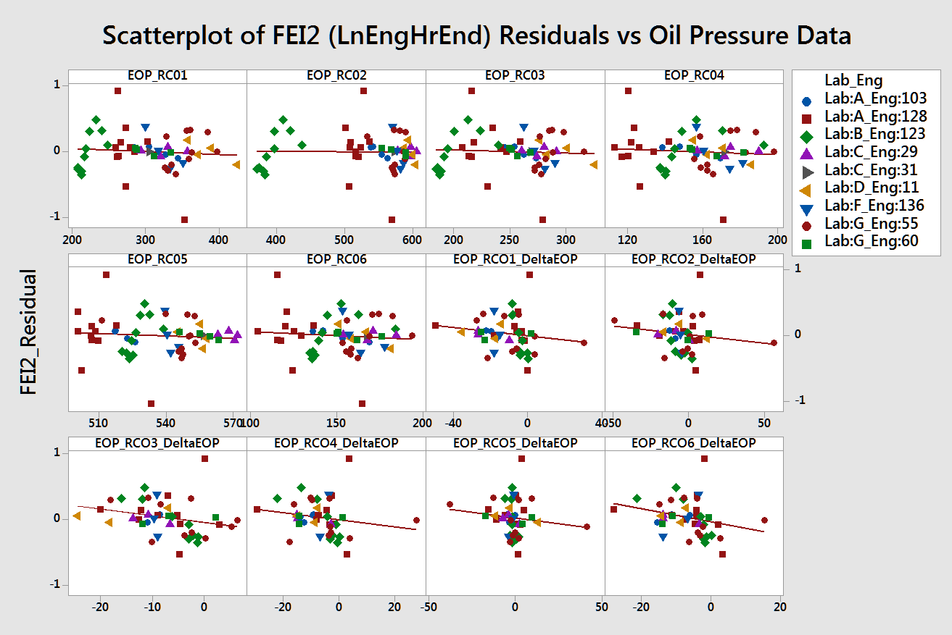
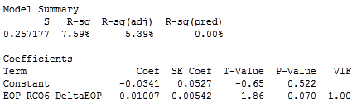
Analyzing PM Data (FEI2 – LnEngHr Model)
Plot of FEI2 residuals vs. oil pressure variable data
  Oil pressure delta_{(t)} = [Eng Oil Pressure]_{(t)}- [Eng Oil Pressure]_{(t-1)}
  Possible evidence of relationship between oil pressure delta and FEI2 residuals
Notes:
NOT UPDATED!!

Slide 55
FEI2 Precision (LnEngHr Model)
Model: Oil, Lab, Engine(Lab), LnEngHr
Model RMSE
Repeatability
Reproducibility
s = 0.32
s = 0.33
R = 0.91
s = 0.32
VID Precision Matrix s=0.16
VIE Prove-out s=0.16
VID current data s=0.13
r = 0.89

Slide 56
FEI2 Precision (LnEngHr Model)
Based upon the Seq. VIE and VID pooled standard deviations (s_{r}) and ASTM’s repeatability (r), there is no significant difference between an FEI2 result^{1,2} of 0.4 – 1.5 for the VIE and
1.0 – 1.5 for the VID.
Note 1: An FEI2 of 1.5 was arbitrarily selected in the calculations as the upper pass/fail limit.
Note 2: If the identified statistical outliers (test keys 115022 & 113244) are from a different population and not representative of real
VIE repeatability, the above statement may not represent the true precision of the test.

Slide 57
Agenda
Review PM Data for Analysis
Evaluating Baseline Weighting Scenarios
Evaluating Alternatives for Engine Hour Adjustment
Analyzing PM Data
  FEI1 – LnEngHr Model
  FEI1 – Ice Hockey Stick Model
  FEI2 – LnEngHr Model
  FEI2 – Ice Hockey Stick Model
  Comparing VIE Precision and Oil Discrimination with other Tests

Slide 58
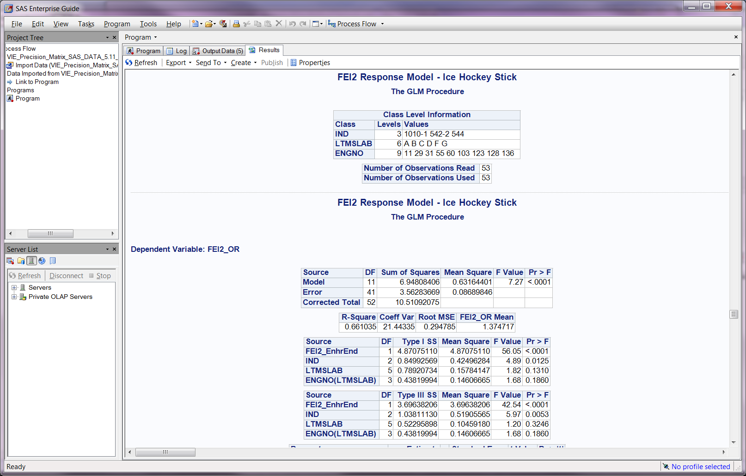
Analyzing PM Data (FEI2 – Ice Hockey Stick Model)
ANOVA Summary of FEI2 data
  FEI2_EnHrEnd & Reference Oil factors are statistically Significant
  VIE PM Test Precision: 0.29 (contrast w/ VID PM test precision: 0.14)
Notes:
Updated

Slide 59
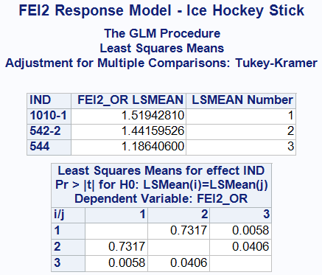
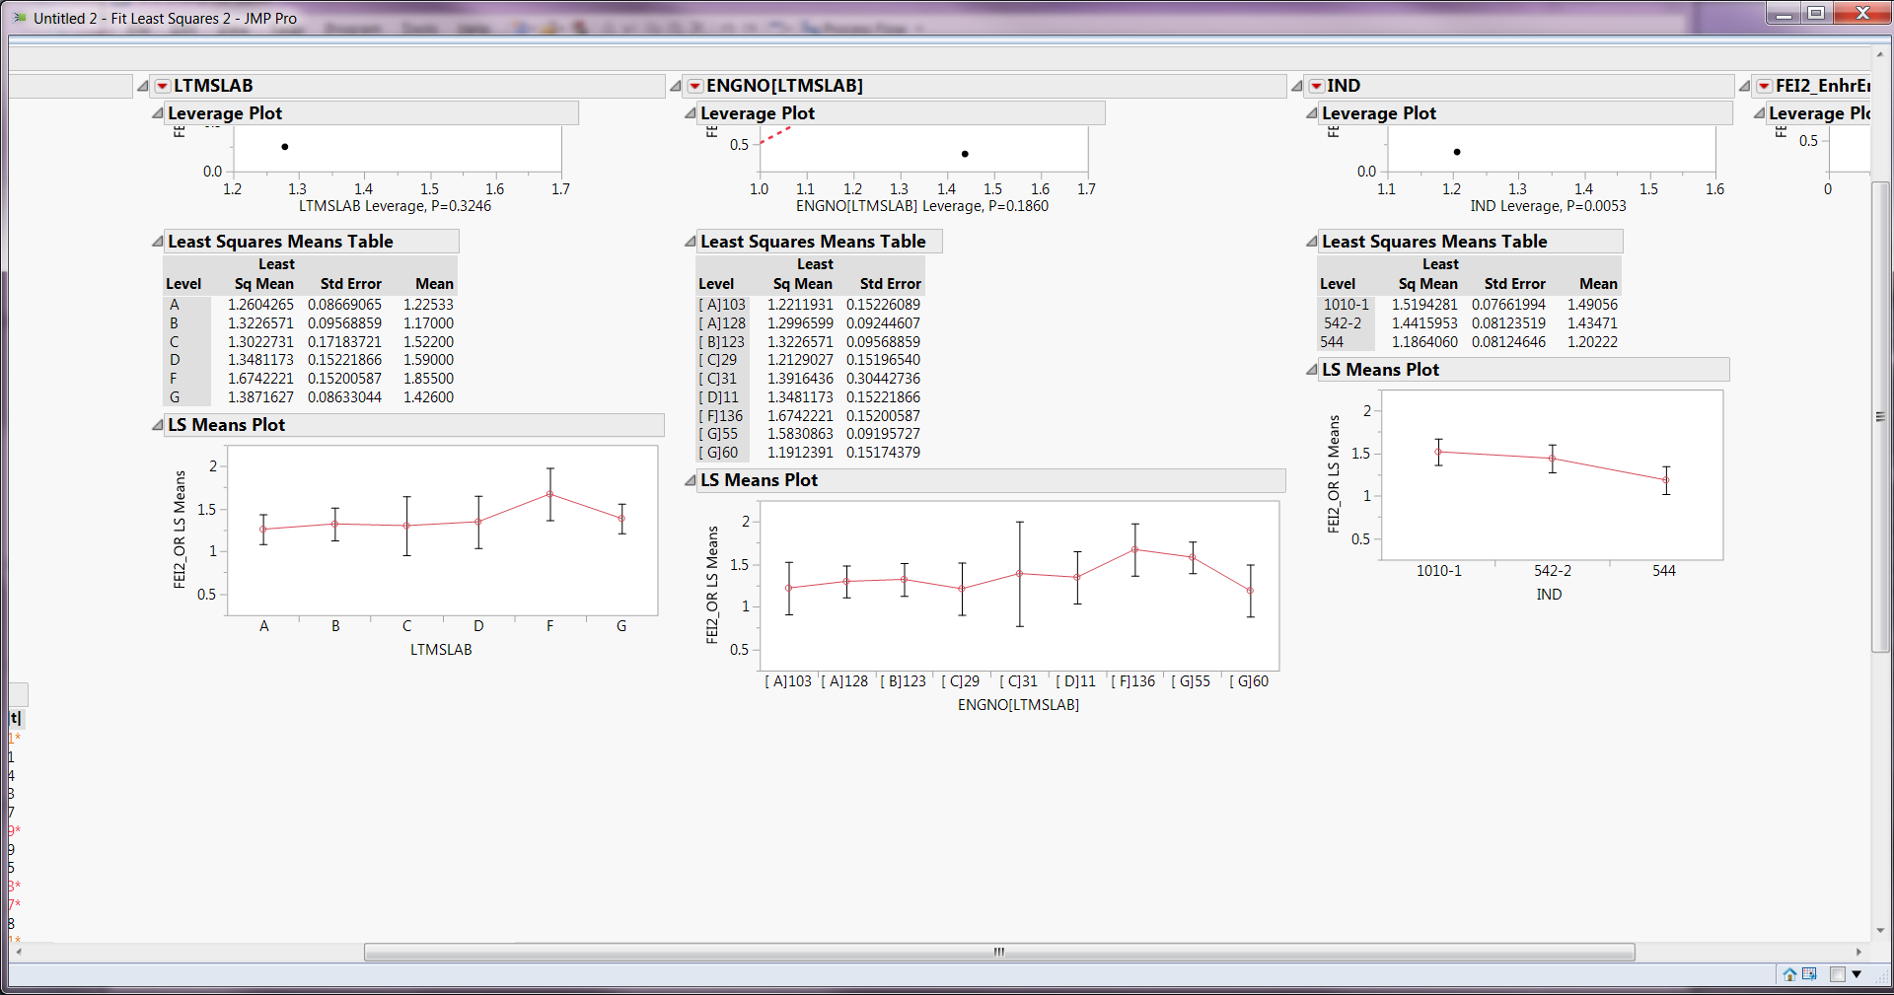
Analyzing PM Data (FEI2 – Ice Hockey Stick Model)
Difference between reference oil LSmeans for FEI2
  Significant Oil Contrast: 544 < 1010-1 and 544 < 542-2
  Higher VIE FEIs as compared to VID is partially due to correction at reduced number of engine hours
Notes:
Updated

Slide 60

Analyzing PM Data (FEI2 – Ice Hockey Stick Model)
Difference between test Lab LSMeans for FEI2
  No significant difference between labs
Notes:
Updated

Slide 61
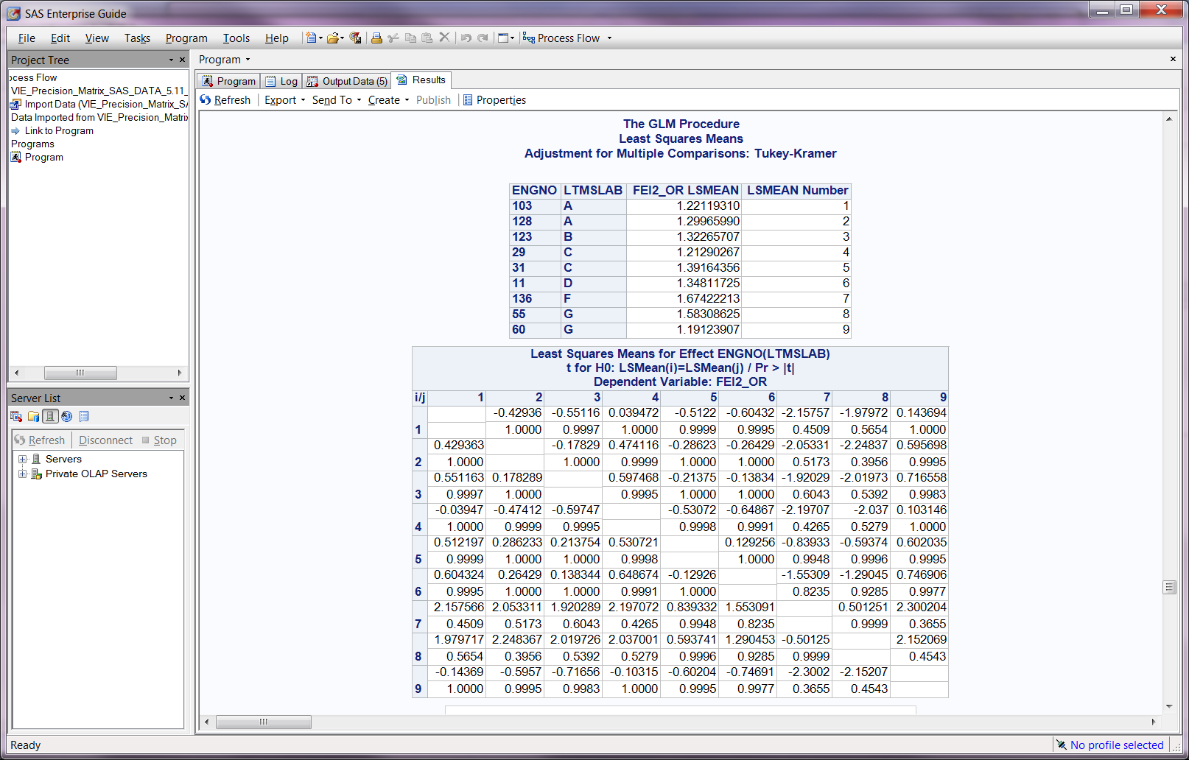
Analyzing PM Data (FEI2 – Ice Hockey Stick Model)
LSMeans difference between engines within the same Lab for FEI2
  Contrasts: {A-103 vs. A-128}, {C-29 vs. C-31}, {G-55 vs. G-60}
  Conclusion: No ¹Significant Difference between engines with Lab
    Lab G engines significantly differ when additional significant model terms are added (lab*oil & oil*engine hours interactions)
¹Familywise error rate critical t of 2.49 selected for 3 contrasts
Notes:
Updated

Slide 62
FEI2 Precision (IHS Model)
Model: Oil, Lab, Engine(Lab), Min(EngHr,1800)
Model RMSE
Repeatability
Reproducibility
s = 0.29
s = 0.31
R = 0.87
s = 0.29
VID Precision Matrix s=0.16
VIE Prove-out s=0.16
VID current data s=0.13
r = 0.81

Slide 63
FEI2 Precision (IHS Model)
Based upon the Seq. VIE and VID pooled standard deviations (s_{r}) and ASTM’s repeatability (r), there is no significant difference between an FEI1 result^{1,2} of 0.7 – 1.5 for the VIE and
1.0 – 1.5 for the VID.
Note 1: An FEI2 of 1.5 was arbitrarily selected in the calculations as the upper pass/fail limit.
Note 2: If the identified statistical outliers (test keys 115022 & 113244) are from a different population and not representative of real
VIE repeatability, the above statement may not represent the true precision of the test.

Slide 64
Agenda
Review PM Data for Analysis
Evaluating Baseline Weighting Scenarios
Evaluating Alternatives for Engine Hour Adjustment
Analyzing PM Data
  FEI1 – LnEngHr Model
  FEI1 – Ice Hockey Stick Model
  FEI2 – LnEngHr Model
  FEI2 – Ice Hockey Stick Model
  Comparing VIE Precision and Oil Discrimination with other Tests

Slide 65
Comparing VIE Precision and Oil Discrimination with other Tests
Comments
A method of measuring test precision and oil discrimination is to divide the (FEI difference of best and worst performing reference oils) by the (test precision)
The result is the # of standard deviations that separate reference oil performance
Comparing the standard deviation alone is not necessarily meaningful; what if the standard deviation is larger, but oils span a larger FEI range? This is what appears to be the case for VIE FEI1
Granted, this approach is influenced by choice of reference oils
Engine tests typically show reference oil discrimination of about 1-3 standard deviations (see next slide)
Models contain lab, engine(lab), oil, ln(ENHREND)

Slide 66
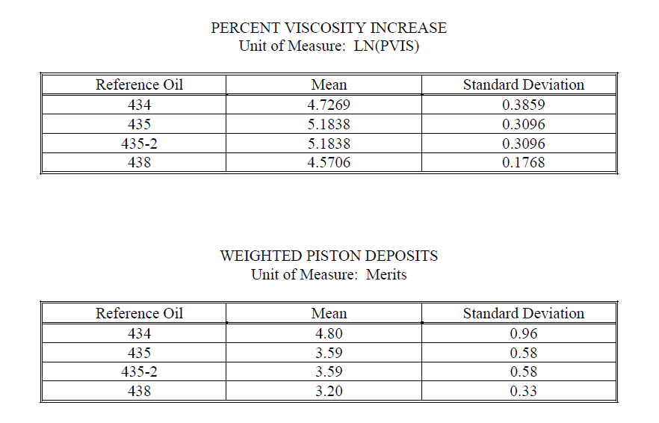
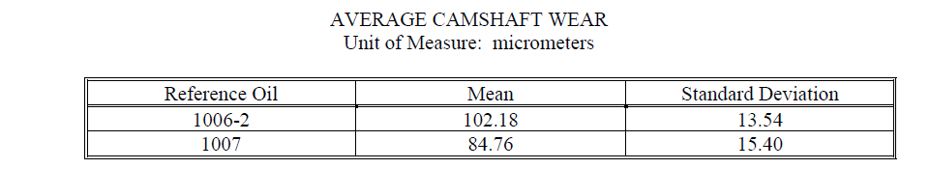
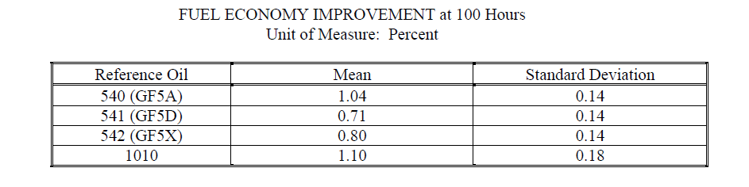
Comparing VIE Precision and Oil Discrimination with other Tests
Seq IIIG
Sequence IIIG ln(PVIS): oils separated by 2.0 standard deviations
Sequence IIIG WPD: oils separated by 2.3 standard deviations
Sequence IVA wear: oils separated by 1.2 standard deviations
Sequence VID FEI2: oils separated by 2.9 standard deviations
Seq IIIG
Seq IVA
Seq VID

Slide 67
Next Steps
Choose Engine Hour Adjustment (Ln vs IHS)
Review BLB-BLA Shift
Review Operational Data
Decide on LTMS

Slide 68
Appendix A
Evaluating FEI1 Eng Hour Adjustment Approach

Slide 69
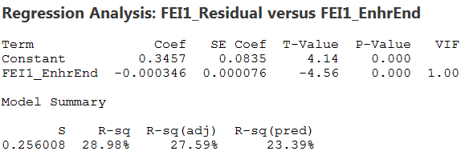
Evaluating Alternatives for FEI1 Engine Hour Adjustment
Model factors: Lab, Eng(LAB), Oil
FEI1 model residuals (y) vs. EngHrEnd [Ice Hockey Stick] (x) data are shown below
Model RMSE and Rsquare are 0.256 and 28.98, respectively
IHS EngHrEnd Transform
Notes:
Updated

Slide 70
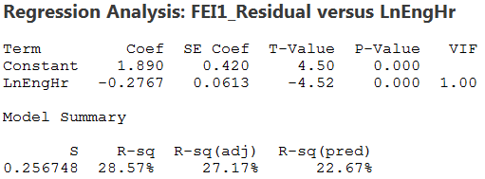
Evaluating Alternatives for FEI1 Engine Hour Adjustment
Model factors: Lab, Eng(Lab), Oil
Fit of FEI1 model residuals (y) vs. Ln(EngHrEnd) (x) data are shown below
Model RMSE and Rsquare are 0.257 and 28.57, respectively
Ln(EngHrEnd) Transform
Notes:
Updated

Slide 71
Evaluating Alternatives for FEI1 Engine Hour Adjustment
Exploring the same data set for those engines that have a higher engine hour age (with Engines 128, 123, and 55, exclusively)
The observed range of engine hour effects by engine is similar to what is observed in the VID (see Appendix D)
Notes:
Updated

Slide 72
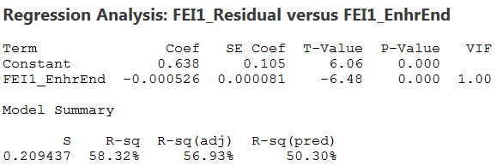
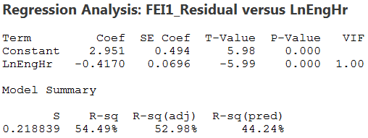
Evaluating Alternatives for FEI1 Engine Hour Adjustment
Higher aged engines have similar model fit results when comparing the Ice Hockey Stick and transformed (natural log) engine hours with respect to the FEI1 model fit residuals.
IHS EngHrEnd Transform
Ln(EngHrEnd) Transform
Notes:
Updated

Slide 73
Evaluating FEI2 Eng Hour Adjustment

Slide 74
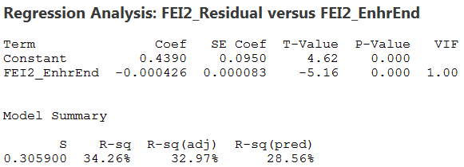
Evaluating Alternatives for FEI2 Engine Hour Adjustment
Linear fit of FEI2 model residuals (y) vs. Ice Hockey Stick EngHrEnd (x) data are shown below
Model RMSE and Rsquare are 0.306 and 34.26, respectively
IHS EngHrEnd Transform
Notes:
Updated

Slide 75
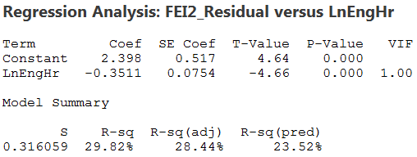
Evaluating Alternatives for FEI2 Engine Hour Adjustment
Fit of FEI2 model residuals (y) vs. Ln(EngHrEnd) (x) data are shown below
Model RMSE and Rsquare are 0.316 and 29.82, respectively
Ln(EngHrEnd) Transform
Notes:
Updated

Slide 76
Evaluating Alternatives for FEI2 Engine Hour Adjustment
Exploring the same data set for those engines that have a higher engine hour age (with Engines 128, 123, and 55, exclusively)
The observed range of engine hour effects by engine is similar to what is observed in the VID (see Appendix D)
Notes:
Updated

Slide 77
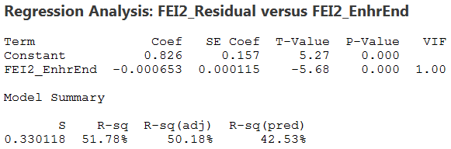

Evaluating Alternatives for FEI2 Engine Hour Adjustment
Higher aged engines have similar results when comparing the untransformed and transformed (natural log) engine hours with respect to the FEI2 model fit residuals.
IHS EngHrEnd Transform
Ln(EngHrEnd) Transform
Notes:
Updated

Slide 78
Appendix B
Residual Diagnostics for LnEngHrEnd Model

Slide 79
Outliers (included in analysis)
Model: Oil, Lab, Engine(Lab), LnEngHr
TK115022 A1 544 FEI2=1.58
TK113244 A1 544 FEI2=0.49

Slide 80

Correlation
Model: Oil, Lab, Engine(Lab), LnEngHr

Slide 81
Appendix C
Further Analyses of Reference Oil Ranking with Lab*Oil and Oil*ENHREND Interaction Terms

Slide 82

Analyzing PM Data (FEI1 – LnEngHr Model)
Notes:
Updated

Slide 83



Analyzing PM Data (FEI1 – LnEngHr Model)
Significant oil differences; oil discrimination is not consistent across labs/engines (In particular, Lab C)
Different Model specified to demonstrate oil differences by engine; had to remove Lab C’s first engine as well (52 obs)
Notes:
Updated

Slide 84
Analyzing PM Data (FEI1 – LnEngHr Model)
Oil discrimination changes over the range of hours; less discrimination at higher hours
Notes:
Updated

Slide 85
Analyzing PM Data (FEI1 – LnEngHr Model)
Lab G engines differ from one another
Notes:
Updated

Slide 86



Analyzing PM Data (FEI1 – LnEngHr Model)
Oils Differ (542-2 > 1010-1 > 544)
Notes:
Updated

Slide 87


Analyzing PM Data (FEI2 – LnEngHr Model)
Evidence of Lab G engine differences
Marginal lab difference
With 2 odd looking tests removed:
Lab G engines still differ
Oil 544 < 1010-1 & 542-2
Hours*oil becomes even less significant
Notes:
Updated

Slide 88


Analyzing PM Data (FEI1 – Ice Hockey Stick Model)
Notes:
Updated

Slide 89



Analyzing PM Data (FEI1 – Ice Hockey Stick Model)
Significant oil differences; Oil discrimination not consistent across labs/engines (In particular, Lab C)
Different Model specified to demonstrate oil differences by engine; had to remove Lab C’s first engine as well (52 obs)
Notes:
Updated

Slide 90
Analyzing PM Data (FEI1 – Ice Hockey Stick Model)
Oil discrimination changes over the range of hours; less discrimination at higher hours
Notes:
Updated

Slide 91
Analyzing PM Data (FEI1 – Ice Hockey Stick Model)
Lab G engines differ from one another
Notes:
Updated

Slide 92



Analyzing PM Data (FEI1 – Ice Hockey Stick Model)
Oils Differ (542-2 > 1010-1 > 544)
Notes:
Updated

Slide 93



Analyzing PM Data (FEI2 – Ice Hockey Stick Model)
Evidence of Lab G engine differences
Marginal lab difference
With 2 odd looking tests removed:
Lab G engines still differ
Oil 544 < 1010-1 & 542-2
Notes:
Updated

Slide 94
Appendix D
Engine Hours Effect by Engine
VID vs. VIE comparison

Slide 95
Data Considered
53 VIE valid matrix tests
572 VID test results
  LTMS file; test results through 5-6-16
  Validity codes AC, AO, OC, OO
  These data include 118 unique engines
Number of Results | Number of Engines
1 | 2
2 | 1
3 | 18
4 | 37
5 | 32
6 | 14
7 | 8
8 | 1
9 | 1
11 | 1
12 | 2
14 | 1
For example, there are 37 engines each with 4 reference test results

Slide 96


VIE FEI1 residuals vs. hours
Residuals are from modeling FEI1_OR vs. oil, lab, engine(lab)
LabStandEngine | ln(ENGHOURS) Estimate
A 1 128 | -0.23823
A 2 103 | 0.14865
B 1 123 | -0.59689
C 3 29 | -0.95117
D 2 11 | -0.31168
F 2 136 | 0.02443
G 1 60 | -0.17904
G 2 55 | -0.45233
Histogram of Engine Hours estimates

Slide 97

VID FEI1 residuals vs. hours
Residuals are from modeling FEI1_OR vs. oil, lab, engine(lab)
Histogram of Engine Hours estimates
There are 116 estimates; one for each engine.
Engines with 1 reference result don’t have an engine hours estimate.
Most VID estimates range from 0.2976 to -0.4854;
VIE estimate range from (0.1487 to -0.9512)
Range of estimates are similar between VID and VIE

Slide 98


VIE FEI2 residuals vs. hours
Residuals are from modeling FEI2_OR vs. oil, lab, engine(lab)
LabStandEngine | ln(ENGHOURS) Estimate
A 1 128 | -0.0265
A 2 103 | -0.3338
B 1 123 | -0.8852
C 3 29 | -0.5138
D 2 11 | -0.1675
F 2 136 | 0.0234
G 1 60 | -0.4293
G 2 55 | -0.7884
Histogram of Engine Hours estimates

Slide 99

VID FEI2 residuals vs. hours
Residuals are from modeling FEI2_OR vs. oil, lab, engine(lab)
Histogram of Engine Hours estimates
There are 116 estimates; one for each engine.
Engines with 1 reference result don’t have an engine hours estimate.
Most VID estimates range from 0.3155 to -0.5829;
VIE estimate range from (0.0234 to -0.8852)
Range of estimates are similar between VID and VIE

