Slide 1
Mack T-13 Oil Filter Housing Modifications
Products Technology
January 14, 2015

Slide 2
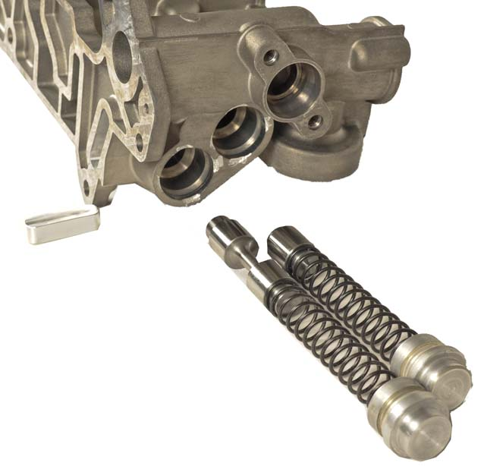
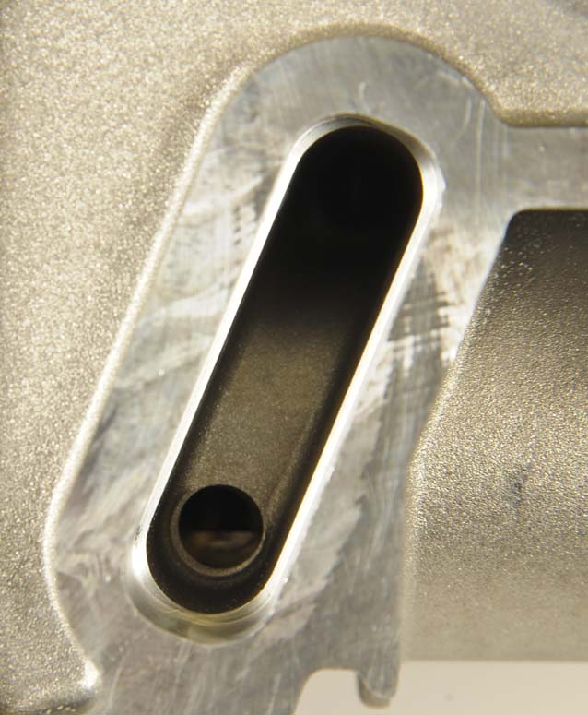
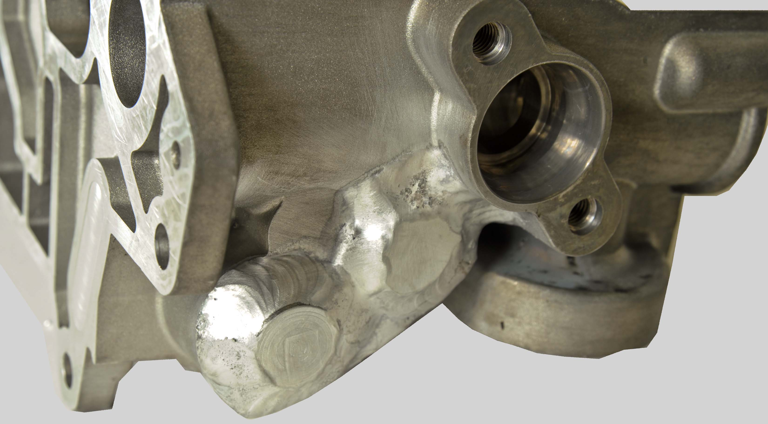
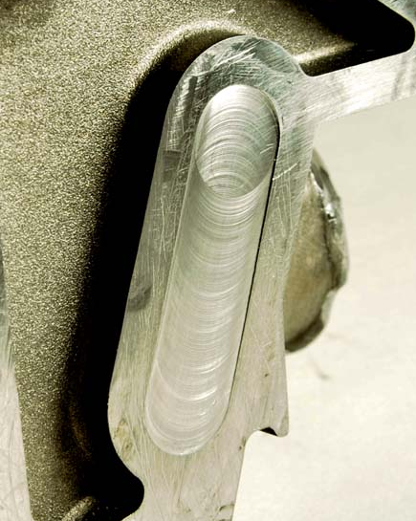
US07 Oil Filter Housing Modifications
Removal of Piston Cooling Jet Control Valves
Modifications
Remove plungers and springs of Opening and Control Valves (A)
Block-off drains of Opening and Control Valves (B)
Seal bores of Opening and Control Valves (C)
Opening Valve Spring and Plunger
Drain Plug
Control Valve Spring and Plunger
Opening and Control Valve Bore Plugs
Drain Holes
(A)
(B)
(C)
Notes:
Presenter Notes

Slide 3
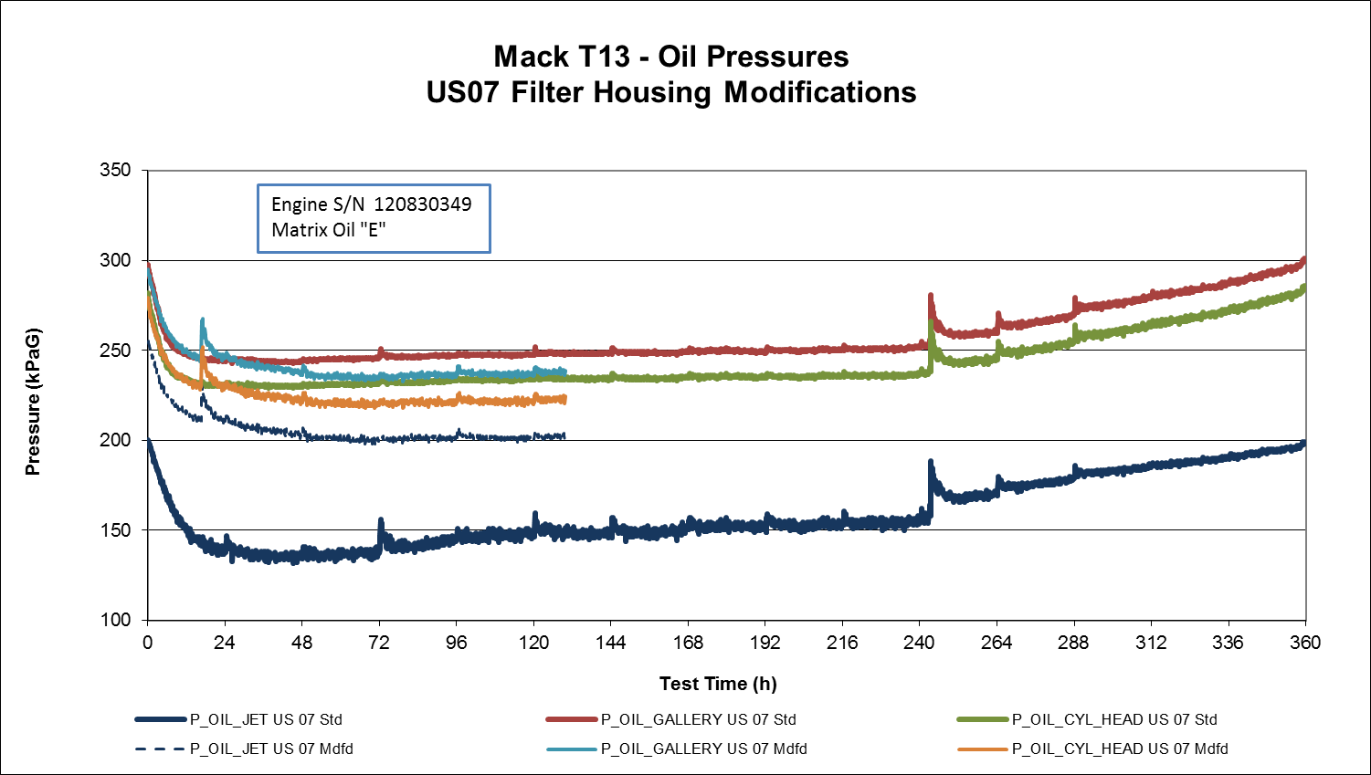
US07 Oil Filter Housing Modifications
Oil Pressure Comparison
Notes:
Presenter Notes

