Slide 1
T-13 RO 824 Target
Philip Rocco Scinto
Lubrizol
March 26, 2025

Slide 2
RO 824 ‘Prelim’ Targets
No change in ICF

Slide 3
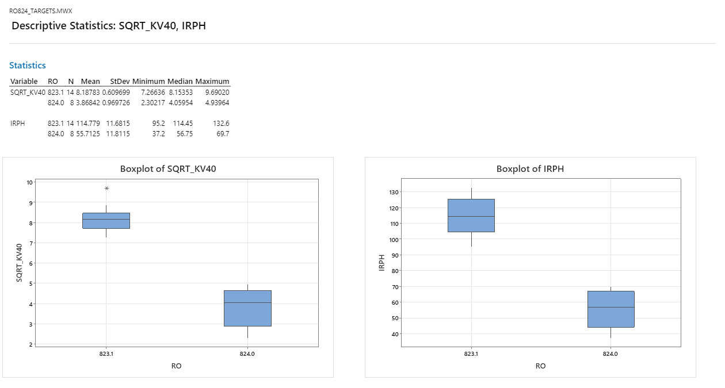
Summary Statistics

Slide 4
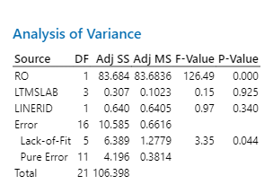
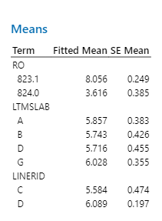
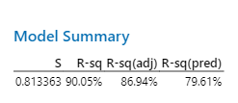
SQRT(KV40)

Slide 5
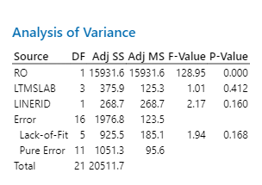
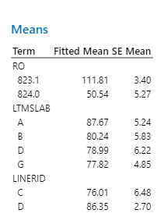
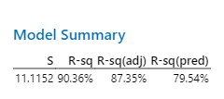
IRPH

