Slide 1
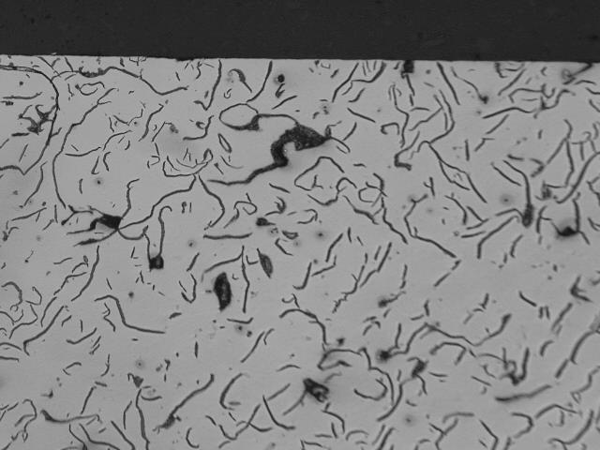
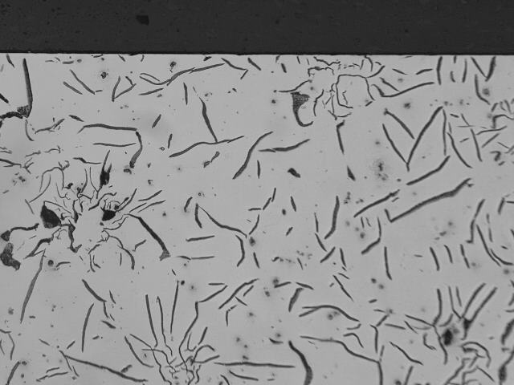
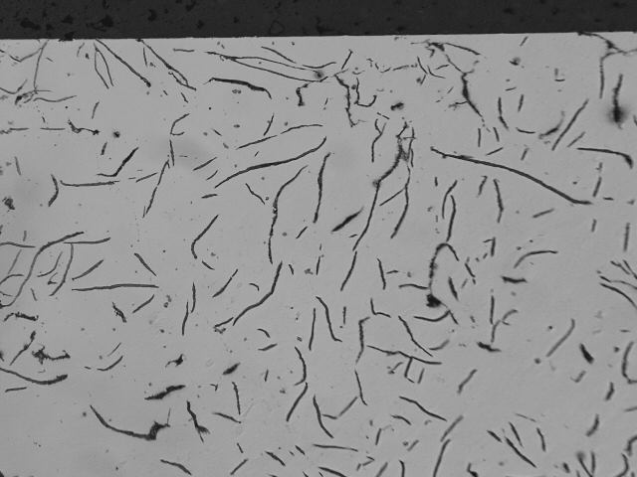
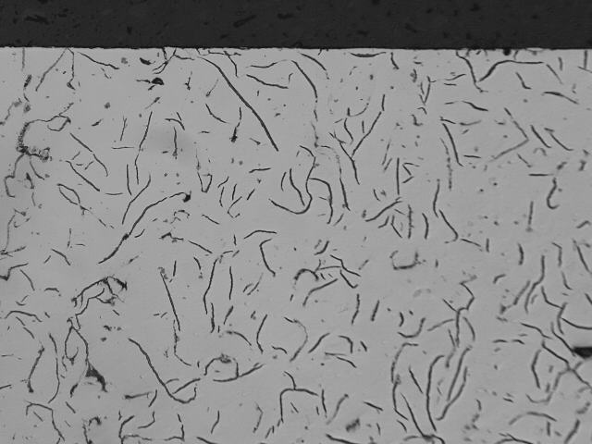
*Top of Liners
As Polished microstructure 100X
*After re-polishing
Cyl. Bore
surface
New TUXO 100X
S 100X
R 100X
LZ-TUXO 100X

Slide 2
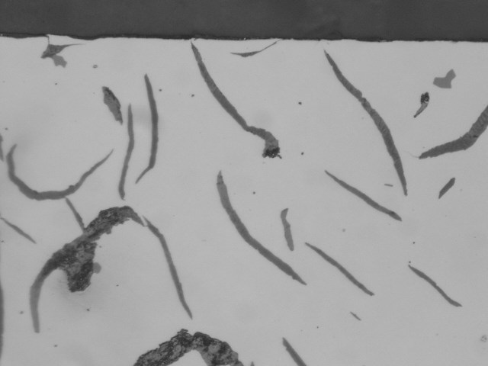
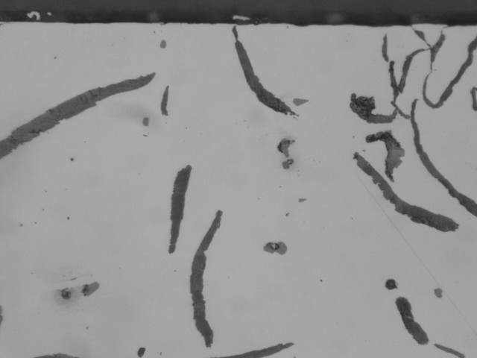
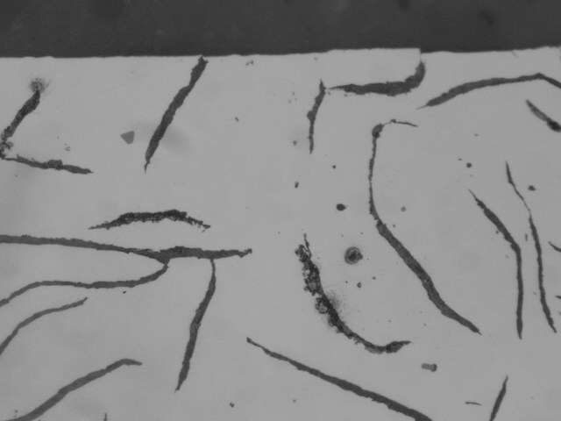
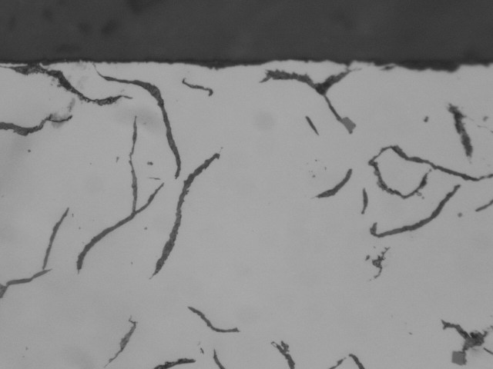
*Top of Liners
As Polished microstructure 500X
*After re-polishing
New TUXO 100X
S 100X
R 100X
LZ - TUXO 100X

Slide 3
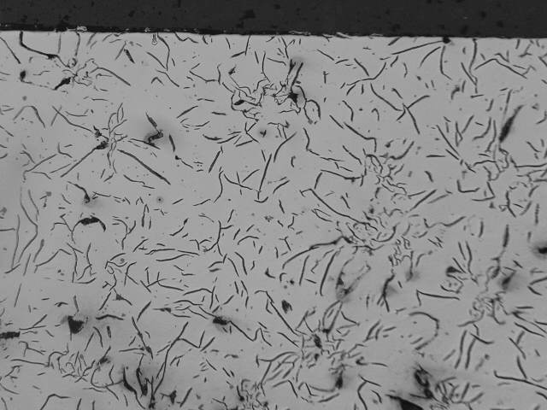
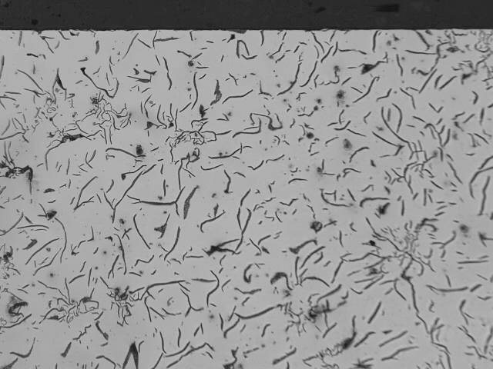
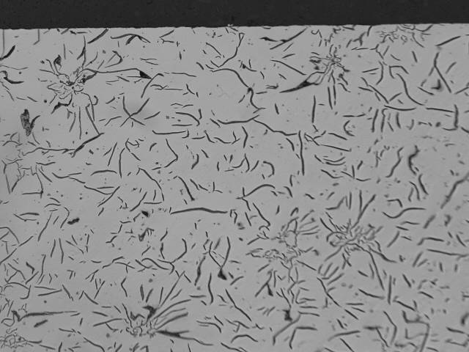
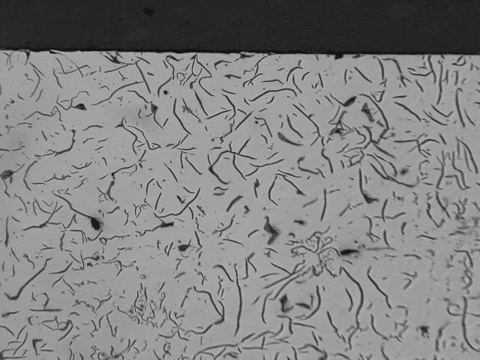
*Bottom of Liners
As Polished microstructure 100X
*After re-polishing
New TUXO 100X
S 100X
R 100X
LZ -TUXO 100X

Slide 4
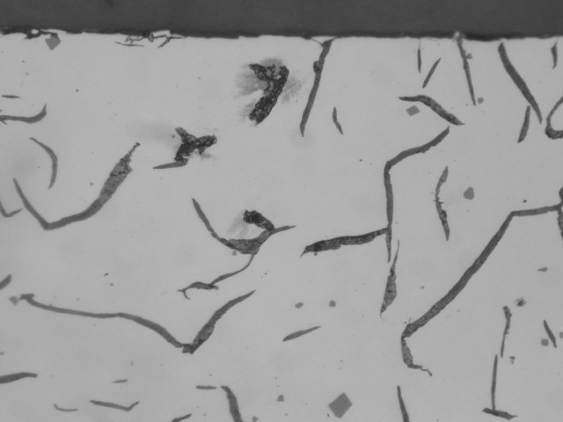
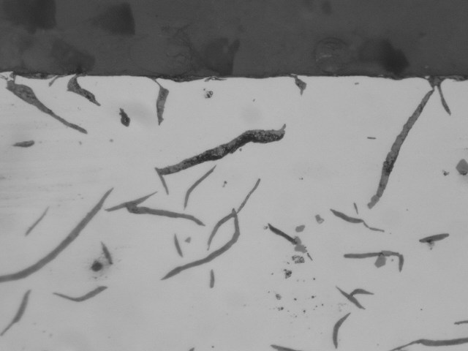
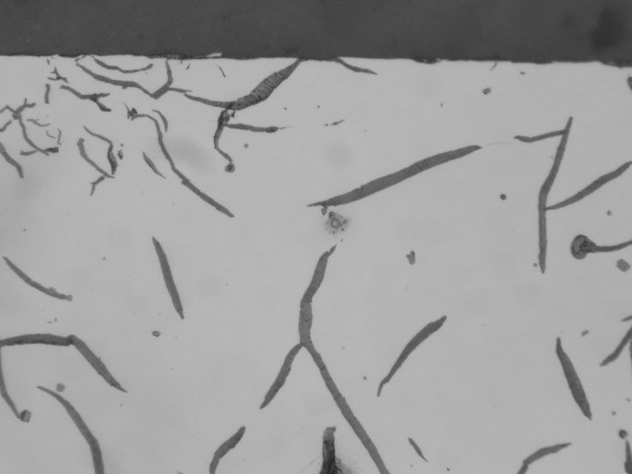
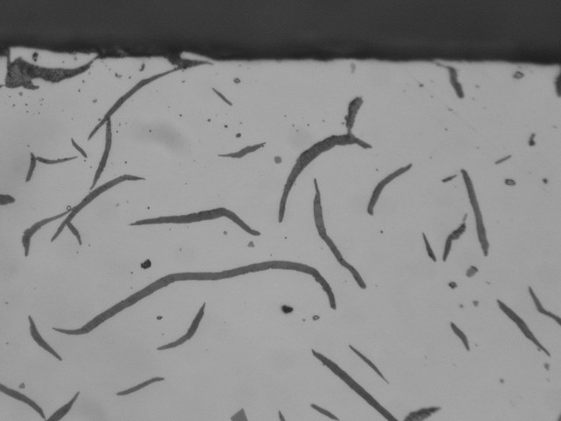
*Bottom of Liners
As Polished microstructure 500X
*After re-polishing
Cyl. Bore surface
New TUXO 500X
S 500X
R 500X
LZ -TUXO 500X

