Slide 1
Mack T-12
Industry Correction Factors
Revisited
May 11, 2012
Presented to Mack Surveillance Panel
Notes:
Notes go here.

Slide 2
Narrative
We have ten additional chartable reference tests since the last correction factor update.
We should base correction factors on improved (V2) principles but don’t have the patience for it right now.
It looks like the most recent 10 tests are less scattered than previous tests with STxN hardware for leads, OC, and ALW.
TRWL and MRV each has at least one questionable result in the last 10 tests.
The proposed CF’s use the most recent tests but show calculations using all available tests for comparison.

Slide 3
Reference Data
Since our last change to industry correction factors, we have accumulated 10 chartable reference tests.

Slide 4
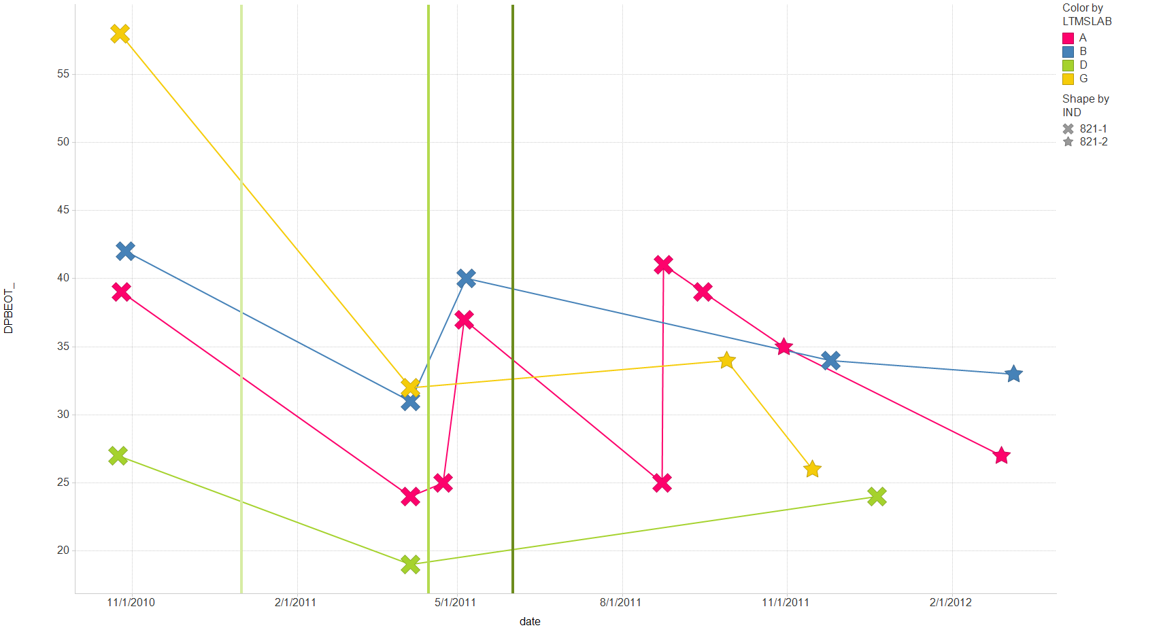
STVN
STWN->

Slide 5
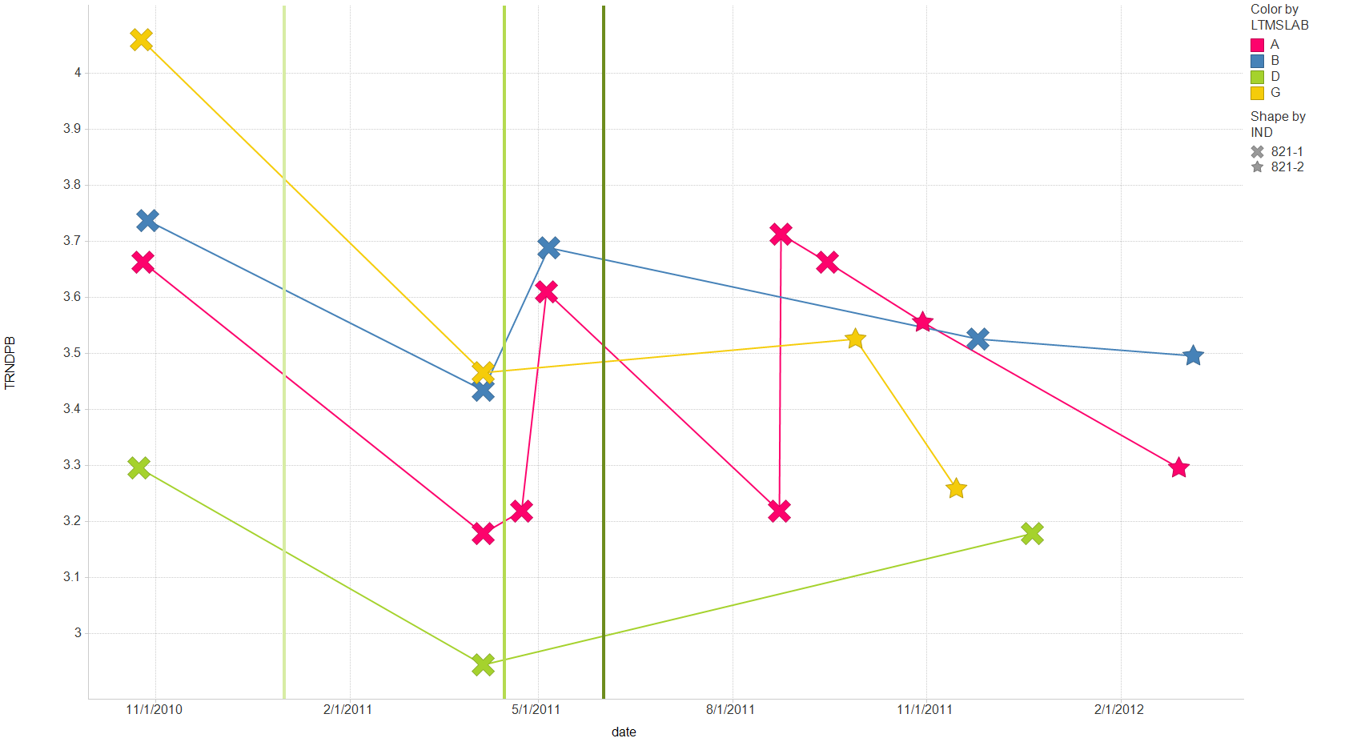
STVN
STWN->

Slide 6
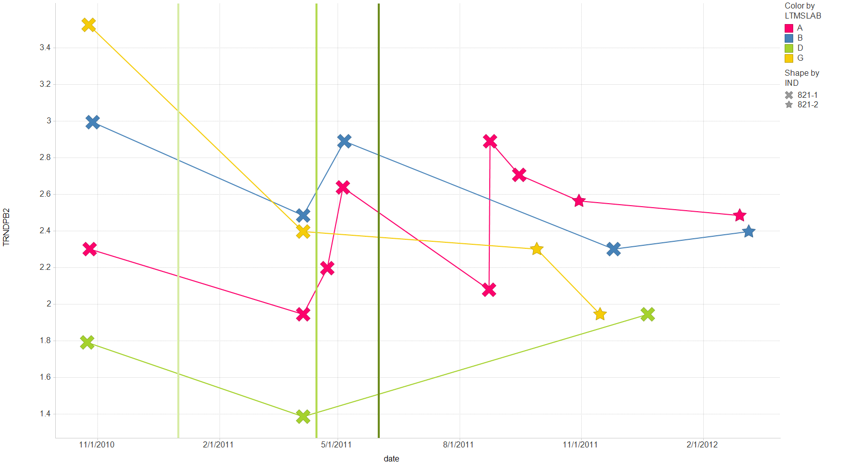
STVN
STWN->

Slide 7
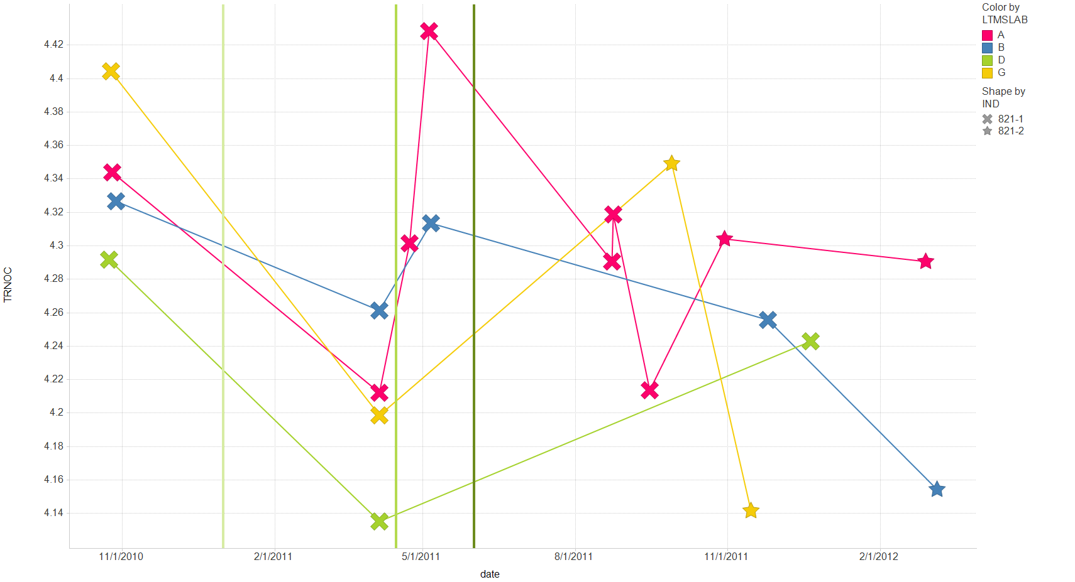
STVN
STWN->

Slide 8
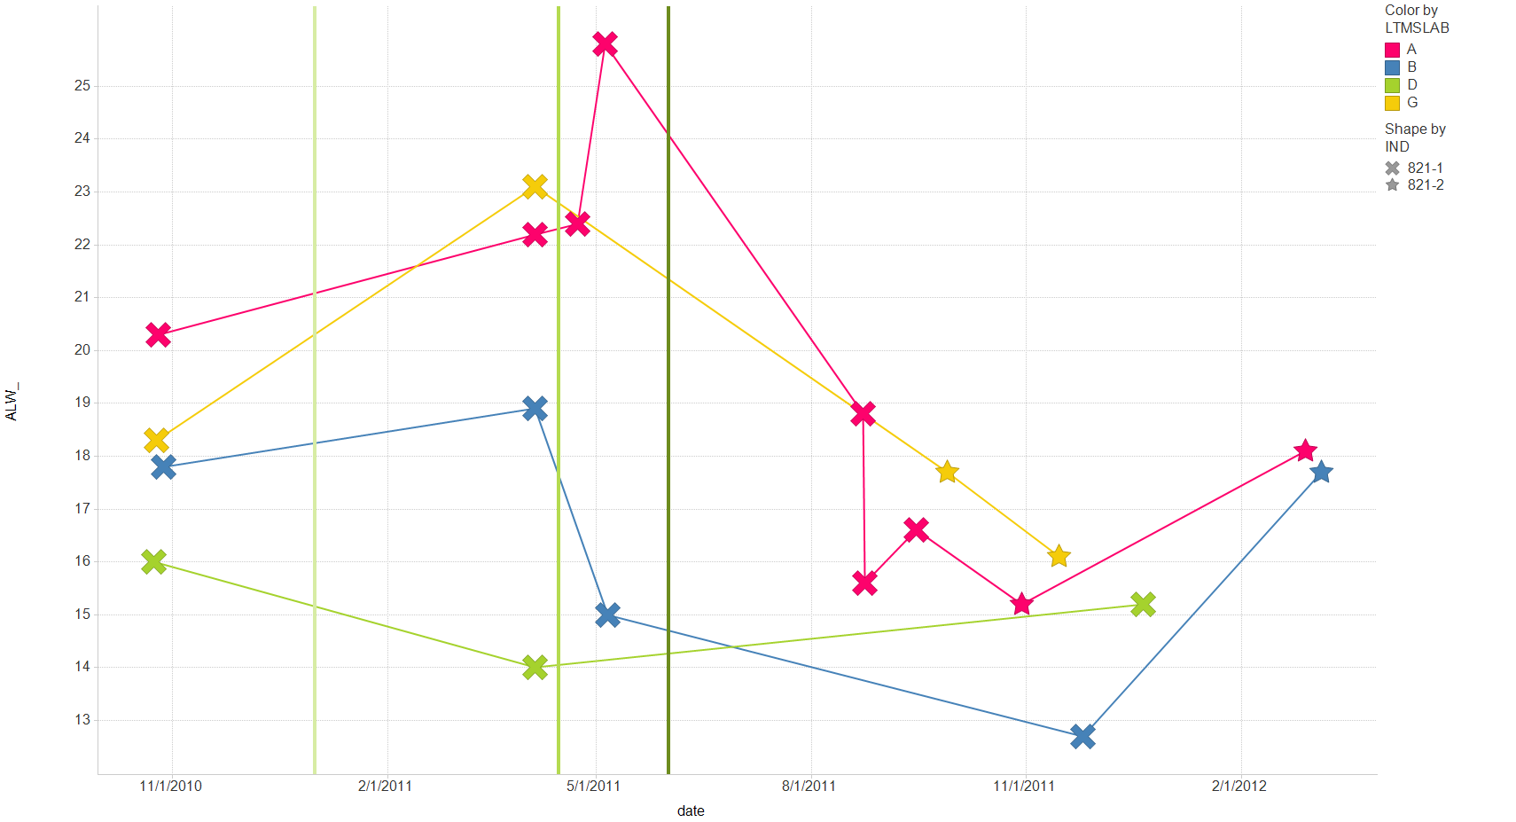
STVN
STWN->

Slide 9
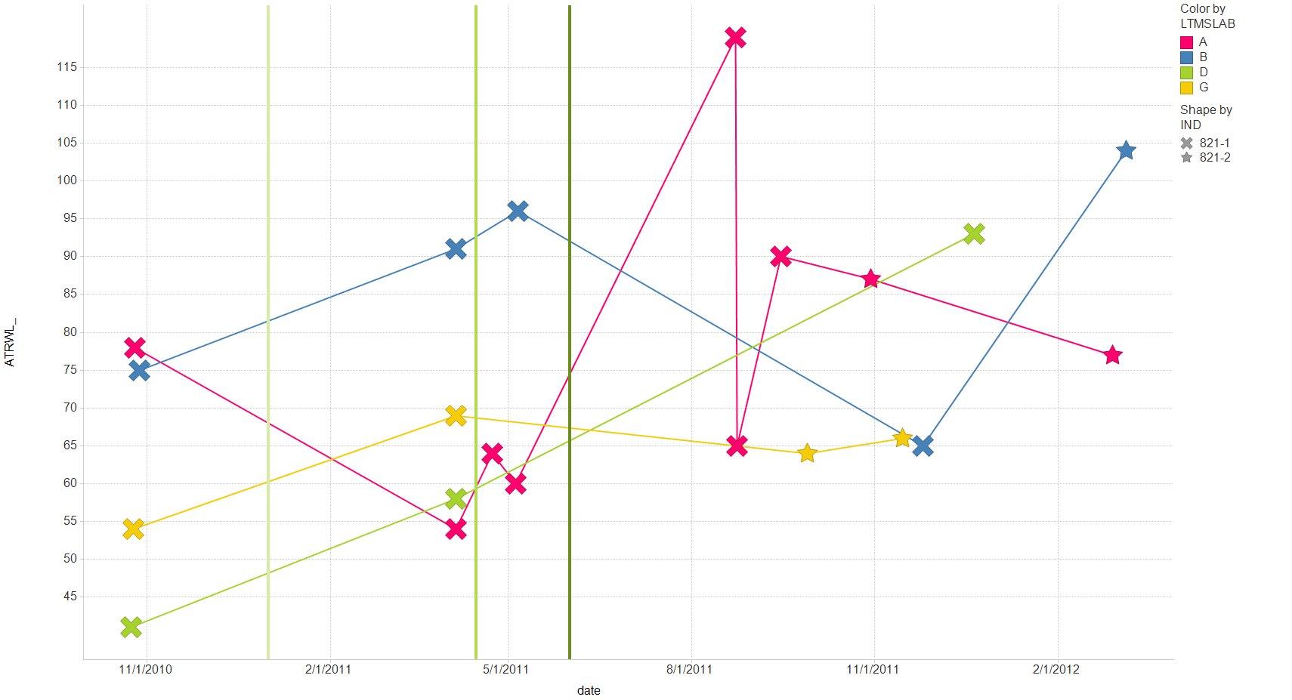
STVN
STWN->

Slide 10
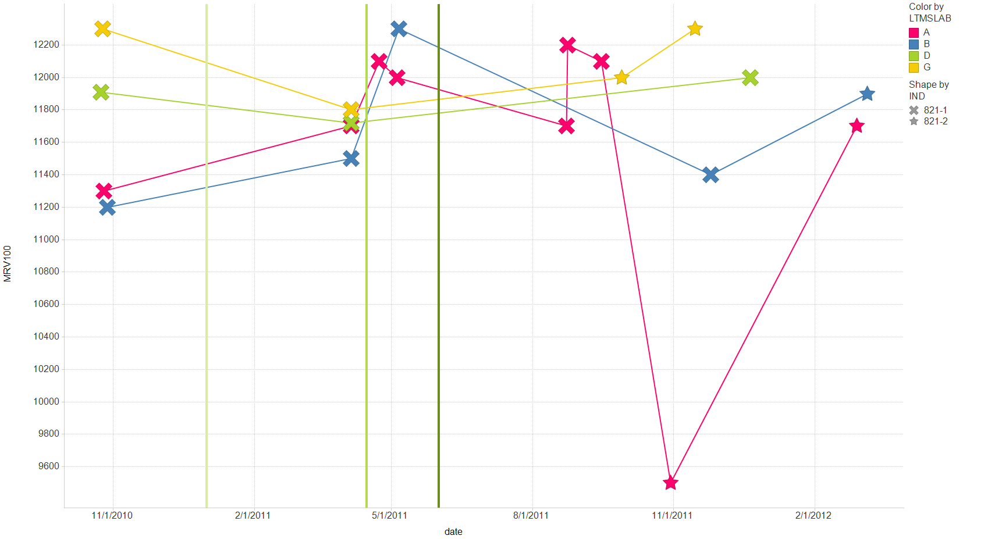
STVN
STWN->

Slide 11
Proposed Correction Factors
 |  |  |  | TRNDPB | ALW_ | ATRWL_ | TRNOC | TRNDPB2 | MRV100
Current Average (4/5/2011) |  |  |  | 3.2556 | 18.8 | 65 | 4.2718 | 2.0538 | 11790
 |  | -- 4 tests for Pb, 8 for others
 | current | target |  | 3.106 | 16.2 | 62 | 4.093 | 2.125 | 11736
 |  | icf |  | 0.95 | 0.86 | 0.95 | 0.96 | 1.03 | 1.00
 | original | target |  | 3.259 | 15.1 | 66 | 4.083 | 2.251
 |  | icf |  | 1.00 | 0.80 | 1.02 | 0.96 | 1.10
Update? Average (5/19/2011) |  |  |  | 3.3630 | 19.4 | 67 | 4.2925 | 2.2774 | 11802
 |  | -- 7 tests for Pb, 11 for others
 | current | target |  | 3.106 | 16.2 | 62 | 4.093 | 2.125 | 11736
 |  | icf |  | 0.92 | 0.83 | 0.92 | 0.95 | 0.93 | 0.99
Update Again? Average (today) |  |  |  | 3.443 | 16.4 | 83 | 4.256 | 2.362 | 11680
 |  | -- 10 most recent tests |  |  |  | 79 |  |  | 11922
 | current | target |  | 3.106 | 16.2 | 62 | 4.093 | 2.125 | 11736
 |  | icf |  | 0.90 | 0.99 | 0.75 | 0.96 | 0.90 | 1.00
 |  |  |  |  |  | 0.78 |  |  | 0.98
Update Again? Average (today) |  |  |  | 3.264 | 17.2 | 71 | 4.129 | 2.239 | 11256
 |  | -- 17 tests for Pb, 21 for others |  |  |  |  |  |  | 11744
 | current | target |  | 3.106 | 16.2 | 62 | 4.093 | 2.125 | 11736
 |  | icf |  | 0.95 | 0.94 | 0.88 | 0.99 | 0.95 | 1.04
 |  |  |  |  |  |  |  |  | 1.00
proposal

