Slide 1
Mack T-8 Reference Data
September 8, 2011
Jim Rutherford

Slide 2
Process
Calculate initial 1004-3 targets and standard deviations arithmetically from all (13) 1998 tests at labs G and J.
Apply LTMS V2 up to start of 1005-2 (June 2007)
Apply severity adjustment from step 2 to 1005 target data set and calculate targets and standard deviations. Using all 1005-2 (10) tests (debatable):
Current Z_{i} = ICF + sa. If sa=0 (debatable):
We could debate what belongs in 1005 target data set and the relationship between ICF and severity adjustments.

Slide 3
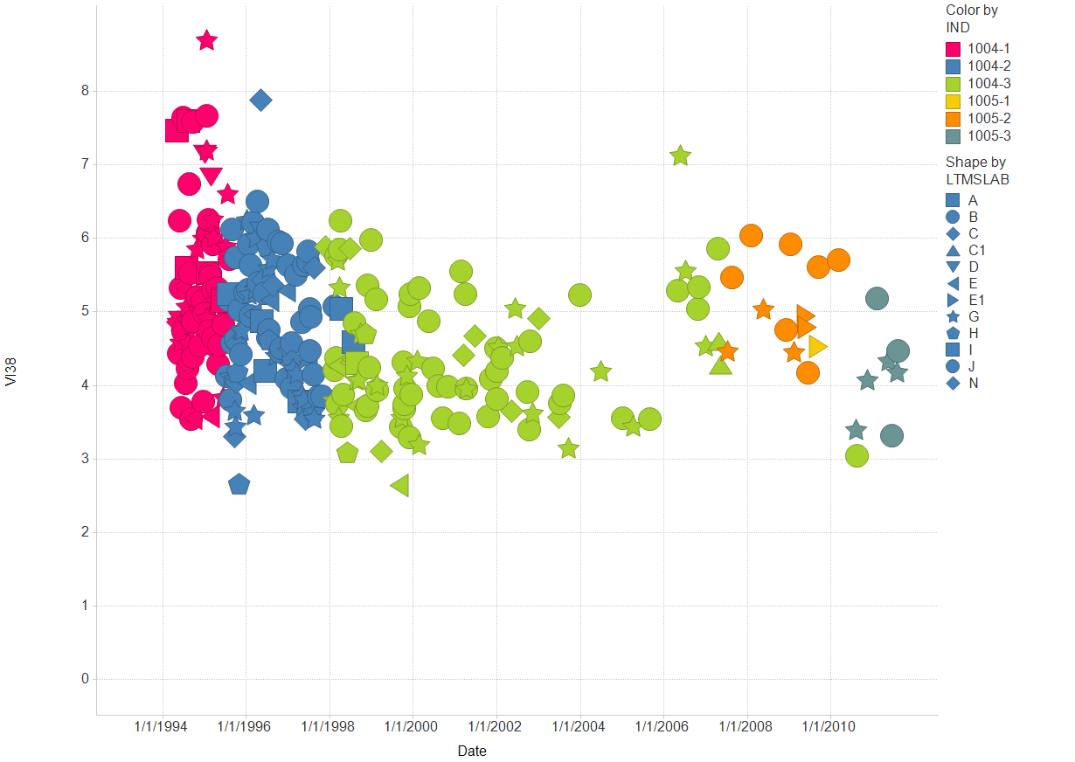
Filter Settings
- CHART: ( Y)

Slide 4
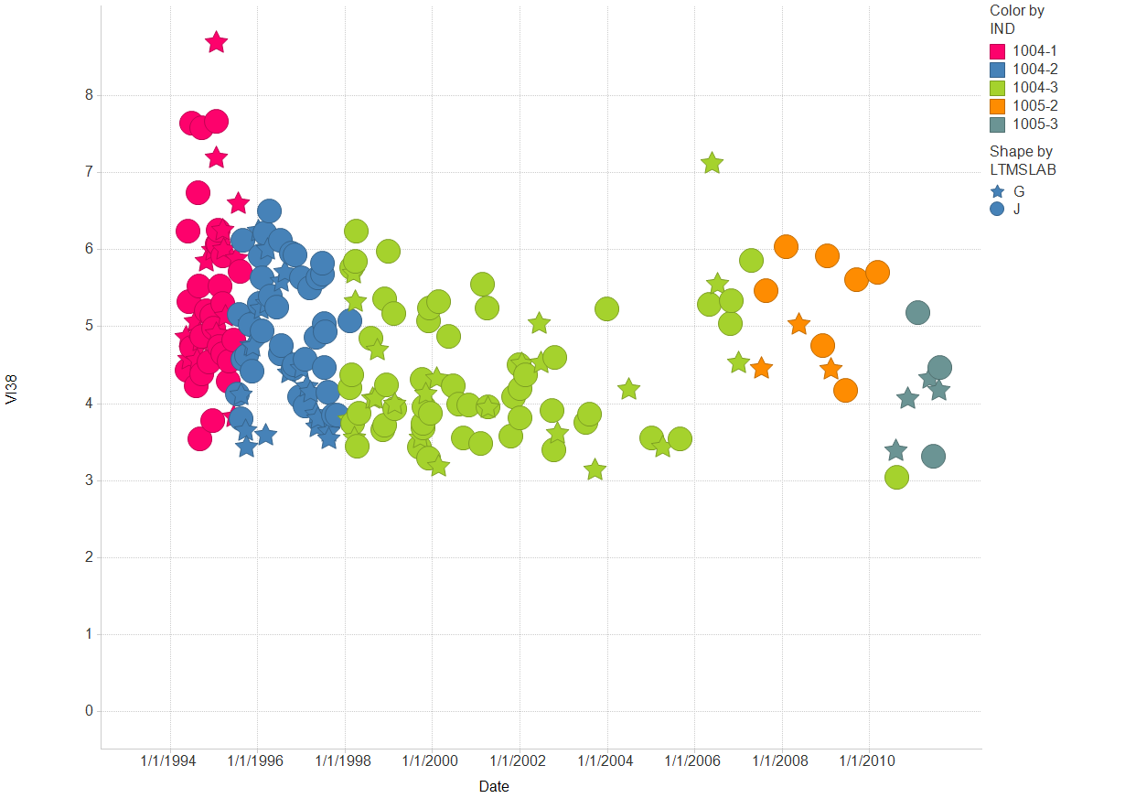
Filter Settings
- LTMSLAB: ( G , J )
- CHART: ( Y)

Slide 5
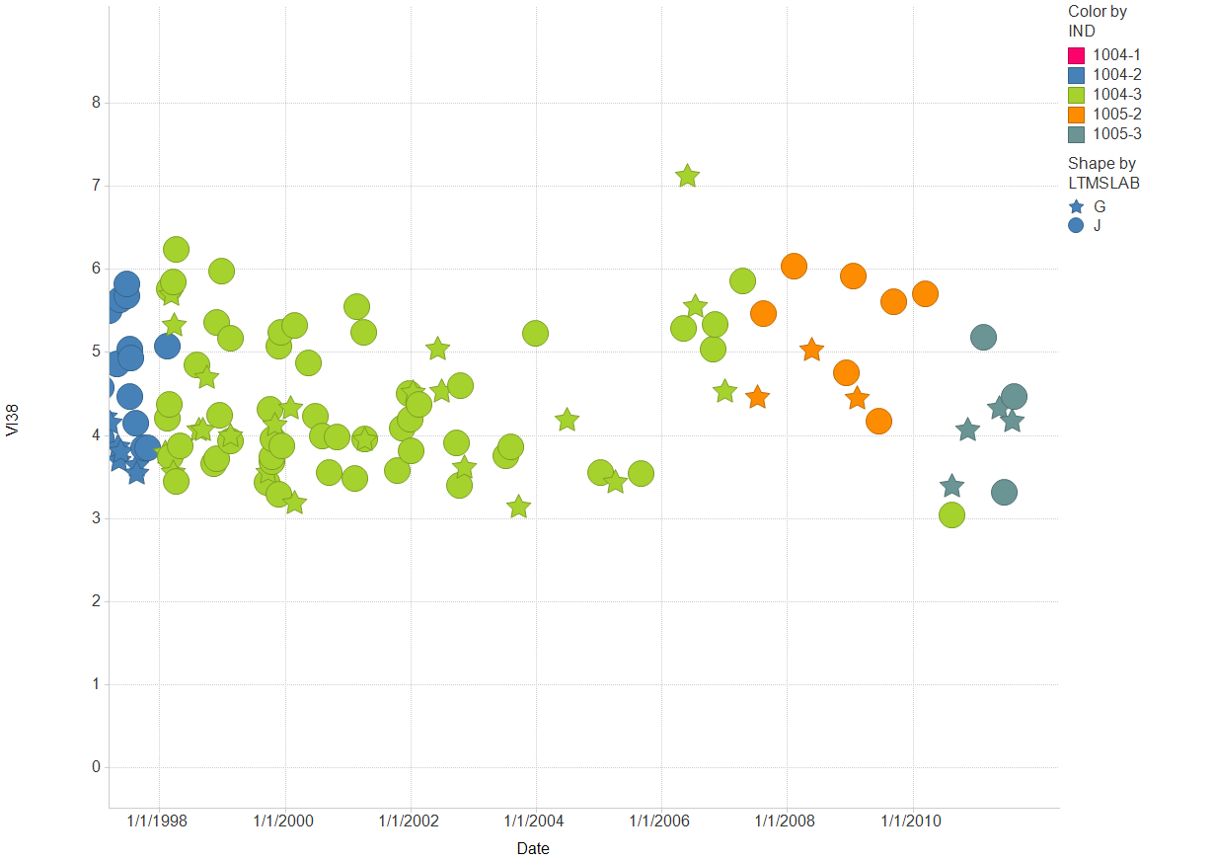
Filter Settings
- LTMSLAB: ( G , J )
- CHART: ( Y)

Slide 6
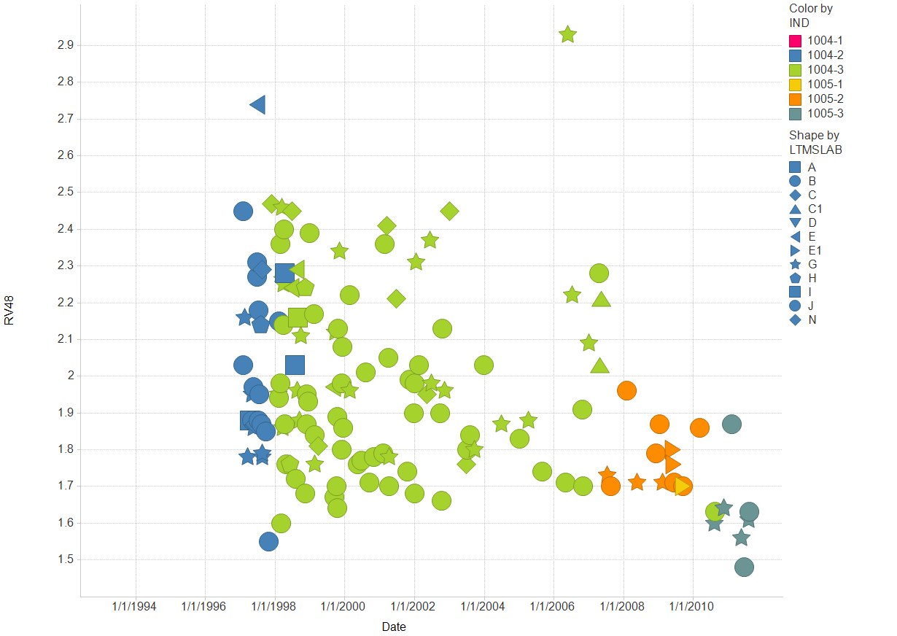
Filter Settings
- CHART: ( Y)

Slide 7
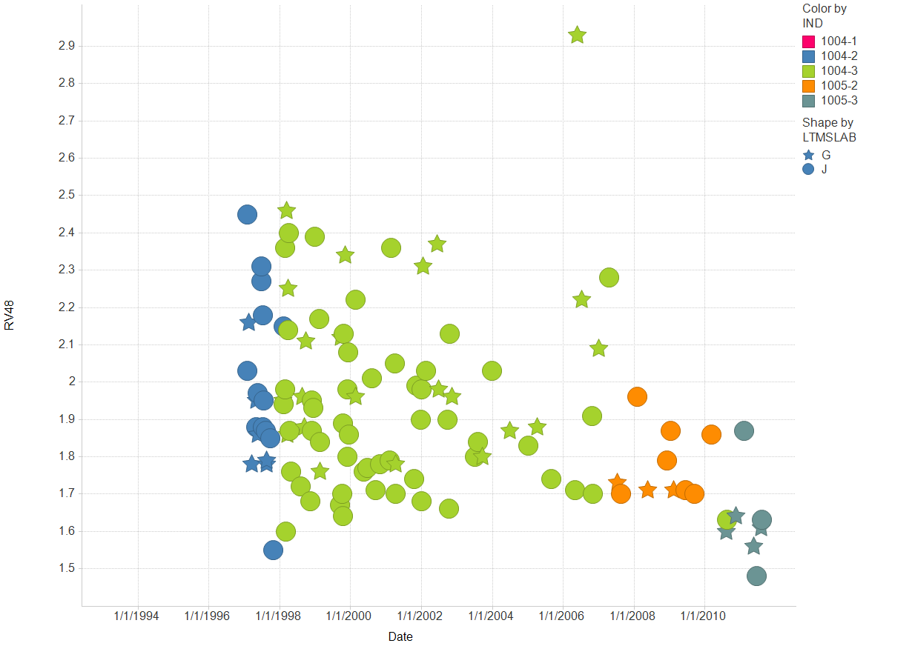
Filter Settings
- LTMSLAB: ( G , J )
- CHART: ( Y)

Slide 8
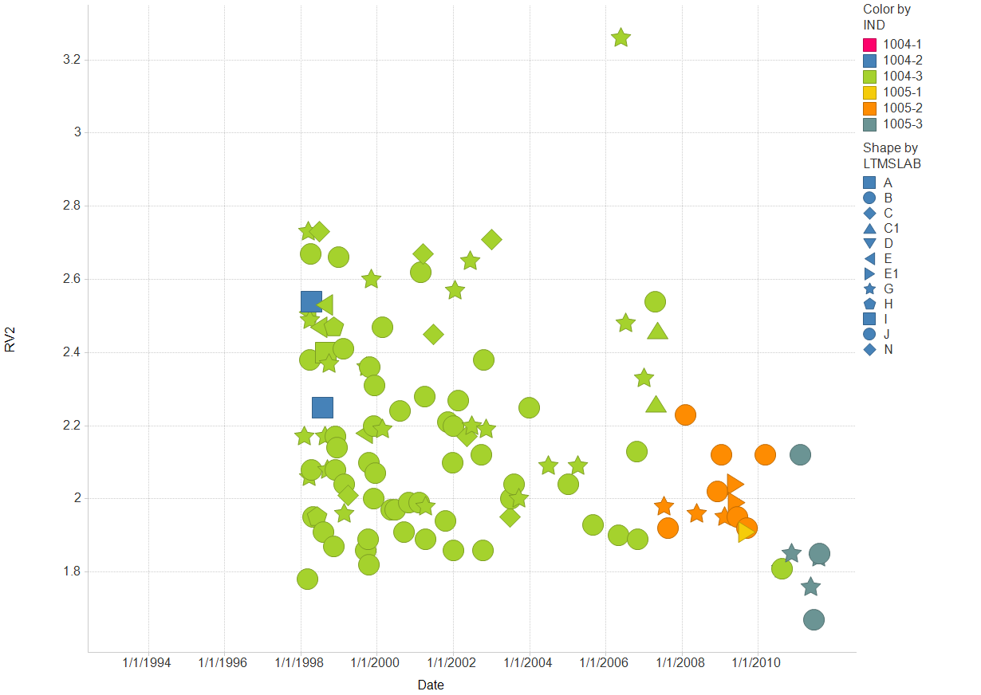
Filter Settings
- CHART: ( Y)

Slide 9
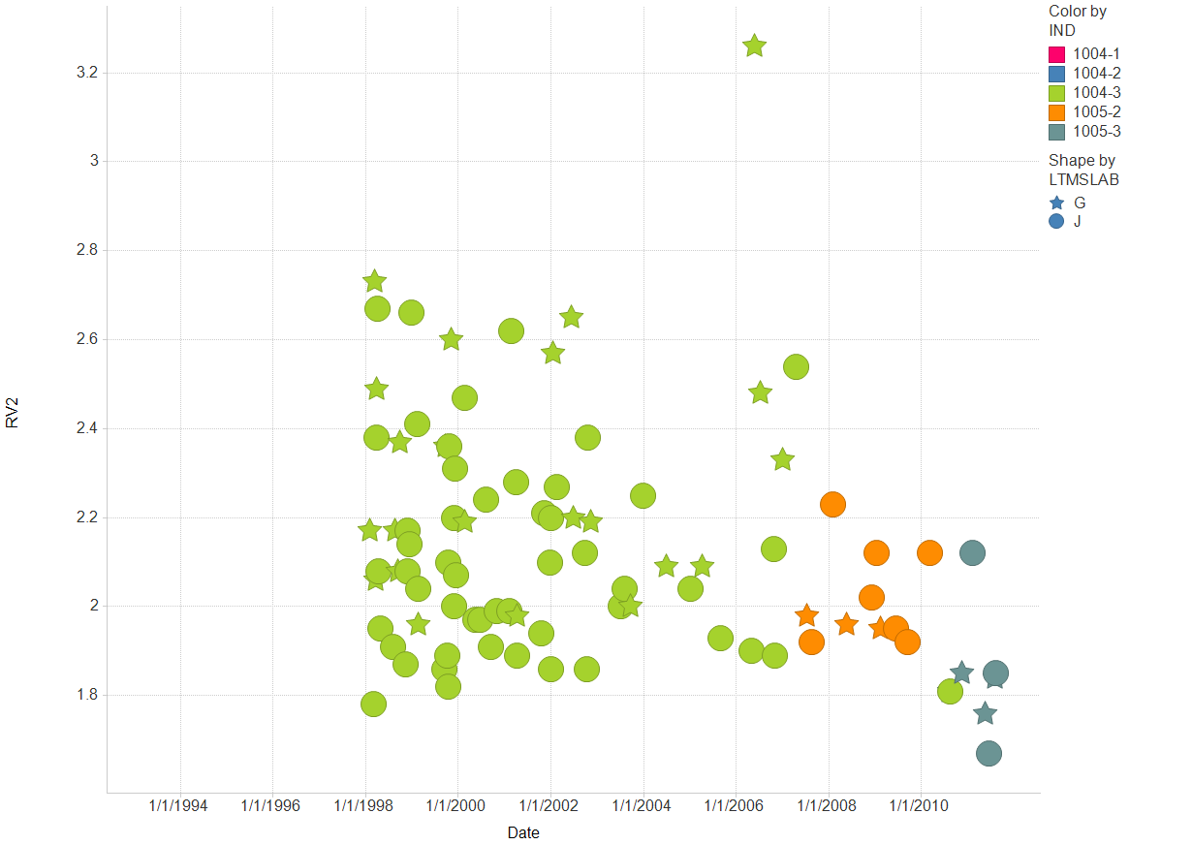
Filter Settings
- LTMSLAB: ( G , J )
- CHART: ( Y)

