Slide 1
Batch S Rings in the Mack T-11 last minute addendum
Presented to Mack Surveillance Panel
Teleconference 23 April 2010
Jim Rutherford

Slide 2
Corrected Corrections

Slide 3
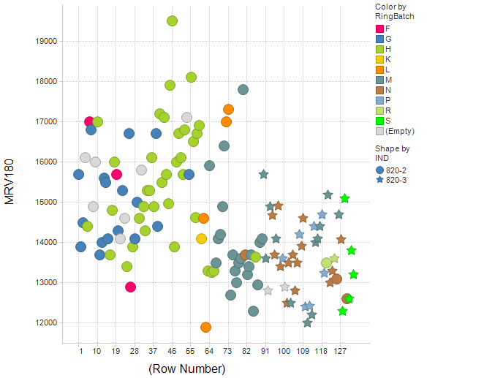

Slide 4
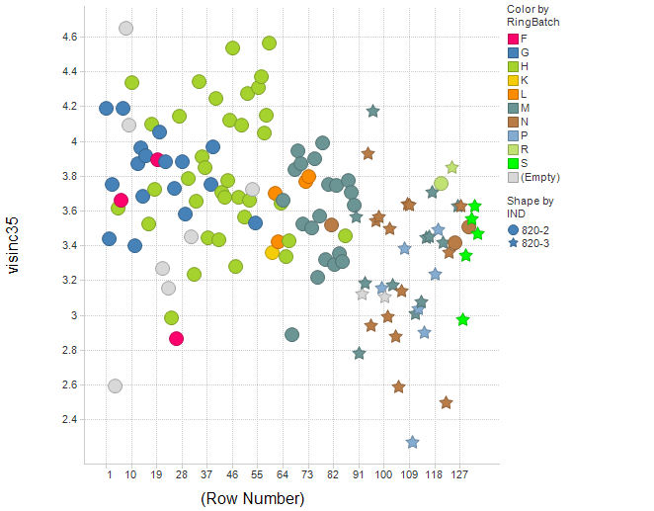

Slide 5
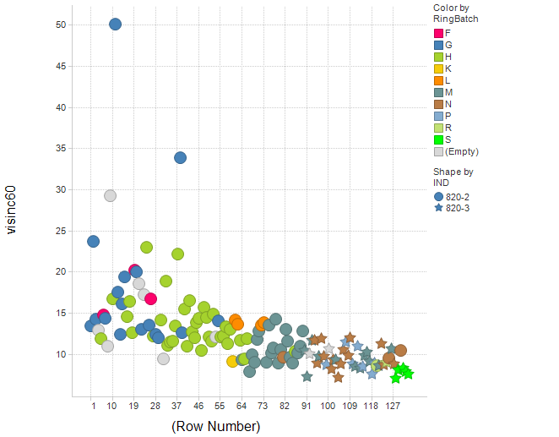

Slide 6
