Slide 1
Batch S Rings in the Mack T-11
Presented to Mack Surveillance Panel
Teleconference 23 April 2010
Jim Rutherford

Slide 2
Bottom Line
We could make a ICF for soot @ 12 and 15 cSt but it would probably be more than 1% so, since we don’t usually get more than 7.7 soot in a test, no candidate would pass.
We could make various ICF’s for viscosity increase at 3.5, 6.0, and 6.7% soot but they are big (>9 cSt) and it is doubtful that a candidate would pass.
Flipping the axes might make it easier to get a simple number but doesn’t really help and hurts precision.
If we flipped axes, D4485 would need fixing due to tiered limits.
If we started LTMS Version 2, it would probably say we are too far from where we started.

Slide 3
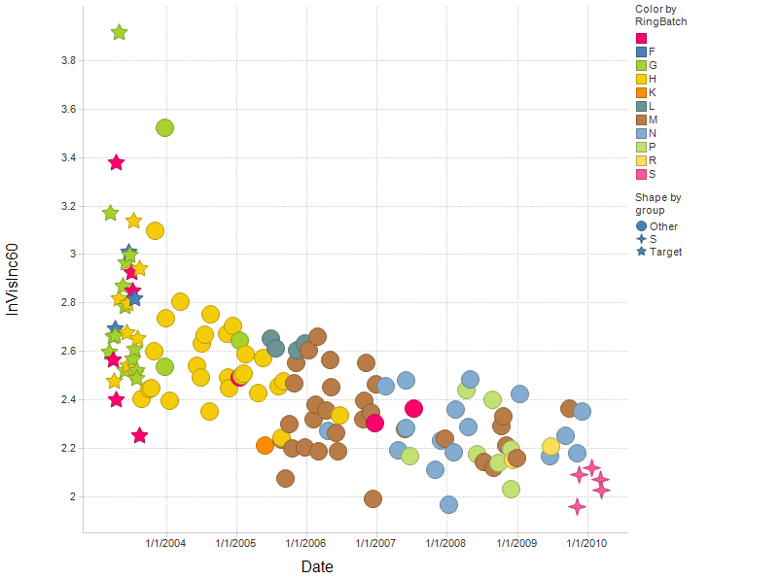
What has happened to Viscosity Increase?

Slide 4
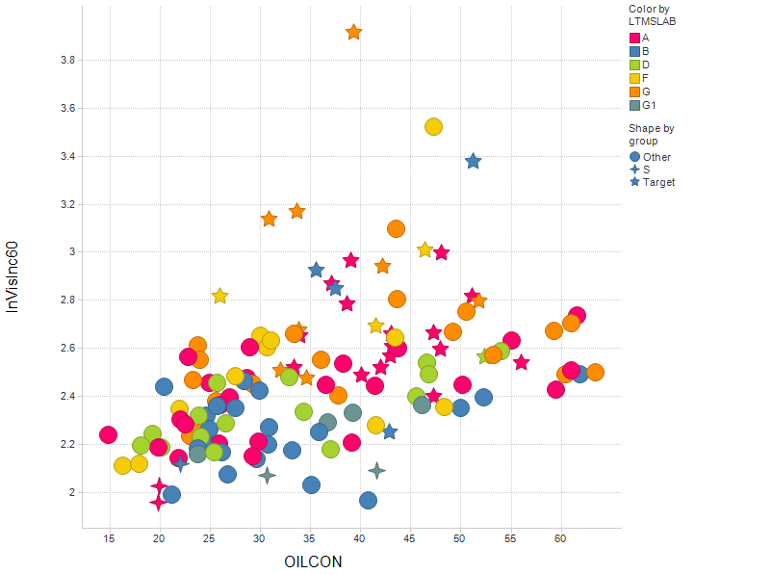
Does Oil Consumption Explain the Change?

Slide 5
A Model of Viscosity Increase at 6.0% Soot

Slide 6
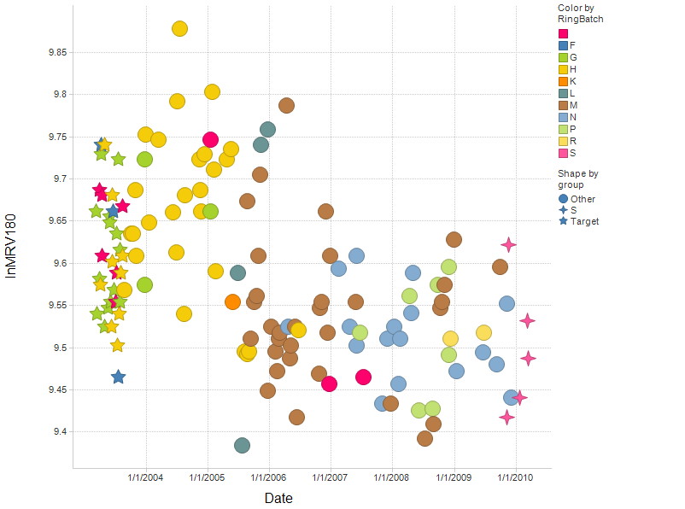
What has happened to MRV?

Slide 7
A Model for MRV

Slide 8
A Model for Viscosity Increase at 6.7% Soot

Slide 9
A Model for Viscosity Increase at 3.5% Soot

Slide 10
The “Best” ICF’s for Viscosity Increase

Slide 11
Other ICF’s

Slide 12
More ICF’s

Slide 13
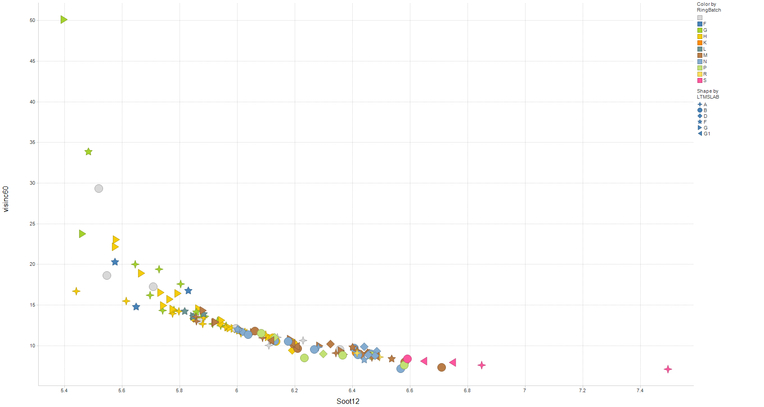
Maybe we should swap axes for this new test
If we are measure viscosity increase near the break, the abscissa has more variability than the ordinate. However, if we are not near break and extrapolating, the reverse could be true.
But are we measuring the same thing then?

Slide 14
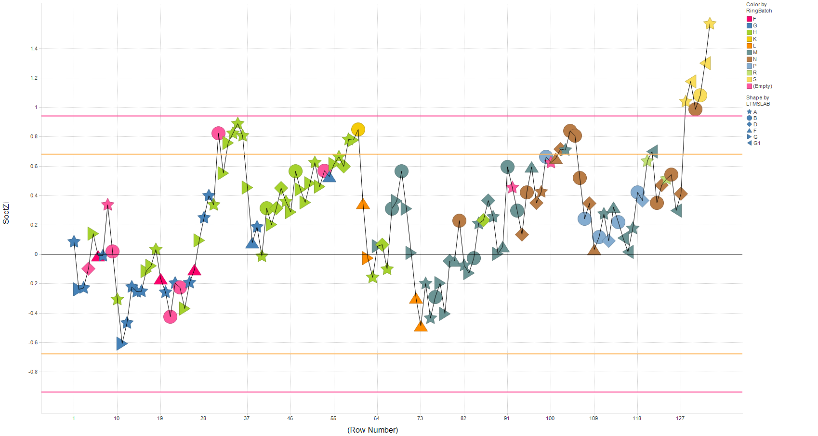
Current LTMS Industry – Soot at 12 cSt

Slide 15
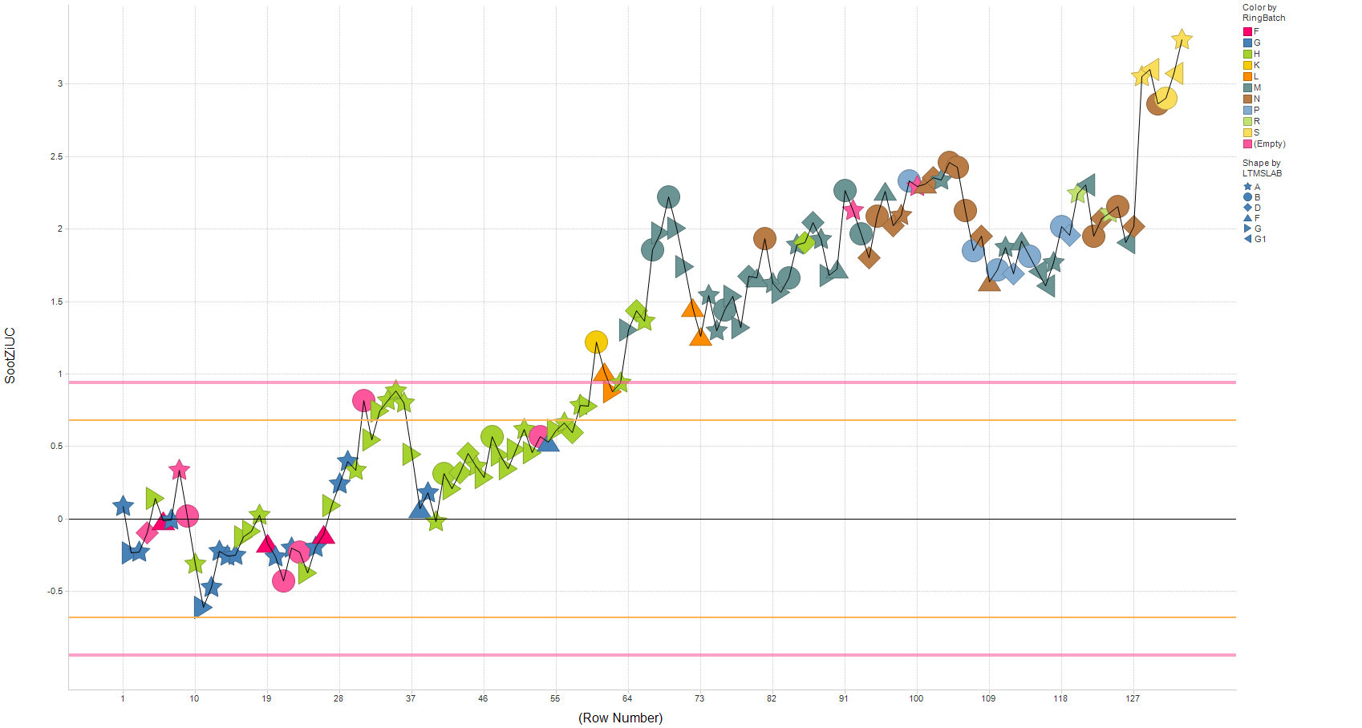
Industry – Uncorrected Soot at 12 cSt

Slide 16
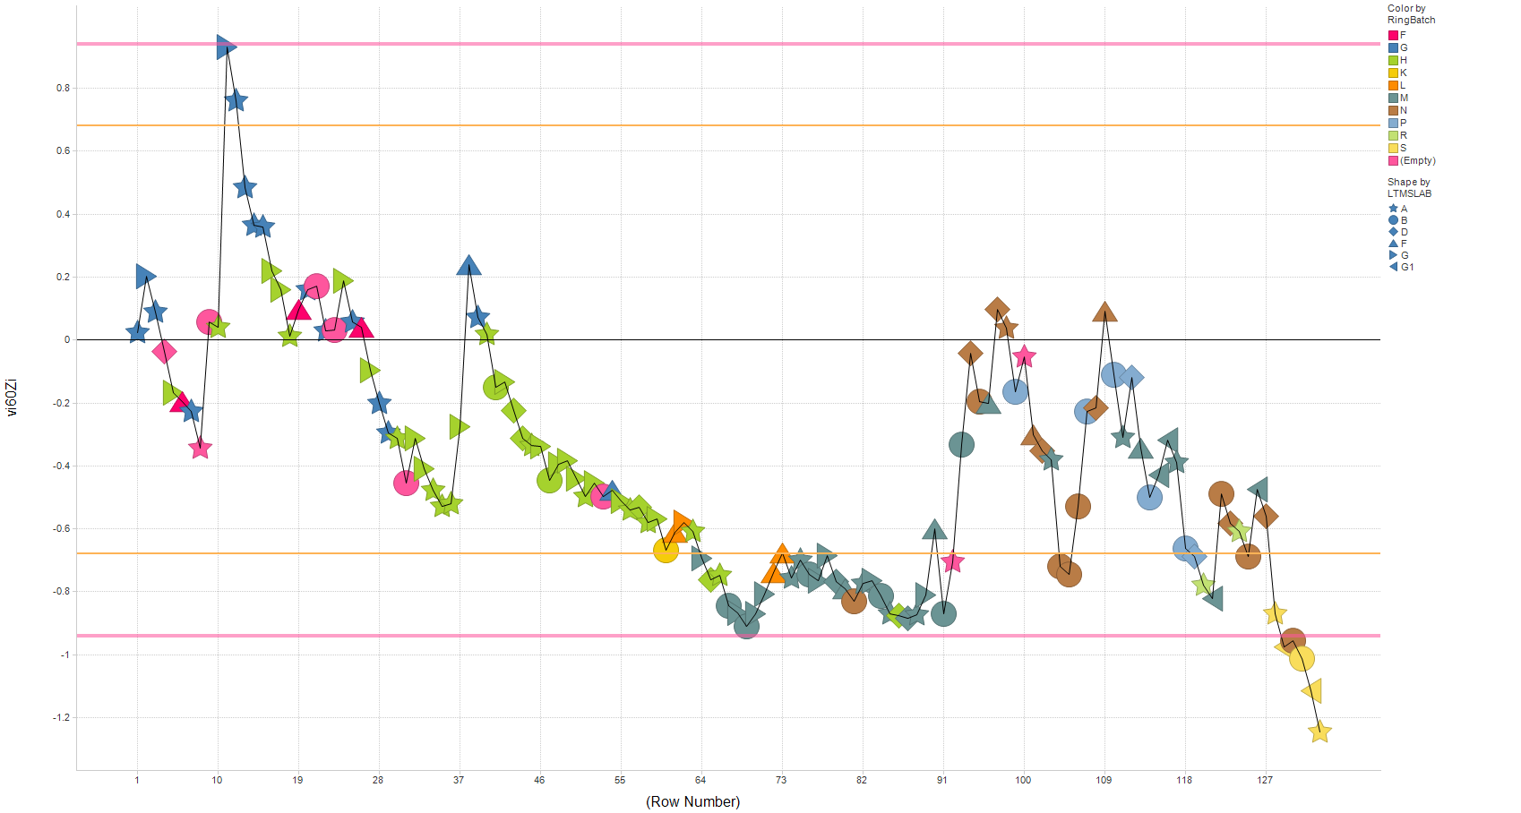
Industry – Viscosity Increase at 6% Soot

