Slide 1
Ford 6.7 VTWT 200 Hour Wear Comparison
File created on: 7/10/2020
2 IAR Tests, 210 Hour Version, HWO & LWO (PC-10 Fuel)
2 SwRI Tests, 210 Hour Version, HWO & LWO (PC-10 Fuel)
1 SwRI Test, 200 Hour Version, HWO, ASTM D975 Fuel
1 SwRI Test, 200 Hour Version, LWO, ASTM D975 Fuel
1 IAR Test, 200 Hour Version, HWO, PC-10 Fuel

Slide 2
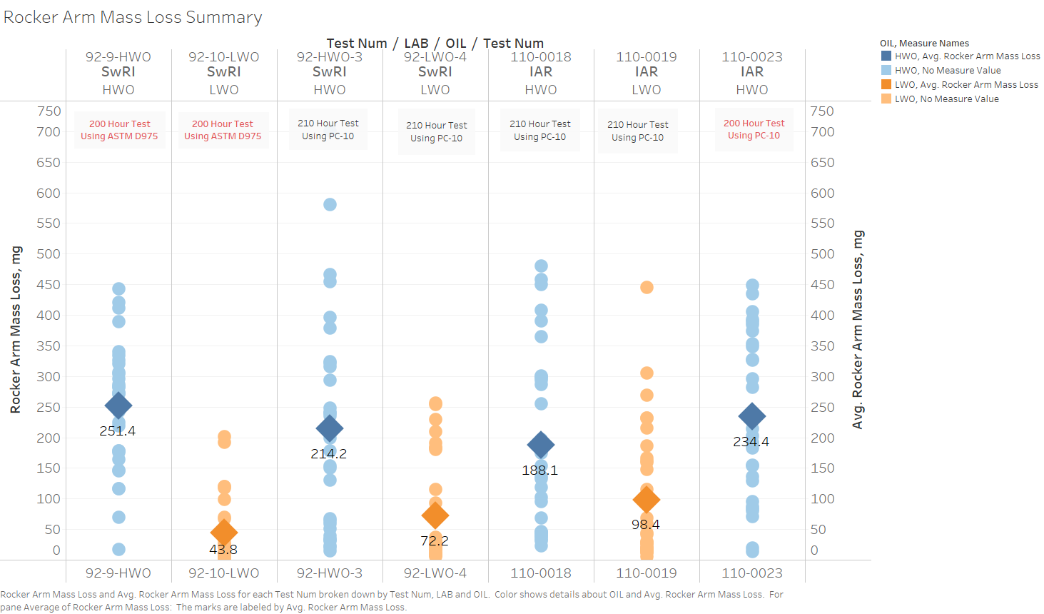

Slide 3
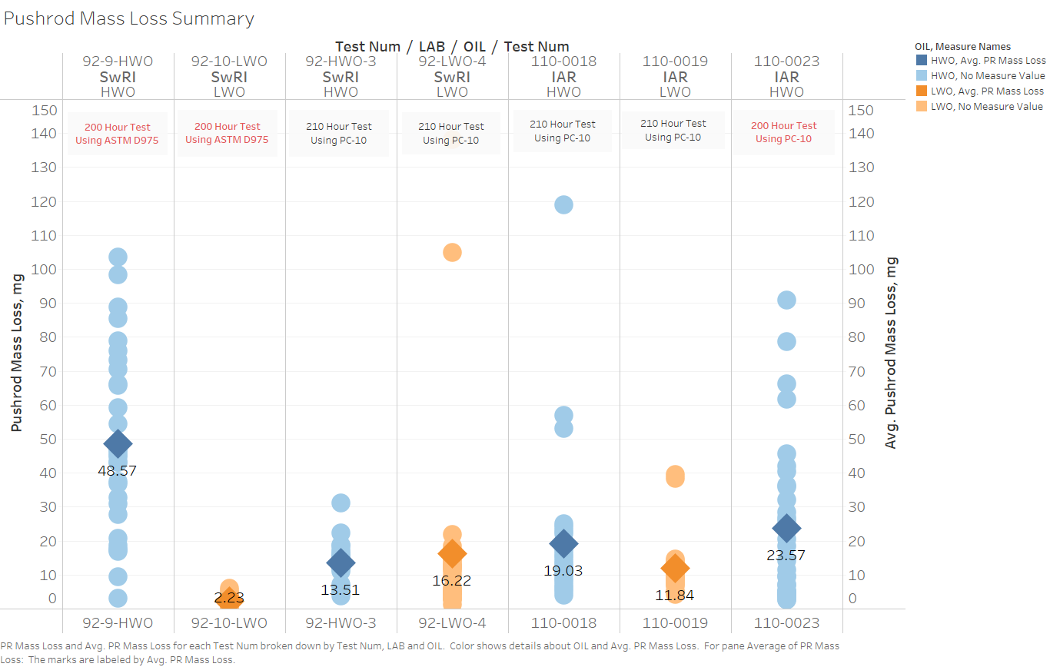

Slide 4
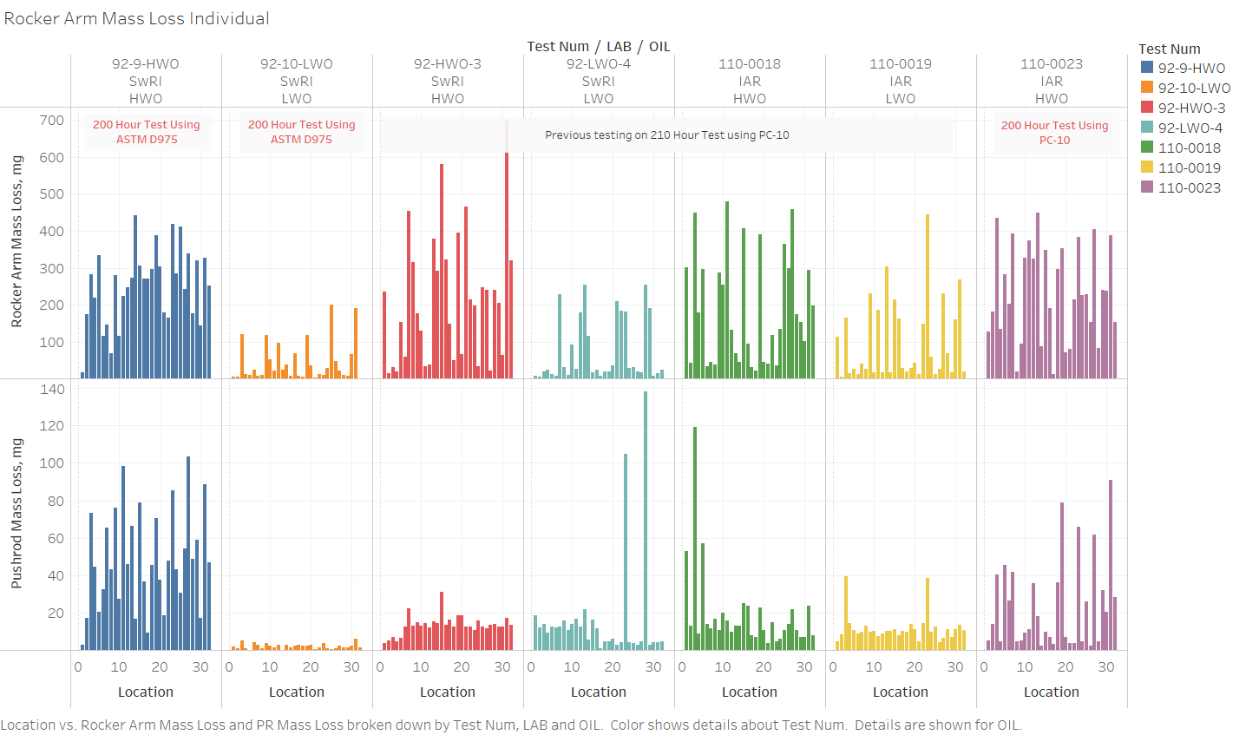

Slide 5
