Slide 1
Ford 6.7 VTWT – 200 Hour Operational Data
File created on: 7/10/2020
4 Total Tests,
1 SwRI Test, 200 Hour Version, HWO, ASTM D975 Fuel
1 SwRI Test, 200 Hour Version, LWO, ASTM D975 Fuel
1 IAR Test, 200 Hour Version, HWO, PC-10 Fuel
1 IAR Test, 200 Hour Version, HWO, PC-10 Fuel, Stopped at ~37 due to engine failure

Slide 2
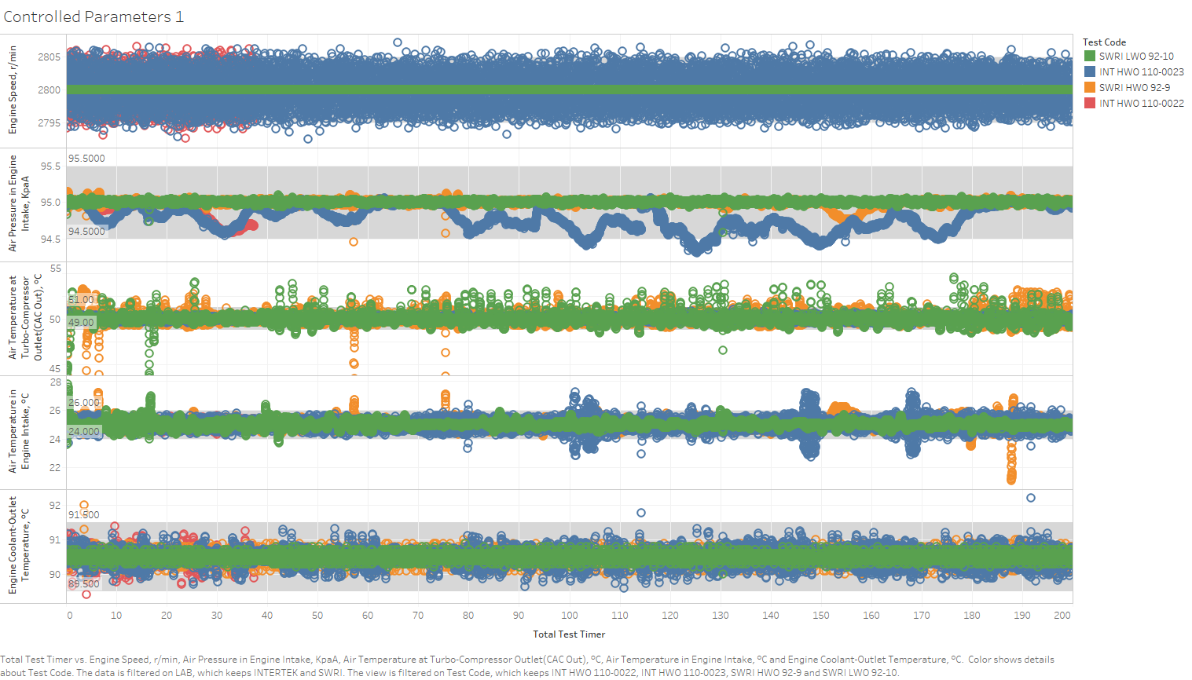

Slide 3
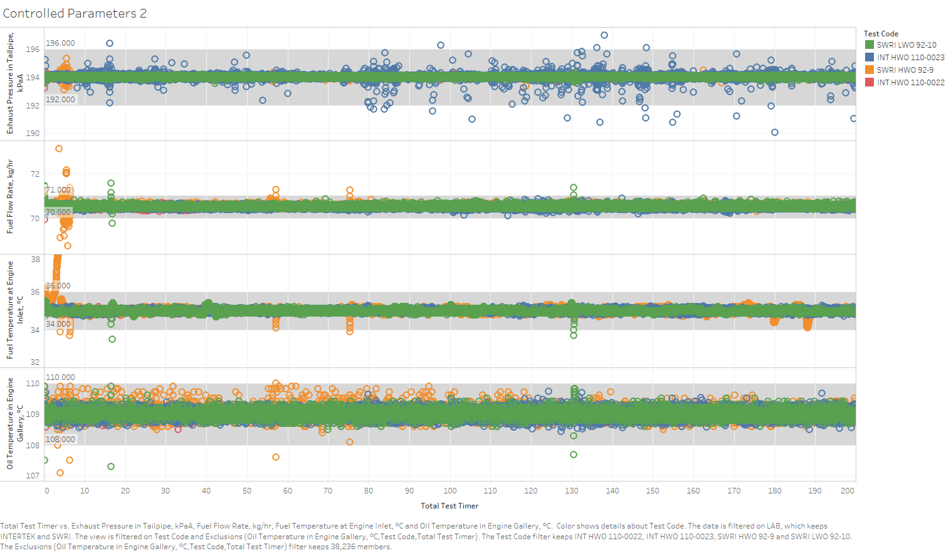

Slide 4
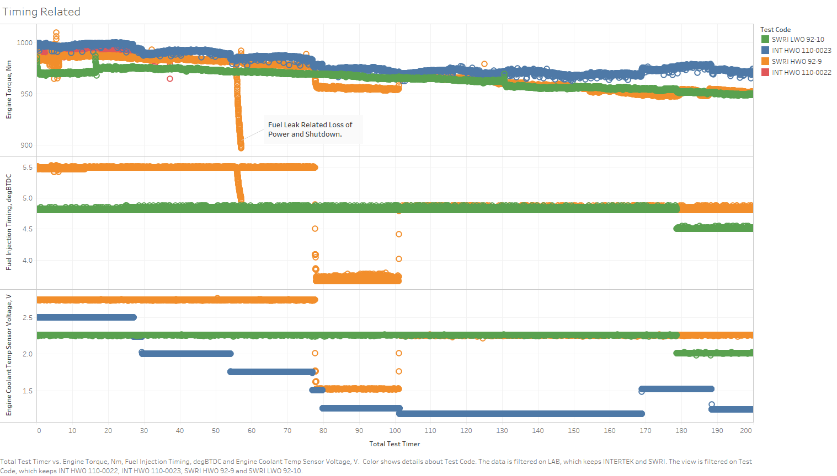

Slide 5
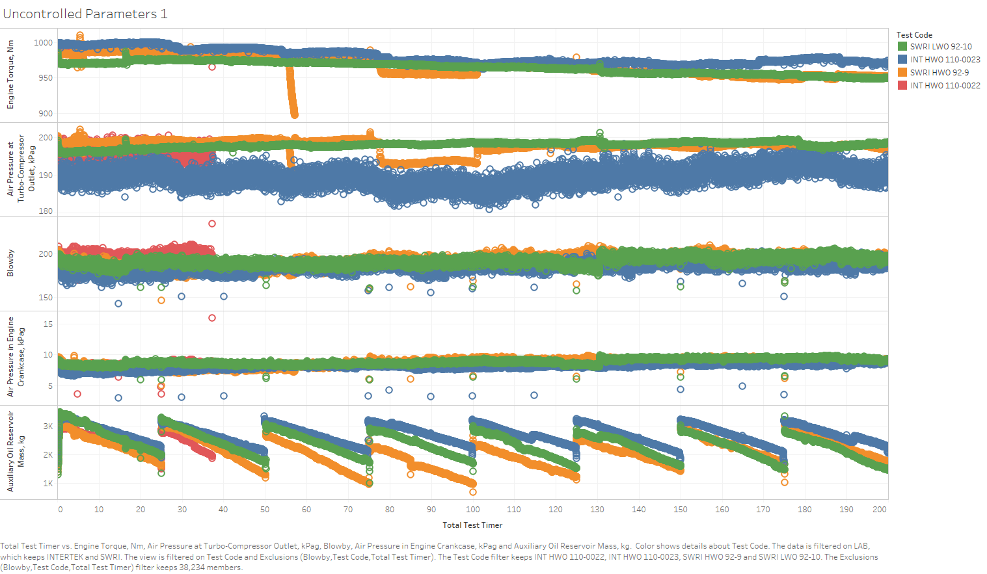

Slide 6
