Slide 1
COAT 1005-6 data review
COAT-EOAT equivalency
Statistics Group
updated Oct. 30, 2024

Slide 2
Statistics Group
Amanda Stone, Afton/New Market
Amy Ross, Valvoline
Dylan Beck, TMC
Jo Martinez, Chevron Oronite
Martin Chadwick, Intertek
Phil Scinto, Lubrizol
Ricardo Affinito, Chevron Oronite
Rich Grundza, TMC
Seth Demel, Shell
Todd Dvorak, Infineum
Travis Kostan, SwRI

Slide 3
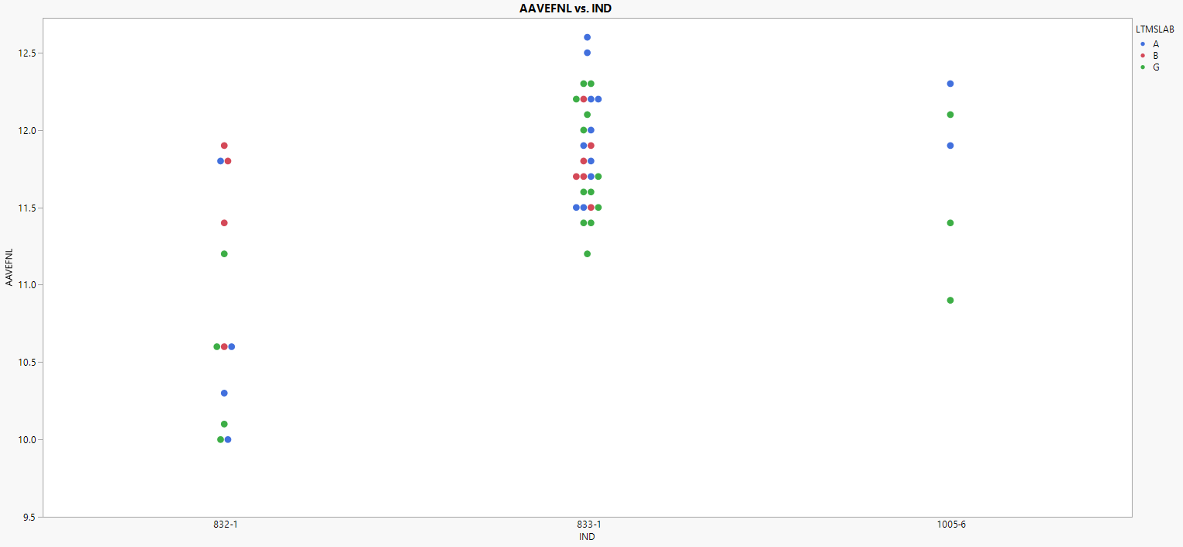
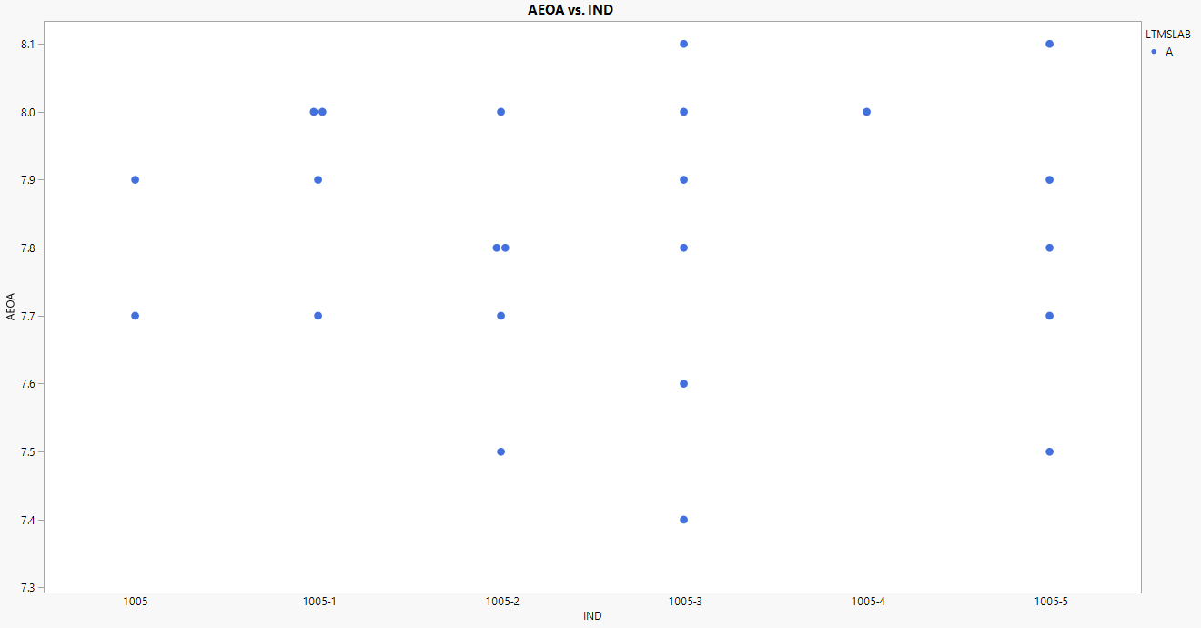
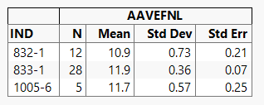
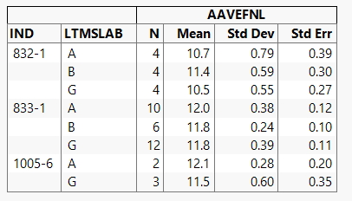
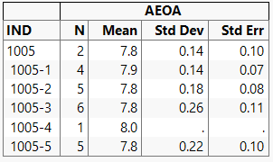
means and standard deviations
COAT
EOAT

Slide 4
equivalent limits calculation
1. Multiply the COAT to EOAT ratio to the EOAT specification limit to get the equivalent COAT limit

Slide 5
equivalent limits calculation
2. Apply the passing rate of oil 1005 in EAOT and determine the equivalent COAT limit with the same passing rate in COAT. This method takes into account the test variability.

