Slide 1
Oil Filter Bypass Valve and Spring

Slide 2
Oil Filter Bypass Valves

Slide 3
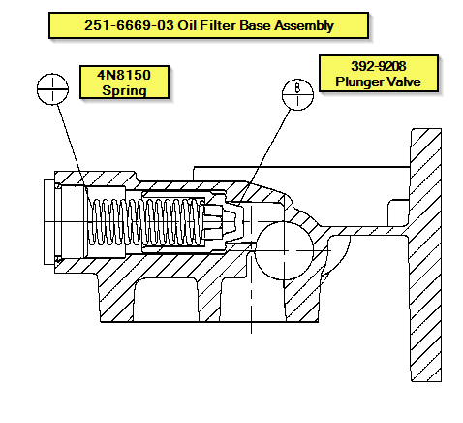
4N-8150 Spring

